Slide 1
Cell and gene therapy in Dyskeratosis congenita treatment
Paola Cerullo
Anna Frappaolo
Maria Luce Genovesi
Corso: Terapia Genica
Docente: Prof.ssa Isabella Saggio

Slide 2
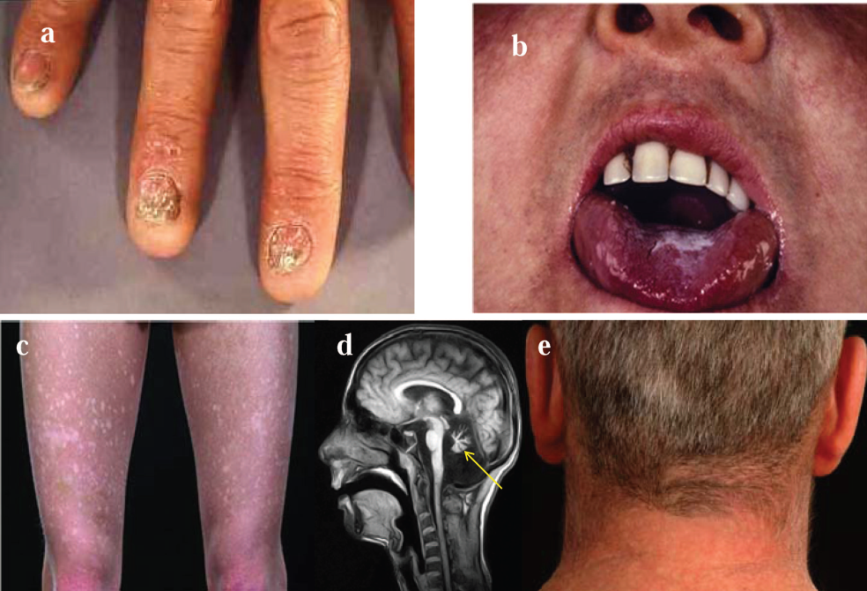
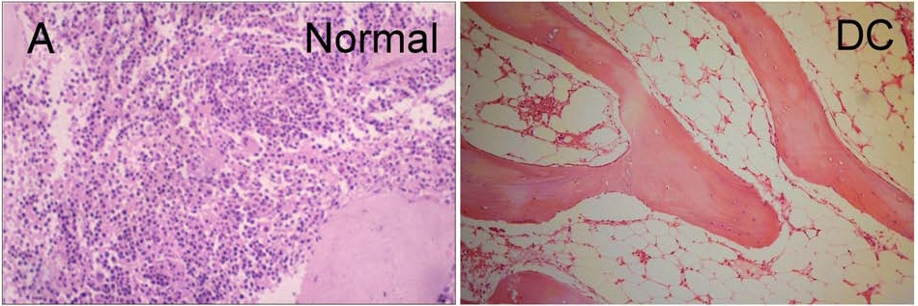
DYSKERATOSIS CONGENITA
Clinical features of DC. The clinical features of DC are:
nail dystrophy (A),
oral leucoplakia (B),
abnormal skin pigmentation (C),
cerebellarhypoplasia (D; highlighted by the arrow),
premature hair loss/graying (E).
Histopathological features of dyskeratosis congenita (DC): (A) bone marrow slides show the loss of cells in an aplastic marrow, typical of dyskeratosis congenita.
Michael Kirwan and Inderjeet Dokal (2009)

Slide 3
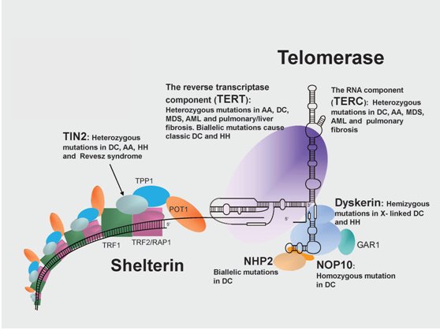
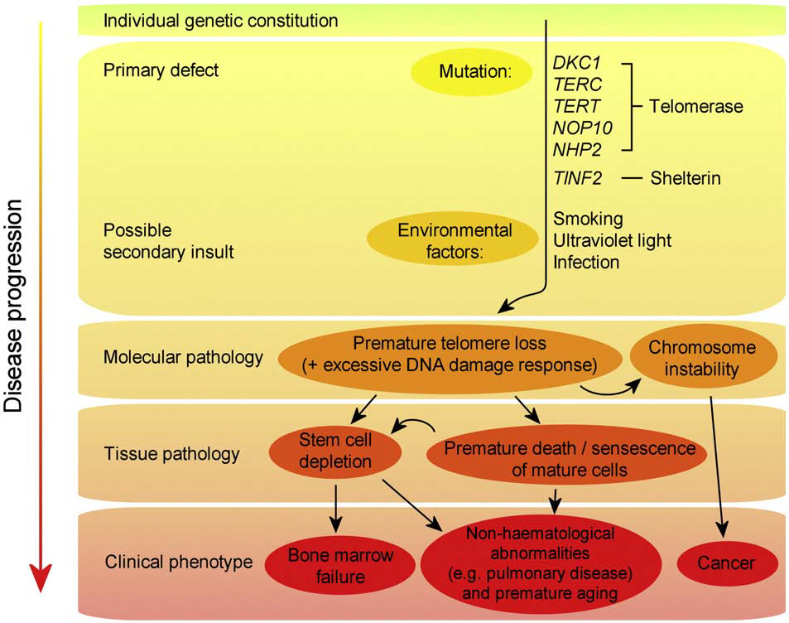
GENETIC BASIS OF THE DISEASE
DC is genetically heterogeneous:
patients have mutations in genes that encode components of the telomerase complex and telomere shelterin complex.
Inderjeet Dokal (2011)
Michael Kirwan and Inderjeet Dokal (2009)

Slide 4
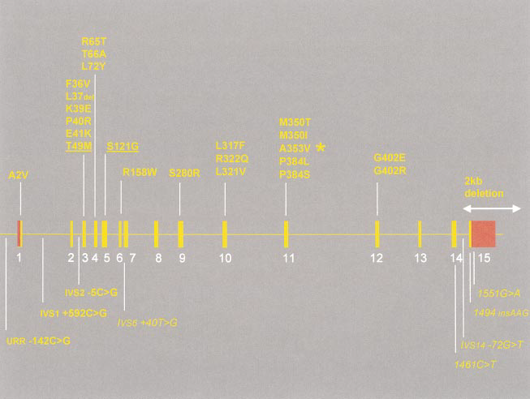
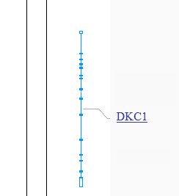
DYSKERATOSIS CONGENITA X-LINKED
Mutations in the DKC1 gene
Schematic representation of dyskerin showing the locations of function domains.
Inderjeet Dokal (2000)

Slide 5
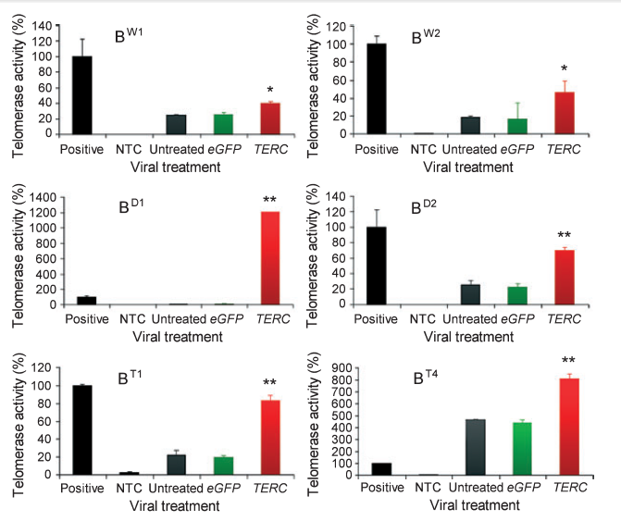
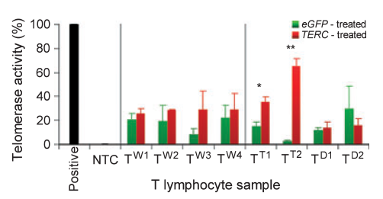
PRELIMINARY DATA IN LITERATURE
Exogenous TERC alone can enhance telomerase activity and telomere length in lymphocytes from dyskeratosis congenita patients with TERC and DKC1 mutations.
Telomerase expression was stimulated by treatment with PHA, telomerase activity was assayed using the telomerase repeat amplification protocol (TRAP) using 1000 telomerase positive cells as a quantification standard. The products were measured by real time, quantitative PCR.
(Kirwan M et al., 2008)

Slide 6
PRELIMINARY DATA IN LITERATURE
Telomerase gene therapy delays aging and increases longevity without increasing cancer. (Bernardes de Jesus B. et al., 2012)
Telomere dysfunction impaired mesenchymal progenitor cell function and reduced the capacity of bone marrow stromal cells to maintain functional HSCs. (Ju Z. et al., 2007)
Peripheral blood hematopoietic stem cell transplantation combined with umbilical cord blood mesenchymal stem cell infusion can be used in treatment of severe aplastic anemia. (Xu L. et al., 2011)

Slide 7
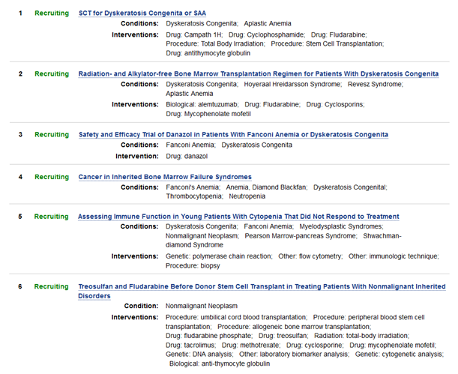
CLINICAL TRIALS

Slide 8
EXPERIMENTAL PLAN AND OBJECTIVE
We want to recover BM function through cell and gene therapy
1° STEP: demonstrate that TERC-transduced hematopoietic and mesenchymal stem cells from patients with mutations in DKC1 behave as lymphocytes treated in the same way
2° STEP: improve BM autologous transplantation in the mouse model:
- HSCs and MSCs isolation
- transduction
- cells are reintroduced in the mouse

Slide 9
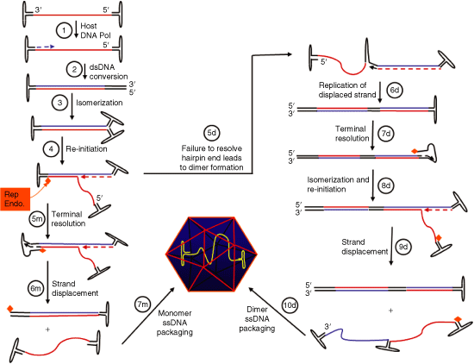
scAAV VECTORS
Self-complementary AAV Vectors; Advances and Applications
Douglas M McCarty (2008)

Slide 10
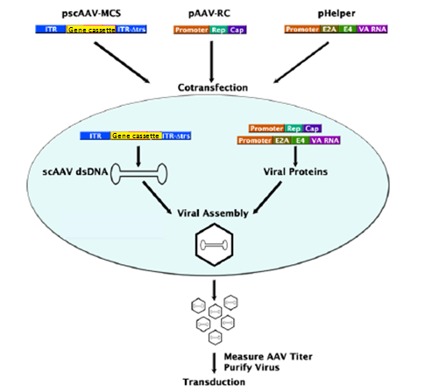
cotransfection in 293 cells (E1)
purification in cesium chloride gradients
titers of viral genomes particles by quantitative real time PCR
293 cells (E1)

Slide 11
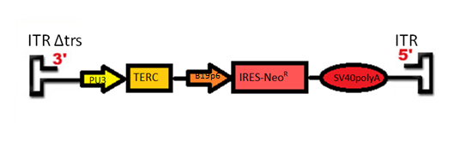
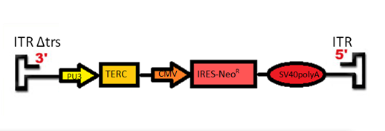
VECTOR FOR HSCs
VECTOR FOR MSCs
TERC= 450bp
Neo = 800bp
AAV genome ̴ 4,7Kb
scAAV genome ̴̴ 2,5 Kb
R

Slide 12
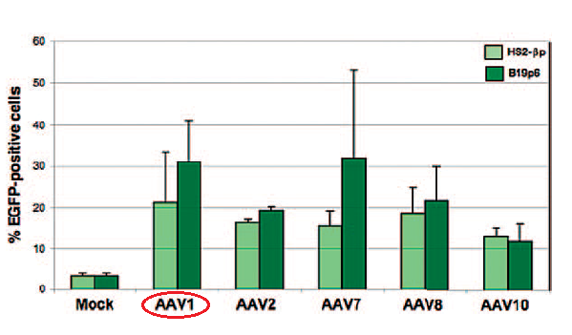
AAV SEROTYPES
scAAV1 FOR HSCs
Transgene expression was evaluated 6 months
posttransplantation by flow cytometry with a
FACStar instrument
(Maina N. et al.,2008)

Slide 13
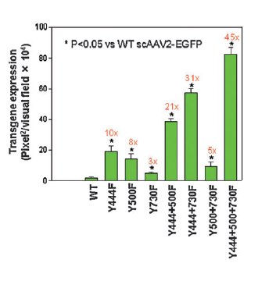
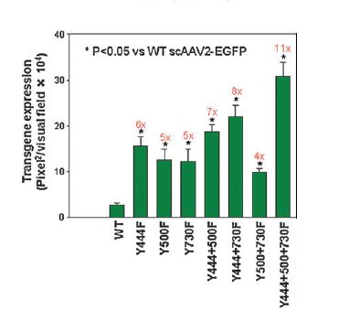
AAV SEROTYPES
scAAV2 FOR MSCs
scAAV2 vectors containing mutations in three surface-exposed tyrosine residues significantly
increase transduction efficiency in both human and murine primary MSCs.
Quantitative analyses of EGFP transgene expression in MSCs compared with the WT vectors
Li M. et al., 2010

Slide 14
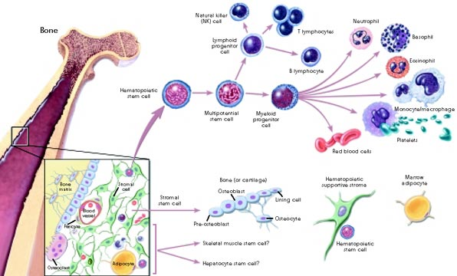
In vitro experiments:
HSCs and MSCs from patients with DKC1 mutations are transduced with our vectors
Neo addition
Resistant cells are selected

Slide 15
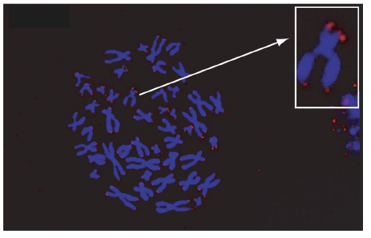
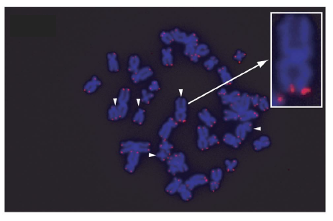
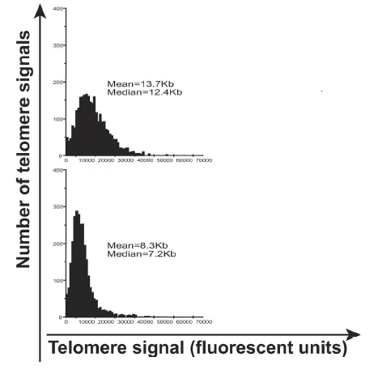
CONTROL EXPERIMENTS
TERC-scAAV- transduced cells
Neo - scAAV-transduced cells
R
wt
① Q-FISH
WT and TERC transduced cells
Quantitative FISH analysis of telomere length distribution
Neo transduced cells
R
WT and TERC transduced cells
Neo transduced cells
R

Slide 16
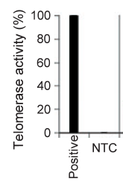
Neo
② TRAP
R
* Mutated DKC1
HSC/MSC
WT
HSC*
MSC*

Slide 17
③ Foci TIF
WT and TERC transduced cells
AA
B
C
D
Neo transduced cells
R
AA
B
C
D
A: nuclei with DAPI
B: γ-H2AX
C: Telomeres
D: merge; when green and red signals overlap a yellow pattern is seen, indicating
co-localization of γ-H2AX with telomeres

Slide 18
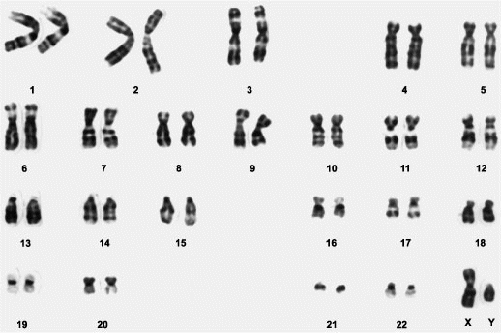
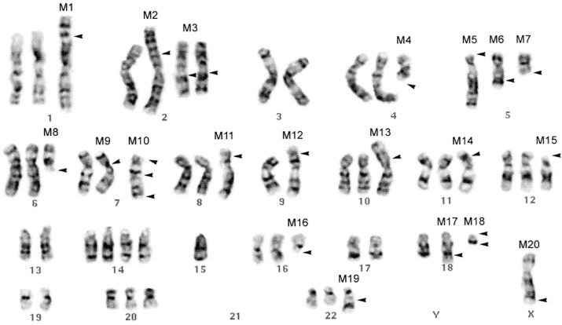
④ Banding and karyotype
Normal karyotype
Chromosomal rearrangements

Slide 19
In vivo experiments
Mouse model of dyskeratosis congenita: mTR−/− CAST/EiJ
The mouse disease model recapitulates the telomere dysfunction and key features observed in DC
When telomere shortening is induced by a telomerase RNA deletion in a strain of mice (CAST/EiJ) with short telomeres (comparable with the length of human telomeres), the phenotypes are similar to those observed in DC (Hao et al. 2005).
Homozygous mTR−/− CAST/EiJ mice and late generation heterozygous mTR+/− CAST/EiJ mice experience a decrease in tissue renewal capacity in the bone marrow.
These mice develop microadenomas of the intestinal epithelium reminiscent of the leukoplakia
that occurs in DC patients.
Consistent with premature death in DC, G2 mTR−/− CAST/EiJ mice have a reduced median survival rate of 129 d. CAST/EiJ mTR−/− animals derived from late-generation heterozygotes have a reduced life span relative to genetically similar animals derived from early generation heterozygotes, suggestive of a genetic anticipation characteristic of DC.

Slide 20
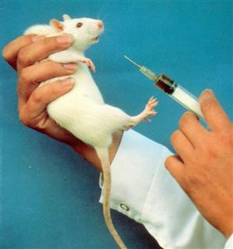
Autologous BM transplantation improvement
We take a sample of BM through aspiration from G2 mice femurs
Stem cells isolation
Stem cells purification
Adherent Cell Culture (MSCs)
Suspension Cell Culture (HSCs)
+
+
+
MSCs : CD9 , CD29 , CD81
+
+
-
+
HSCs: Sca 1 , c-kit , lin , CD38

Slide 21
HSCs and MSCs are transduced separately with the same vectors used in previous experiment
Resistant cells to Neo are selected and analyzed
Recipient mice are irradiated with 950 cGy from a cesium-137 source (myeloablative conditions)
The recipient mice are anesthetized with isoflurane and injected with both stem cells into the tail vein

Slide 22
CONTROL EXPERIMENTS
Mice:
with HSCs-MSCs with HSCs Untreated WT
① life span

Slide 23
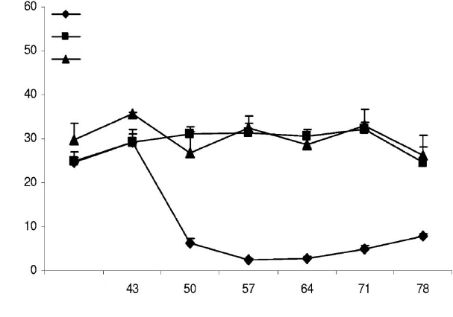
② Complete lymphocyte count after autologous transplantation
HSCs
HSCs-MSCs
Healthy
% lymphocyte
Days
③ Bone marrow dissection
④ Incidence of tumors

Slide 24
CONCLUSIONS
TERC-transduced hematopoietic and mesenchymal stem cells from patients with mutations in DKC1 recover telomerase activity and telomere lenght
Bone marrow autologous transplantation is improved injecting at the same time
TERC-transduced hematopoietic and mesenchymal stem cells
FUTURE POSSIBILITIES
Maybe in the future this strategy can be coupled with new preliminary treatments in order to make the transplantation more safe and efficient

Slide 25
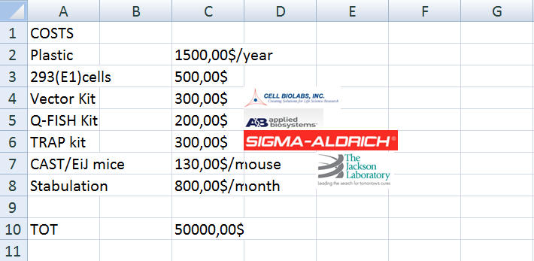

Slide 26
Bibliography:
Exogenous TERC alone can enhance proliferative potential, telomerase activity and telomere length in lymphocytes from dyskeratosis congenita patients. Michael Kirwan, Richard Beswick,Tom Vulliamy,Amit C. Nathwani, Amanda J. Walne,Colin Casimir and Inderjeet Dokal. (2008). British Journal of Haematology, 144, 771–781
Dyskeratosis congenita. Dokal I.(2011). Hematology Am Soc Hematol Educ Program.;2011:480-6
Dyskeratosis congenita in all its forms. Dokal I. (2000). British Journal of Haematology, 110, 768-779
Telomere restoration and extension of proliferative lifespan in dyskeratosis congenita fibroblasts. Erik R. Westin,Elizabeth Chavez, Kimberly M. Lee,Francoise A. Gourronc,Soraya Riley,Peter M. Lansdorp, Frederick D. Goldman and Aloysius J. Klingelhutz. (2007). Aging Cell 6, pp383–394
Premature aging. Vulliamy T.J. (2009). Cell. Mol. Life Sci. 66:3091–3094
Short Telomeres are Sufficient to Cause the Degenerative Defects Associated with Aging. Mary Armanios,, Jonathan K. Alder, Erin M. Parry, Baktiar Karim, Margaret A. Strong, and Carol W. Greider. (2009). The American Journal of Human Genetics 85, 823–832.
Dyskeratosis congenita as a disorder of telomere maintenance. Nya D. Nelsona, Alison A. Bertuch. (2012). Mutation Research 730,43– 51

Slide 27
Telomerase gene therapy in adult and old mice delays aging and increases longevity without increasing cancer. Bernardes de Jesus B, Vera E, Schneeberger K, Tejera AM, Ayuso E, Bosch F, Blasco MA. (2012) EMBO Mol Med. 4(8):691-704
Telomere dysfunction induces environmental alterations limiting hematopoietic stem cell function and engraftment. Ju Z, Jiang H, Jaworski M, Rathinam C, Gompf A, Klein C, Trumpp A, Rudolph KL. (2007) Nat Med 13(6):742-7.
Efficacy of haploidentical allogeneic bone marrow hematopoietic stem cell transplantation combined with umbilical cord blood derived mesenchymal stem cells for severe aplastic anemia. Xu LX, Cao YB, Wang ZH, Liu ZY, Liu B, Zhao DD, DA WM, Gao CJ, Wu XX (2011)
POT of gold: modeling dyskeratosis congenita in the mouse. Chantal Autexier.(2008). Genes Dev. 22: 1731-1736.
Short Telomeres, even in the Presence of Telomerase, Limit Tissue Renewal Capacity. Ling-Yang Hao,Mary Armanios, Margaret A. Strong, Baktiar Karim, David M. Feldser, David Huso, and Carol W. Greider (2005). Cell, Volume 123, Issue 6, 1121-1131.
Telomerase gene therapy in adult and old mice delays aging and increases longevity without increasing cancer. Sampler E., Flores M.J. And Blasco M.A. (2001). EMBO reports. Vol.2, n° 9 pp 800-807
Dyskeratosis congenita, stem cells and telomeres . Michael Kirwan , Inderjeet Dokal. (2009) Biochimica et Biophysica Acta 1792, 371–379

Slide 28
Self-complementary AAV vectors; advances and applications. McCarty DM. (2008). Mol Ther;16(10):1648-56.
Recombinant self-complementary adeno-associated virus serotype vector-mediated hematopoietic stem cell transduction and lineage-restricted, long-term transgene expression in a murine serial bone marrow transplantation model. Maina N, Han Z, Li X, Hu Z, Zhong L, Bischof D, Weigel-Van Aken KA, Slayton WB, Yoder MC, Srivastava A. (2008)Hum Gene The.19(4):376-83.
High-efficiency transduction of fibroblasts and mesenchymal stem cells by tyrosine-mutant AAV2 vectors for their potential use in cellular therapy. Li M, Jayandharan GR, Li B, Ling C, Ma W, Srivastava A, Zhong L. (2010)Hum Gene Ther.21(11):1527-43
http://www.clinicaltrials.gov/

