Slide 1
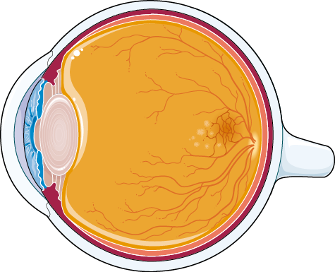
Treatment of age-related macular degeneration (AMD): VEGFA knockdown with shRNA mediated by AAV2.7m8
C.Ceresoni, A.Frenza, M.Ionta, G.Lombardelli
A GENE THERAPY PROJECT
Prof.ssa I. Saggio
Prof.ssa R. Burla
A.A. 2021/2022

Slide 2
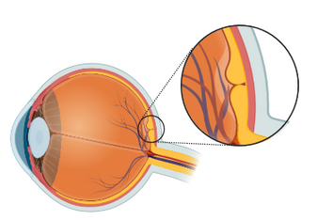
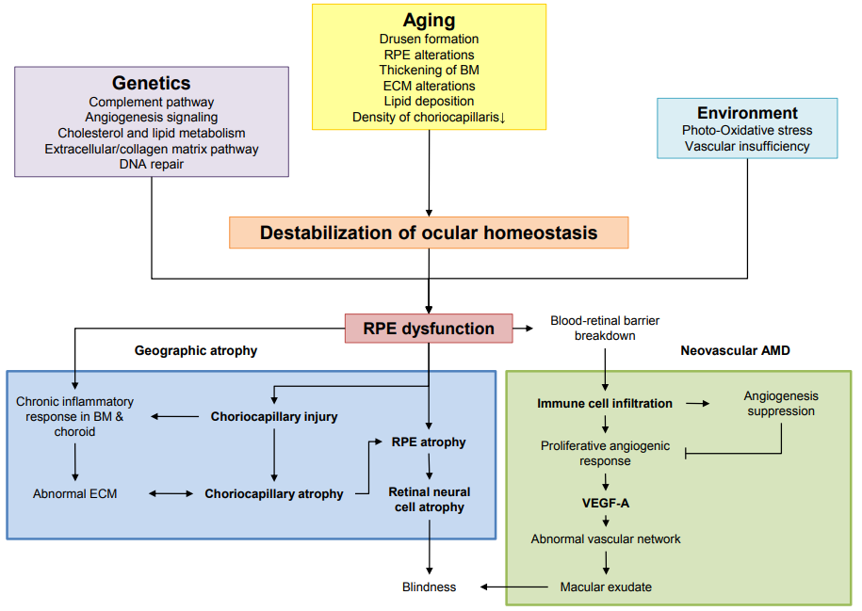
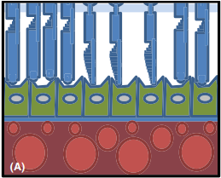
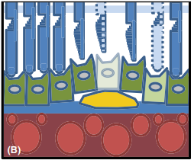
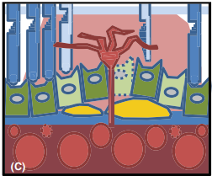
BACKGROUND
Age-related macular degeneration (AMD)
Ocular disease that affects the macula, which is the most central portion of the retina. It is the leading cause of severe central vision loss after age 55
WHAT IS IT?
Age-related changes, chronic oxidative stress and inflammatory response. This led to RPE disfunction and chorocapillary injury
CAUSES
PATOLOGICAL OUTCOME
Overproduction of VEGF driven by RPE, which induces neovascularization and vascular permeability.
Notes:
Age-related macular degeneration (AMD) is a disease that affects the macula, which is the most central portion of the retina. It is the leading cause of severe central vision loss after age 55. There are two forms of AMD: dry and wet (or exudative), and we will talk about wet AMD. 1-1,5% of individuals over the age of 75 will develop exudative AMD. A systematic review and meta-analysis predicted the number of patients affected by the condition worldwide to be 288million by 2040. It is principally generated by the damage to the retinal pigment epitelium (RPE). The inevitable age-related changes in the retina and choroid constitute the initial event. The chronic oxidative stress (led by environmental causes) can cause RPE and chorocapillary injury. This result in an inflammatory response that fail to restore homeostasis. In wet AMD we are witnessing retinal detachment with neovascularization and vascular permeability into the avascular subretinal space of fenestrated blood vessels, developing from chorocapillaris. The leakage of fluid into the retina and subretinal space cause edema, which can lead to blindness. It appears that AMD is primarily driven by overproduction of vascular endothelial growth factor (VEGF), which target VEGFR on EC cells and induce EC proliferation, migration and vascular permeability. Early-stage AMD revealed significantly increased VEGFA expression in RPE cells. Speaking of therapy, anti-VEGF drugs are now the gold standards treatment for AMD. They inhibit neovascularization by binding to VEGF or VEFGR. The high drug costs and the chronic need for intravitreal injections have resulted in a significant burden, economically, logistically and socially. Moreover, the chronical injection can also cause additional problems, such as infections, despite the fact that visual acuity gains during the first years was not maintained. It’s also for these reasons that gene therapy could offer the real possibility of treatment in “one and done” manner.

Slide 3
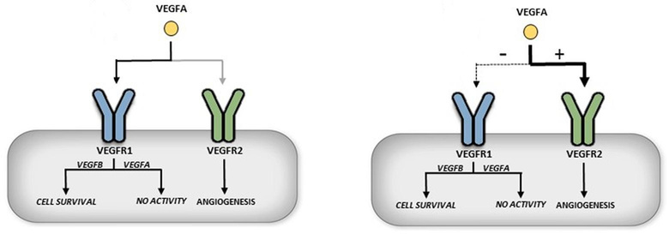
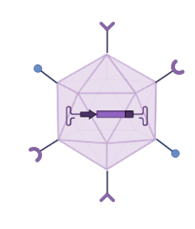
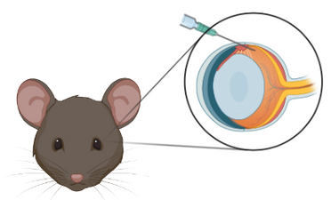
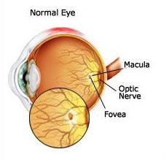
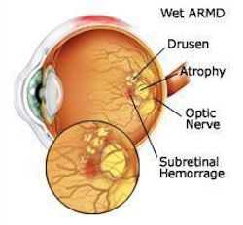
AIM OF THE PROJECT
VEGFA knockdown, via shRNA, to reduce exudates and neovascularization
WHAT?
HOW?
AAV2.7m8-shRNA intravitreal injection
Retinal Pigment Epithelium (RPE)
of the central macula
WHERE?
Notes:
Four genes structurally related to VEGF have been identified, of these VEGF-A and VEGF-E are considered the most powerful angiogenic factor. We have chosen VEGF-A as the target of our therapy because it is one of the most characterized isoforms and is the one produced by the RPE cells. VEGF-A causes an increase in angiogenesis and vascular permeability
resulting in invasive growth of choroidal blood vessels to the retina, where they have a destructive effect on the retinal structure. The present study aimed to develop a strategy based on AAV2.7m8-delivery of anti-VEGF-A shRNA. This engineered vector allows for intravitreal administration that can be preferable because they are less invasive, provide broader coverage and are surgically simpler. AAV2-7m8 is characterized by the insertion of a 10 amino-acid peptide ‘LALGETTRPA’ referred to as ‘7m8’ composed of a heptamer (LGETTRP) and 3 amino acids as linkers, all inserted in the loop IV. The insertion of the peptide is responsible for high-level gene delivery into deep layers of the retina when virus is delivered into the eye’s vitreous. The arginine's R585 and R588 interact with each other and are involved in binding to the heparan sulfate proteoglycan (HSPG), the 7m8 peptide insertion in position 588 impedes this interaction. Since HSPG is abundant on the inner limiting membrane (ILM) -the dense network of glycosaminoglycans between the vitreous and the retina, AAV2’s strong interaction with the HSPG of the ILM limits its diffusion into the retina. Accordingly, AAV2-7m8’s reduced affinity for HSPG might increase passage through the ILM. Another hypothesis is that the 7m8 peptide can exert an effect on its own, by interacting with another cell-surface glycan.

Slide 4
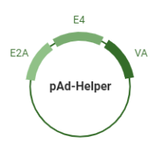
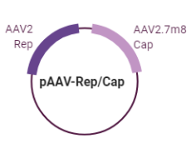
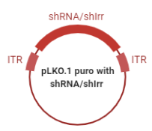
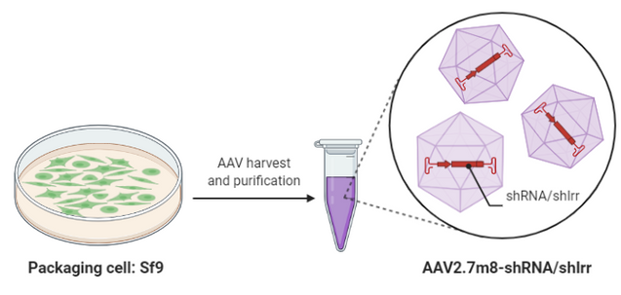
PROCEDURES
IN VITRO
VEGFA sequence gene
Vectors and plasmids production
pLKO.1 is used for transfection of 3T3 cells
sh3
sh9
Co-tranfection
For Dual luciferase assay
sh12
psiCHECK-2-VEGFA
shIrr
3 different human shRNAs + 1 control
AAV2.7m8 vector is used for infection of ARPE-19 cells and C57/B16 mice
AAV2.7m8-shRNA
Notes:
To find the most potent shRNA for maximum VEGFA knock-down we employed design tools to identify theoretically functional shRNA. We searched the coding sequence of human VEGFA mRNA exon 1 (which is present in all VEGFA isoforms) for potential target site. Since we will have to work on human cells, but also on 3T3 mice cells and C57BL/6J mice, we made sure that the sequence of exon 1 in mouse and human was orthologous (we did this on blastn NCBI). At this point we choose 3 shRNA from GPP web portal (Broad Institute). All this shRNA have a 100% match with the VEGFA transcript and were selected in order to avoid as much as possible off-target effects. A negative control, shIrr, was designed to avoid targeting of any sequences in the
human or mouse genome. For the construction of AAV2.7m8 vector we used 3 plasmid: pAd-Helper (which is critical to making AAV-based vectors work), pAAV-Rep/Cap (with the sequence Rep from AAV2 and the sequence Cap from the ENGINEER AAV2.7m8) and pLKO.1. This last plasmid contains the sequence for the transcription of shRNA (sh3, or sh9, or sh12, or shIrr) which is under the control of hU6 promoter, and also the transgene for PuroR for successive selection of cultured cells (under control of human PGK promoter). Plasmids were co-transfected in Spodoptera
frugiperda 9 (Sf9) cell line. After approximately three days, Sf9 cells were lysed, and the lysate was processed through a series of filtration membranes to generate clarified supernatant or cell lysate. In the subsequent steps, rAAV particles were purified by successive chromatography steps. A 4th plasmid was produced for its use, together with the viral vector, in dual luciferase assay (an assay that proved the efficacy of shRNA): psiCHECK-2-VEGFA, in which is cloned the target gene (VEGFA) fused with Renilla luciferase gene under the control of T7 promoter and PLuc gene under control of HSK-tk (this last gene produces another luciferase used as a control to normalize RLuc levels).

Slide 5
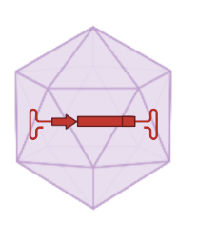
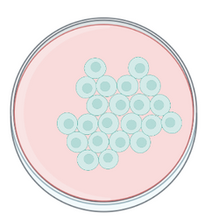
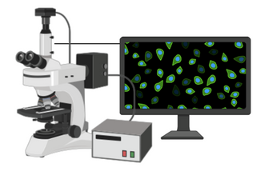
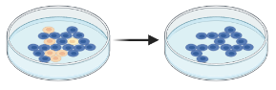
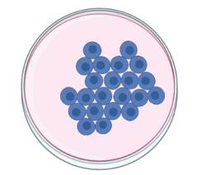
EXPERIMENTAL PLAN
IN VITRO
Infection with AAV2.7m8 shRNA3/9/12/Irr
+ psiCHECK-2-VEGFA
Cells selection with PuroR
ARPE19 cells*
72h after
3-4 days after
Trasfection with pLKO.1 puro with shRNA3/9/12/Irr
+ psiCHECK-2-VEGFA
Dual luciferase reporter assay system and RT-PCR
Lipofectamine 2000 diluted 1:25 in Opti-MEM
Mouse-derived
3T3 cells*
*supplemented with 10% fetal bovine serum (FBS) were seeded to a density of 1 × 10^4 cells/well in a 24-well plate
Notes:
We infected with viral vector AAV2.7m8 ARPE19 (human adult retinal pigment epithelial) cell line. The cells are diploid and can be carried for over 30 passages. We prepared transfection complexes by mixing 40 µl of serum free medium, 5.5 µl of transfection reagent, and AAV2.7m8 containing one of the 4 shRNA (shRNA3/9/12/Irr). So, we obtained 4 plates: in the first we added shRNA3, in the second shRNA9, in the third shRNA12 and in the fourth shRNAIrr. Each plate contained also psi-CHECK-2-VEGFA. We incubated cells at 37ºC in a humidified CO2 incubator for 72h. Contemporary, we transfected 3T3 cell line with pLKO.1.puro plasmid. Cells are maintained in Dulbecco’s modified Eagle’s medium and supplemented with 8% fetal bovine serum (FBS) were seeded to a density of 1 × 10^4 cells/well in a 24-well plate and allowed to adhere overnight. The 3T3-cells were then transfected using Lipofectamine 2000 and diluted 1:25 in Opti-MEM. Each shRNA-containing plasmid diluted (20 ng/µl) in Opti-MEM was first added to the transfection mix at a 1:1 ratio and incubated at room temperature for 5 min. Then we added shRNA/transfection agent complexes and the cells were incubated for 72 h in 8% FBS DMEM at 37 °C under 5% CO2. We obtained 4 plates with either shRNA3, shRNA9, shRNA12 or shRNAIrr, and psiCHECK-2-VEGFA for Dual luciferase reporter assay system. Then, we selected both cell lines (ARPE-19 and 3T3) with puromycin and after 3-4 days the remaining puromycin transfected cells have taken up the plasmids/viral vectors and we examined results by Dual luciferase reporter assay system and RT-PCR.

Slide 6
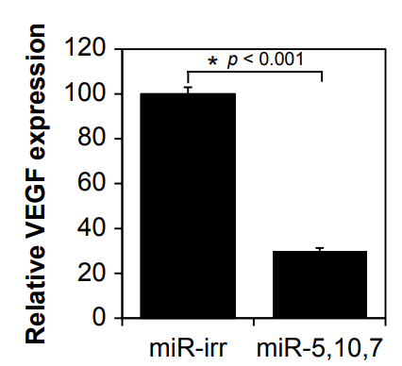
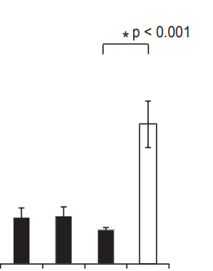
EXPECTED RESULTS
IN VITRO
ARPE19 cells
3T3 cells
Quantitative RT-PCR. shRNA3,9,12-silenced VEGFA levels by 70% compared to sh-Irr (p < 0.001).
Efficacy screening of three shRNAs, using semiquantitative RT–PCR.
sh-Irr
sh3,9,12
shIrr sh12 sh9 sh3
Adapted from Igarashi et al 2014.
Adapted from IActa Ophthalmol. 2014: 92, thesis 3: 1–38
Efficacy of shRNAs assessed in dual luciferase assay. sh3 reduced importantly RLuc-VEFGA expression.
Efficacy of shRNA3/9/12 targeting VEGF assessed in an RLuc-screening assay. sh3, sh9 and sh12, significantly reduced RLuc-VEGFa reporter activity.
sh12 sh9 sh3 shIrr
sh9 sh12 sh3 shIrr
Adapted from IActa Ophthalmol. 2014: 92, thesis 3: 1–38
Notes:
We performed RT-PCR and Dual luciferase reporter assay system to determine which shRNA, between shRNA3/9/12, achieved the best result by decreasing the expression of VEGFA.
The luciferase reporter assay system is commonly used to monitor the repression activities of shRNAs and miRNAs. To show the functionality of a shRNA, it is sufficient to clone the target site into the psiCHECK-2 vector to generate a fusion gene with the Renilla luciferase (RLuc) gene. Expression of shRNAs from shRNA-vectors will initiate the RNAi process towards the VEGFA exon1 target site and will result in degradation or translational inhibition of the fusion mRNA. The concomitant decrease in RLuc activity can be measured and will be an indicator of shRNA efficacy. So, as we see in the two graphs (one for each cell line results), shRNA3 caused more decrease in VEGFA expression level than shRNA9/12. Quantitative reverse transcription PCR uses fluorescent reporter molecules to monitor the amount of amplification products generated during each cycle of the PCR reaction. All RT-PCR experiments have been performed with the fluorescent dye SYBR Green. SYBR Green binds to all double- stranded DNA and due to the unspecific binding, high primer specificity is required to obtain reliable results. RT- PCR was performed as a two-step reaction, that is, creating cDNA first by means of a separate RT reaction and then adding the cDNA as a template in the PCR reaction. The cDNA was equally diluted prior to addition, thereby diluting out potential inhibitors of the following synthesis reaction to ensure optimum efficiency. RT-PCR was used to quantify the amount of VEGFA mRNA in vitro. As we see, in ARPE-19 cells graph, the VEGFA expression is relative to HPRT expression (a housekeeping gene). In the 3T3 cells graph (VEGFA expression is relative to GAPDH), we observed that, again, shRNA3 obtained the major decrease in VEGFA expression.

Slide 7
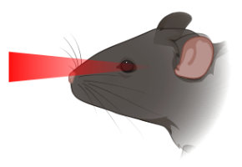
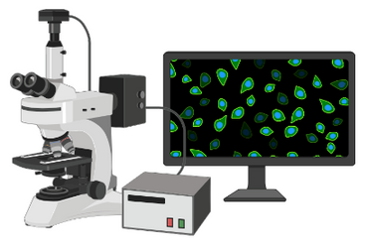
EXPERIMENTAL PLAN
IN VIVO
Intravitreal injection of 2μL of AAV vector solution (10^10 vg)
AAV2.7m8-CMV-GFP
left eye
12 Dpi
24 Dpi
Generation of murine
laser-induced CNV model
Histological analysis and CNV size measurement
12 Dpi
24 Dpi
6 weeks-old
C57BL/6J mice
x12
AAV2.7m8-hU6-sh3
right eye
Notes:
We took 12 C57BL/6J mice (six weeks-old) and get an intravitreal injection with 2μL of AAV vector solution (10^10 vg). We injected AAV2.7m8-hU6-sh3 into the right eye and AAV2.7m8-CMV-GFP into the left eye as a controlateral control. 12 days after the injection, we generated laser photocoagulation-induced CNV in mice: CNV was induced in mice by four burns (at the 3, 6, 9 and 12 o’clock positions) using a green argon laser indirect ophthalmoscope. 24 days after, we finally did histological analysis: Fundus fluorescein angiography, Optical coherence tomography, OCT angiography and Cryosectioning. Then, we measured CNV size (a measure of the newly- developed blood vessels) using computer-assisted image analysis software. CNV size was defined as the thickness from Bruch’s membrane to the top of the neovascular membrane. The thickness of total CNV including the choroid was measured and then the thickness of the choroid was measured on the same section (unaffected area) and subtracted from the total CNV and choroid thickness. Measurements were performed in all sections from each laser photocoagulation site, and maximum CNV size was included in the dataset when laser damage was present in the superior half of the retina (corresponding to the injection site). The diameter of CNV is a measure of the lateral extension of the CNV.

Slide 8
PROCEDURES
IN VIVO
Fundus fluorescein
angiography (FA)
Optical coherence tomography (OCT)
AAV2.7m8-CMV-GFP
1 eye
OCT angiography (OCT-A)
x12
CONTROLATERAL CONTROL
Cryosectioning
AAV2.7m8-hU6-sh3
1 eye
6 weeks-old
C57BL/6J mice
Computer assisted image analysis of CNV
immunostained
serial sections from GFP-injected eyes compared with AAV2.7m8-hU6-sh3-treated eyes
Notes:
Twelve days after inducing CNV, animals were anesthetized with isoflurane inhalation, and the pupils were dilated with 1% tropicamide and 2.5% phenylephrine prior to imaging. Fluorescein-isothiocyanate (FITC) was administered intravenously via the jugular vein at a dose of 5 mg/kg. FA and OCT imaging were performed using a custom-built multi modal OCT and SLO mouse retinal imaging system developed at the small animal ocular imaging facility. FA and OCT images were acquired simultaneously with a SLO (Scanning Laser Ophtalmoscopy) excitation
and OCT with superluminescent diodes light source respectively. For FA, reflectance and fluorescence images were averaged from 50 consecutive images. For OCT and OCT-A, 1080 horizontal B-scans acquired with a series of three multiple B- scans (BM-scans) per one location corresponding to the SLO images were captured for three-dimensional cross-sectional visualization and co-registration. En-face depth average projections of the phase variance signal were used to generate OCT-A images. CNV size was measured by Fiji image-processing software (NIH). After these in vivo analyses, the mice are sacrificed to perform cryosectioning and the CNV analysis on sections. The nasal corner of the eye was cauterized for cryostat orientation, the eyes were enucleated, and the cornea perforated, and fixed in 4% PFA for 60 min. The eyes were washed in phosphate-buffered saline (PBS) and transferred to 30% sucrose in PBS overnight. The eyes were oriented and embedded in Yazzulla mounting media and sagittal sections of 7mm were cut using a Microm HM 500M cryostat. After a series of rehydration and tissue fixation steps with DAPI, Alexa fluor 568, fluorescein-conjugated GLS I-isolectin B4 and anti-laminin antibody, three day after sections were analyzed by fluorescence microscopy and images captured with a Leica DFC 360 FX camera. We used computer-assisted image analysis software to measure CNV size.

Slide 9
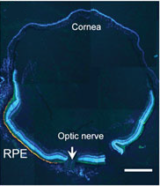
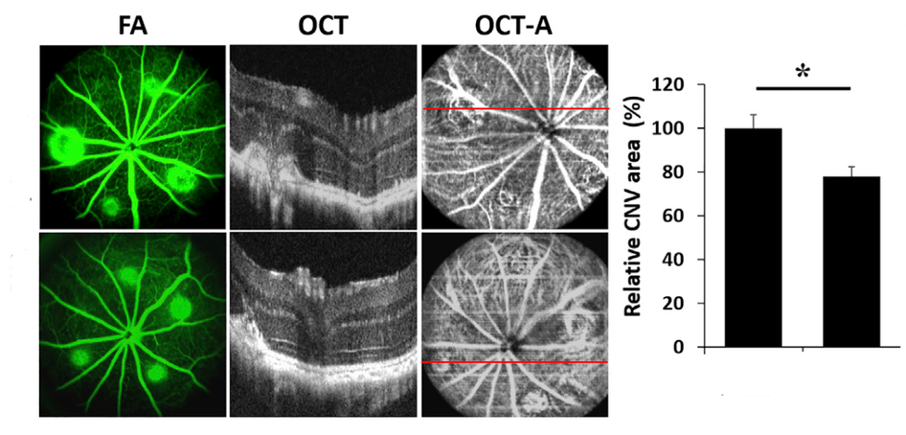
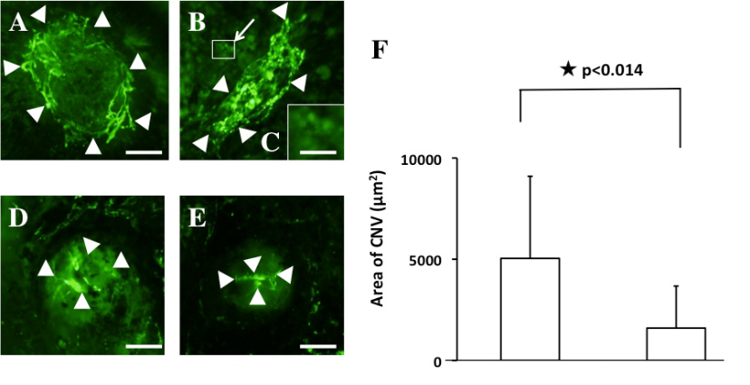
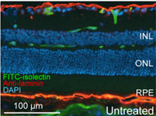
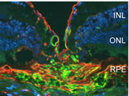
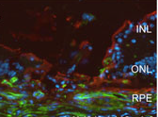
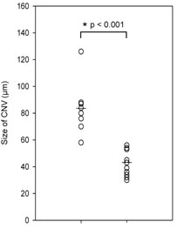
EXPECTED RESULTS
IN VIVO
Images and Graphic adapted from [9]
AAV2.7m8-CMV-GFP
AAV2.7m8-CMV-GFP
AAV2.7m8-hU6-sh3
AAV2.7m8-CMV-GFP
AAV2.7m8-hU6-sh3
We found that CNV was significantly inhibited in the mice treated with AAV2.7m8-hU6-sh3 (n = 12), compared with the mice treated with AAV2.7m8-CMV-GFP (1597.3±2077.2 versus 5039.5±4055.9 μm2; n = 12, p<0.014).
AAV2.7m8-hU6-sh3
AAV2.7m8-CMV-GFP
AAV2.7m8-hU6-sh3
Images and graphic adapted from [4]
Untreated
AAV2.7m8-CMV-GFP
AAV2.7m8-hU6-sh3
We found that, in the eyes treated with AAV2.7m8-hU6-sh3, the size of the CNV was significantly reduced (48%; p<0.001) compared to the CNV size in the GFP-injected control eyes.
Images adapted from [8]
AAV2.7m8-hU6-sh3
AAV2.7m8-CMV-GFP
Graphic adapted from [8]
Notes:
FA, OCT and OCT-A analysis reveal that eyes received AAV2.7m8-hU6-sh3 show a ±40% reduction in CNV area compared with eyes received AAV2.7m8-CMV-GFP. The margins of the CNV lesion (highlighted with white arrows in the images A,B,D,E) were defined with the Green FITC fluorescence and determined using image-analysis software. We found that CNV was significantly inhibited in the mice treated with AAV2.7m8-hU6-sh3 (n = 12), compared with the mice treated with AAV2.7m8-CMV-GFP. Finally, the analysis of the histological sections confirmed that in addition to a reduction in the diameter of the lesion, there is also a reduction in its thickness. We compared an image taken from the literature of an untreated eye with the sections we obtained. It is evident how the morphology of the tissue presents itself differently in the untreated eye compared to the control eye and to the one that received AAV2.7m8-hU6-sh3. Data show eyes treated with AAV2.7m8hU6-sh3, the size of the CNV was significantly reduced (48%; p<0.001) compared to the CNV size in the GFP-injected control eyes.

Slide 10
PITFALLS
SOLUTIONS
shRNA longer than 21 nt could activate TLR3
Make shorter shRNA and deliver them into the cell with viral vectors
It is nearly impossible to eliminate the miRNA-like off-targeting completely
Designing the guide sequences with overall weaker binding energy to the target sequence can dramatically reduce the off-target while maintaining a good on-target effect
Despite its potency and high fidelity, pol III promoter can cause toxicity by its interference with the endogenus miRNA processing pathways
off-targets
hU6
capacity
length
Notes:
In this therapy there are some disadvantages due to the design of the shRNA. The first one concerns the length: from literature we've learned that shRNA longer than 21 nt suppress CNV in a mouse model by the activation of cell surface Toll-like receptor (TLR)-3 rather than because of a specific RNAi effect. In order to solve this problem, we found a shRNA not longer than 21 nt and delivered it into the cell with a specific adeno-associated vector. An important negative feature is even that it is nearly impossible to eliminate the miRNA-like off-targeting completely, but it is possible to significantly reduce them by designing the guide sequence with overall weaker binding energy to the target sequence. Since in vitro biochemical studies indicated that base paring in the central region was critical for on-target cleavage but less important for RISC–target association, it was seen that designing a shRNA with AU-rich sequences both in seed region and 3', but not in the central region (where there must be a balanced content in GC), we can have potent on-target activity while having minimal off-target effects. The last negative feature is about pol.III promoter U6. The U6 promoter is known to be robust and possess a very precise start. Thus, U6-driven shRNAs are more potent, compared to those transcribed by Pol II. The main disadvantage of Pol III promoters hindering their application as therapeutic agents is the toxicity caused by their interference with the endogenous miRNA processing pathways. This concern can be minimized using weaker Pol II promoters at the expense of a possible loss in the therapeutic efficacy. Despite all, even in literature the most used promoter is U6 because pol. II promoters are not yet well characterized, so there is not a real solution for this problem.

Slide 11
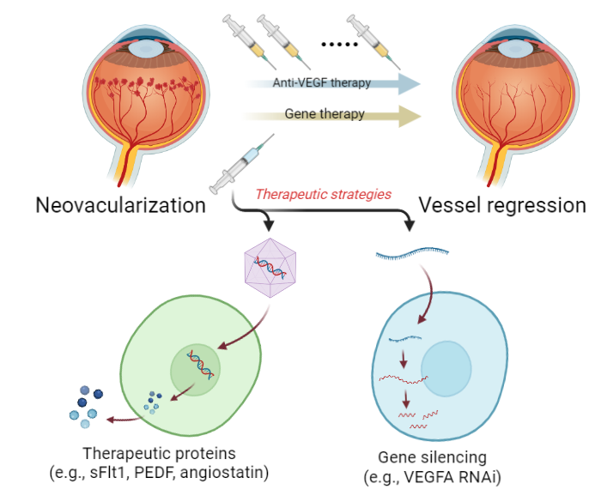
CONCLUSION
1
AAVdelivered shRNAs-targeting VEGFA, impairing neovessel formation in CNV mouse model demonstrates the feasibility of an in vivo gene therapeutic approach to the clinical management AMD.
2
AMD is a disease with a multitude of pathways involved in its pathogenesis. Viral-delivered RNAi-based anti-VEGFA therapy is one alternative, but combination therapy targeting multiple pathways could be another alternative.
3
A greater understanding of the underlying drivers of inflammation in AMD, as are developments in viral vectors, will be resulting in safe delivered therapy to millions of patients with nAMD.
Notes:
As we have seen in the previous slides, shRNA works well for the Knock-down of VEGFA in vitro and AAVdelivered shRNAs-targeting VEGFA significantly impaired neovessel formation in the laser-induced CNV mouse model. We this study we have set the basis for procedure therapies, but what is important is to continue to monitor the conditions of the treated models (6 or 12 months after the injection will be used to investigate the potential of viral-delivered RNAi effector molecules as a long-term treatment modality for exudative AMD). Indeed, as noted by the literature, long-term studies have been completed on this CNV model. Fortunately, these studies concluded that gene therapy can be sufficiently safe and substantially efficacious to pursue for development of new treatment based on gene therapy. This study demonstrates preclinical proof of a principle that supports proceeding to clinical studies in human patient with wet AMD. Based also on what we have said, AMD is a complex disease with a multitude of pathways involved in its pathogenesis, with this heterogeneity posing therapeutic challenges. So, viral-delivered RNAi-based anti-VEGFA therapy is only one therapeutic alternative for AMD: combination gene therapy targeting multiple pathways (for ex. PEDF, sFlf1, angiostatin) could be another alternative (in that case, however, attention should be focused on the search for different viral vectors to be used to convey therapy, given that the size of the AAVs, although very useful for treating ophthalmic pathologies, provide a very limited space to insert more transgenes at the same time). Moreover, a greater understanding of the underlying drivers of inflammation in AMD is needed for identification of other factors whose Knock-down can be safer. Also, developments in viral vectors that can be safely delivered intravitreally and have robust expression profiles can be useful. These two developments will arguably be resulting in safe therapy to millions of AMD patients.

Slide 12
BUDGET
2 MONTH EXPERIMENT
Lipofectamine 2000 Transfection Reagent (958€)
Helper and rep/cap plasmids (150€ x 4)
psiCHECK-2-VEGFA (75€ x 8)
PLKO.1puro (75€ x 4)
VECTORS and PLASMIDS
2.458€
C57BL/6J - the Jackson Laboratory (22€ ca)
SF9 cells (708€) and viral vector extraction (360€)
NHI-3T3 cells (595€) and puromycin (127€)
ARPE19 cells (595€) and puromycin (127€)
MICE and CELL LINES
2.776€
IN VITRO ANALYSIS
Dual luciferase reporter assay system kit (250€ x 100 assays)
RT-PCR (1424€ 5x5mL)
Histological analysis (256€)
1.930€
IN VIVO ANALYSIS
Green argon laser and other materials (7.685€)
Cryosection and and fixation materials (21.722€)
Indocianin (1.745€)
FA and OCT materials (8.171€)
39.323€
Salary costs of researchers for 1 PI, 2 Phd and 1 technician (~20.000€)
TOT = ~ 66.490€

Slide 13
REFERENCES
[1] Askou, Anne Louise. "Development of gene therapy for treatment of age‐related macular degeneration." Acta ophthalmologica 92 (2014): 1-38.
[2] de Guimaraes, Thales Antonio Cabral, et al. "Gene therapy for neovascular age-related macular degeneration: rationale, clinical trials and future directions." British Journal of Ophthalmology 105.2 (2021): 151-157.
[3] Grishanin, Ruslan, et al. "Preclinical evaluation of ADVM-022, a novel gene therapy approach to treating wet age-related macular degeneration." Molecular Therapy 27.1 (2019): 118-129.
[4] Igarashi, Tsutomu, et al. "Adeno-associated virus type 8 vector–mediated expression of siRNA targeting vascular endothelial growth factor efficiently inhibits neovascularization in a murine choroidal neovascularization model." Molecular vision 20 (2014): 488
[5] Bofill-De Ros, Xavier, and Shuo Gu. "Guidelines for the optimal design of miRNA-based shRNAs." Methods 103 (2016): 157-166.
[6] Khabou, Hanen, et al. "Insight into the mechanisms of enhanced retinal transduction by the engineered AAV2 capsid variant‐7m8." Biotechnology and bioengineering 113.12 (2016): 2712-2724.
[7] Bennett, Antonette, et al. "Structure comparison of the chimeric AAV2. 7m8 vector with parental AAV2." Journal of structural biology 209.2 (2020): 107433.
[8] Askou, Anne Louise, et al. "Reduction of choroidal neovascularization in mice by adeno‐associated virus‐delivered anti‐vascular endothelial growth factor short hairpin RNA." The journal of gene medicine 14.11 (2012): 632-641.
[9] Chung, Sook Hyun, et al. "Factors impacting efficacy of AAV-mediated CRISPR-based genome editing for treatment of choroidal neovascularization." Molecular Therapy-Methods & Clinical Development 17 (2020): 409-417.
[10] Gu, Shuo, et al. "Weak base pairing in both seed and 3′ regions reduces RNAi off-targets and enhances si/shRNA designs." Nucleic acids research 42.19 (2014): 12169-12176.
All illustrations were made using BioRender.com

