Slide 1
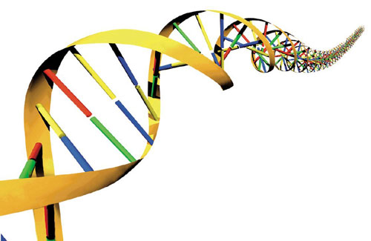
Gene Therapy for Parkinson Disease
Terapia Genica Prof. Saggio
Tutor Dott.ssa Piersanti
Carolin Tauber
Graziana Luciotto
Ludovica Taglieri
Veronica Cacciamani
Bianca Fabi

Slide 2
Parkinson Disease (PD)
Second most common neurodegenerative disorder.
Cause: Death of dopamine-generating cells in the substantia nigra of the brain.
Main symptoms:
Muscle rigidity
Tremor
Bradikinesia (Slowness of movement)
Postural instability
Parkinsonian gait
Additional clinical features of PD:
Executive dysfunction
Slowed cognitive speed
Confusion, depression
Dementia

Slide 3

Risk & Protective Factors
Risk Factors:
Age
Family history
Head trauma, illness or exposure to environmental toxins like herbicides and pesticides
Protective Factors:
Caffeine
Tobacco smoking

Slide 4
Types of Parkinson
Idiopathic Parkinson-Syndrome
(Unknown reason)
Familiar Parkinson-Syndrome
(genetical inheritance)
Symptomatic Parkinson-Syndrome
(induced)
Atypic Parkinson-Syndrome
(accounting for other neurodegenerative diseases)

Slide 5
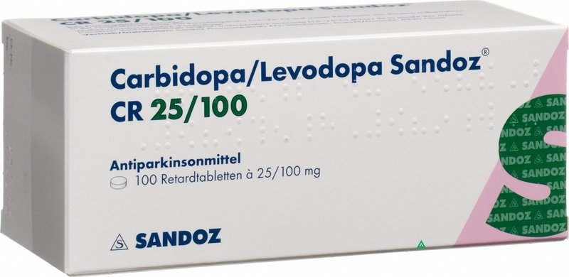


Actual Treatment
Pharmaceuticals:
Levodopa (L-DOPA)
Dopamine-agonists
COMT Inhibitors (Levodopa degradation )
Alternative approaches:
Use of Stem Cells
Gene Therapy

Slide 6
Alpha-synuclein
With gene therapy, we plan to intervene in familial forms of Parkinson's disease.

Slide 7
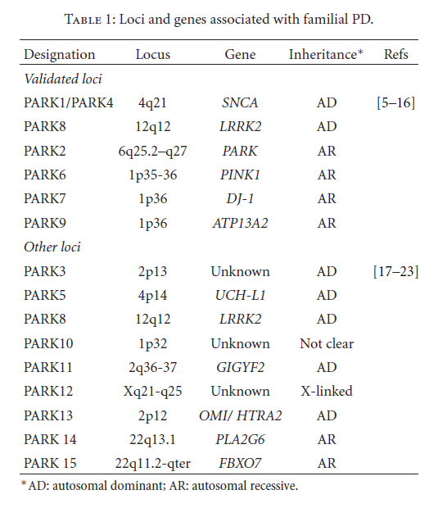
There are various pathological phenotypes due to mutations in various genes:
Fabio Coppede`

Slide 8
The alpha-synuclein is a protein belonging to the family of sinucleine encoded by three distinct genes homologous.
Andrei Surguchov

Slide 9
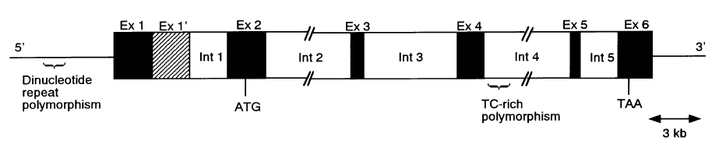
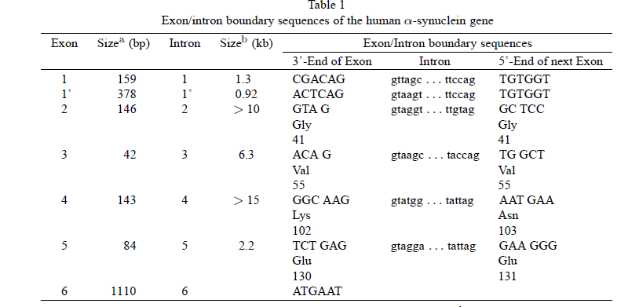
Yu Xiaa et al.

Slide 10
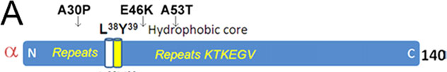
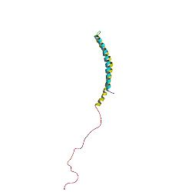
It consists of 140 aa
It is a tetramer folded of 58 kDa
Andrei Surguchov

Slide 11
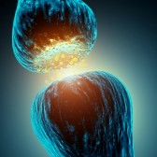
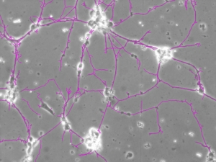
Despite alpha-sinucleine have been associated with neurodegenerative diseases escapes their clear biological function.
However their modulatory or regulatory functions have been tested for many cellular processes:
regulation of synaptic functions and of the vesicular trafficking
release of the neurotransmitter.
Lasse Pihlstrøm

Slide 12
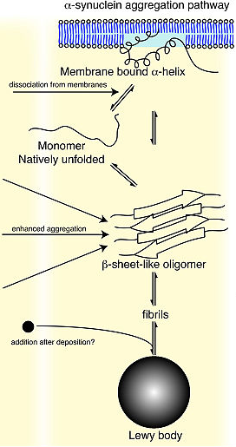
The toxic mechanism and which determines the necrosis of dopaminergic neurons of the nigrostriatal via, it is believed at present that consists in the process of aggregation of the molecules of α-synuclein monomers, oligomers via intermediates, amyloid fibrils able to trigger the sequence of events leading to death of the dopaminergic neurons.

Slide 13
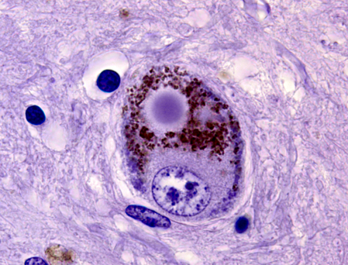
A growing amount of data has suggested that alpha-synuclein is aggregated in Lewy bodies.
They are bodies roundish of varying diameter, including between 8 and 30 uM, made ​​from fibers of proteins aggregates.
Lasse Pihlstrøm

Slide 14
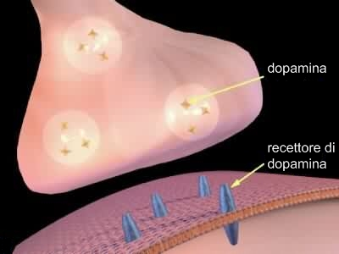
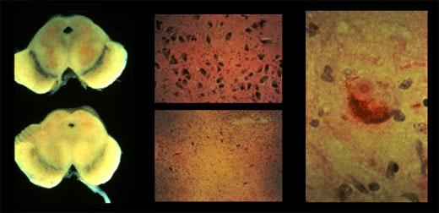
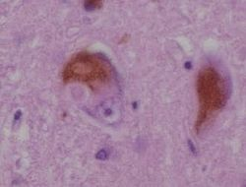
A53T mutation and toxicity in dopaminergic neurons
It is a missense mutation in which there is a guanine at position 209 instead of an adenine.
You get the aminoacid substitution from threonine to alanine in position 53.
Alexander Kurz et al.
Conway et al.

Slide 15
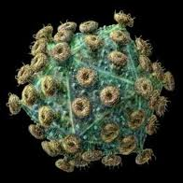

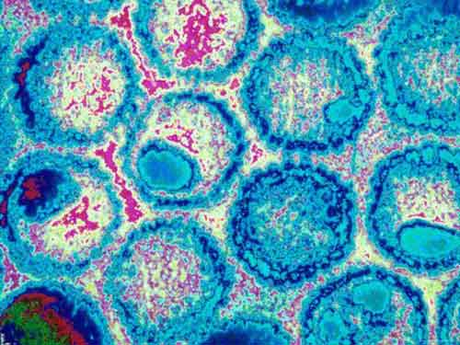
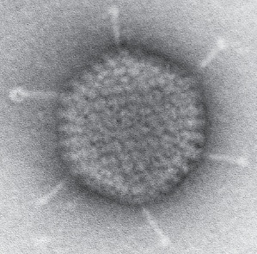
Retroviral vector: need a cell proliferative.
Lentiviral vector: does not need a cell proliferating, but integrates randomly in the genome and might induce the phenomenon of insertional mutagenesis. The lentiviral vector being an HIV virus-like can give rise to phenomena of homologous recombination.
Vector Herpes virus: has a large genome and difficult to manipulate.
Adenoviral vector human: highly immunogenic.
Vector adenoassociated: (AAV9) able to pass the blood brain barrier.
The genome is small.

Slide 16
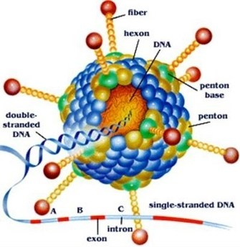
Development of optimized vectors for gene therapy
The ideal gene therapy vector would be:
injectable
targetable to specific sites in vivo
able to maintain long-term gene expression
nonimmunogenic
Choise of GUTLESS CAV-2
Gary J. Nabel.Proc. Natl. Acad. Sci. USA Vol. 96, pp. 324–326, January 1999

Slide 17
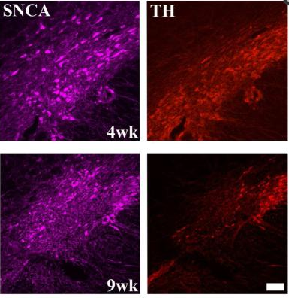
Model of gene therapy: pitfalls and solutions
A53T SNCA gene mutation is autosomal dominant mutation
silencing the mutant mRNA with shRNA
2. Also wilde-type synuclein accumulation is toxic
Regulate gene expression
Mice treated with PD neurotoxin MPTP
(1-methyl-4-phenyl-1,2,3,6-tetrahydropyridine)
Kuhn et al. The mouse MPTP model: gene expression changes in dopaminergic neurons. Eur J Neurosci. 2003; 17:1–12.

Slide 18
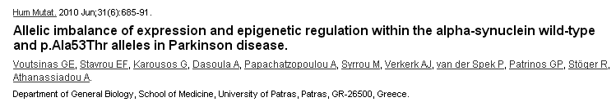
3. Allelic imbalance
Introduction of wt SNCA gene to restore allelic balance

Slide 19
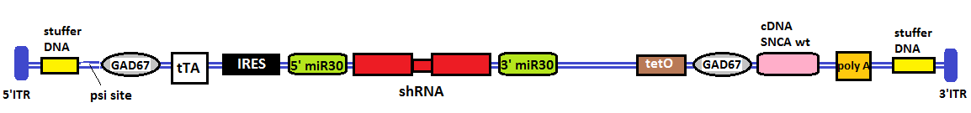
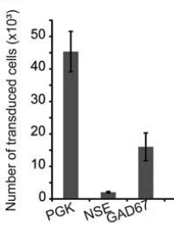
ADENOVIRAL CONSTRUCT
Step 1: PROMOTER CHOISE
Choise of GAD67 promoter ( 67kDa glutamic acid decarboxylase) instead of the well characterized NSE promoter (neuron-specific enolase).
Delzor et al.HUMAN GENE THERAPY METHODS 23:242–254 (August 2012)Mary Ann Liebert, Inc.DOI: 10.1089/hgtb.2012.073

Slide 20
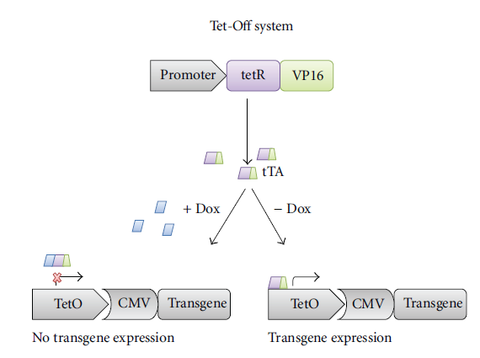
Step 2:REGULATION SISTEM FOR GENE EXPRESSION
Choise of “Tet-off” system
Naidoo et al. Hindawi Publishing Corporation Neurology Research International Volume 2012

Slide 21
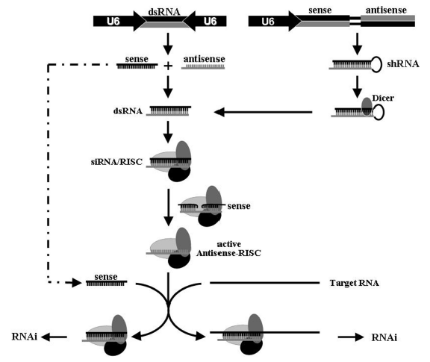
Step 3: SILENCING OF A53T MUTANT
siRNA or shRNA
Wich one?
Jin et al. Nucleic Acids Research, 2012, Vol. 40, No. 4 1797–1806

Slide 22
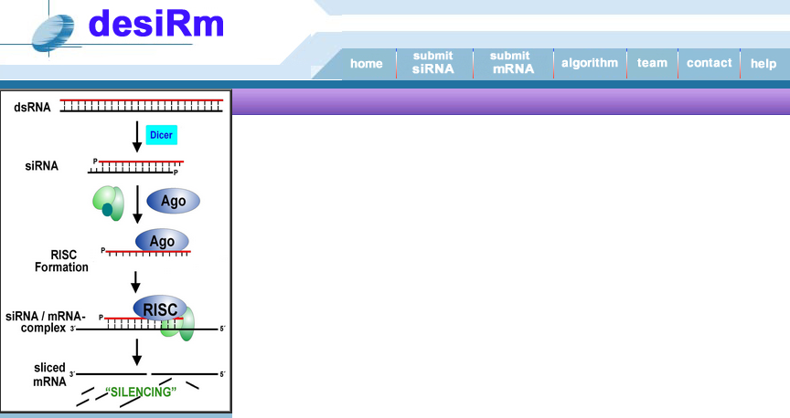
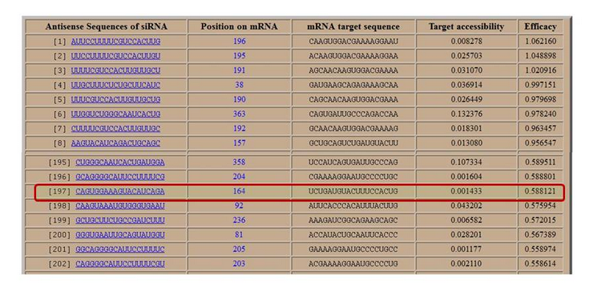
Step 4: RNAi ALLELE DISCRIMINATION
http://www.imtech.res.in/raghava/desirm/

Slide 23
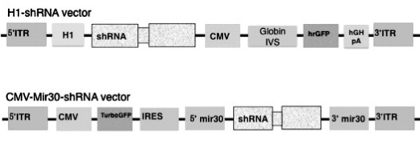
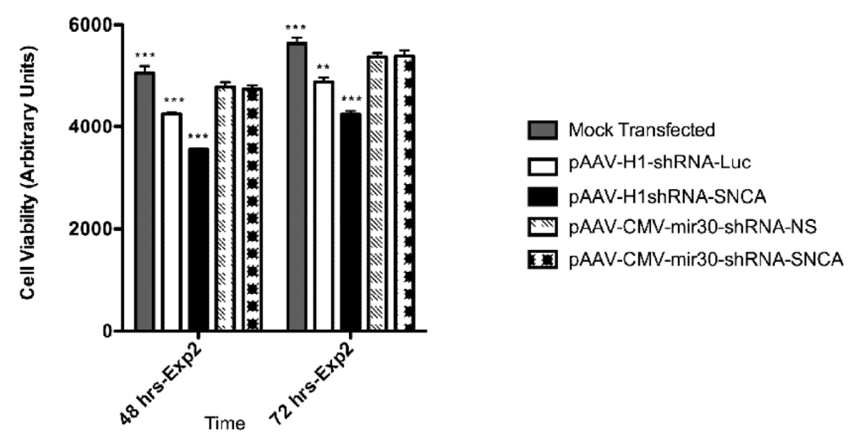
Step 5: BACKBONE miRNA
Han et al. Brain Res. 2011 April 22; 1386: 15–24.

Slide 24
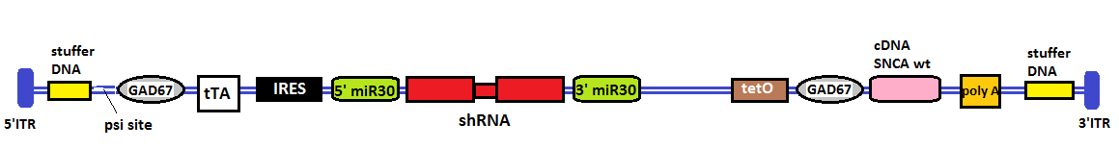
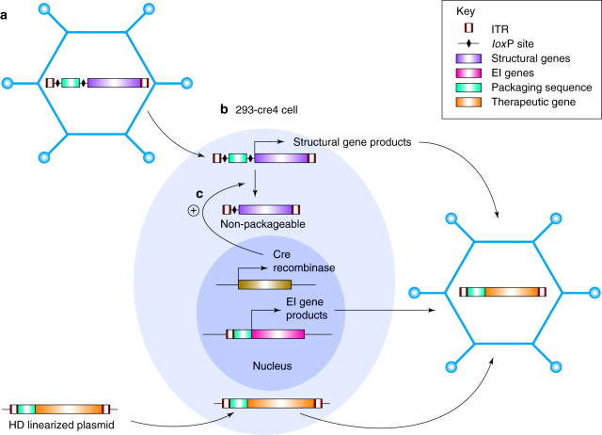
Ready vector for the in vitro and in vivo experiments

Slide 25
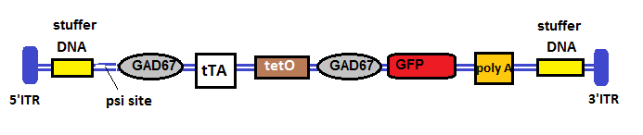
SPECIFICITY OF TET OFF CONTROL
Choose the human dopaminergic neuroblastoma SH-SY5Y cell line as an in vitro model of dopaminergic neurons

Slide 26

Trasfection of the vector into the cells
whit Doxycycline
without Doxycycline
GFP protein isn’t expressed
GFP protein is expressed
used FACS “Fluorescence activated cell sorting” for the calculation and assessment of the cells

Slide 27
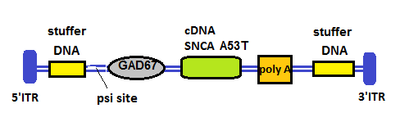
SPECIFICITY OF THE VECTOR
Which cellular model can we use???
induce the specific mutation in
SH-SY5Y with CAV-2

Slide 28
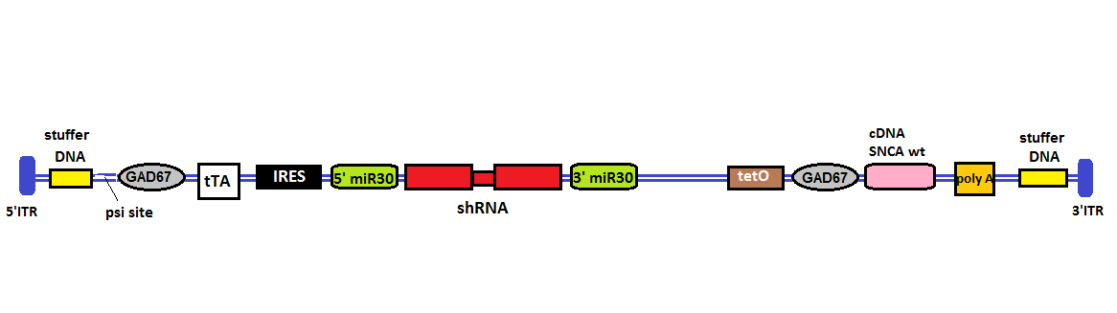
trasfection cell line mutated SH-SY5Y with:
Empty vector control (negative control)
Our vector (positive control)

Slide 29
Evaluation whit:
WESTERN BLOT (% WT and mutant α-synuclein)
RT-PCR and following hybridization with labeled specific oligo (% WT and mutant mRNA)
Next step
EXPERIMENTATION IN VIVO

Slide 30
Modello animale
A normal complement of dopamine neurons at birth with selective and gradual loss of dopamine neurons commencing in adulthood
2. The model should have easily detectable motor deficits, the cardinal symptoms of PD, which are bradykinesia, rigidity and resting tremor
3. The model should show the development of characteristic Lewy bodies
4. It should have a relatively short disease course of a few months, allowing rapid and less costly screening of therapeutic agents

Slide 31
B6;C3-Tg(Prnp-SNCA*A53T)83Vle/J
Mice homozygous for the transgenic insert and express
human A53T variant alpha-synuclein
Behavior/neurological phenotype
Akinesia
Paresis
Tremors
Weakness
Aphagia
Decreased grooming behavior
Nervous system phenotype
Abnormal myelination
Abnormal spinal nerve morphology
Apha-synuclein inclusion body
Neurodegeneration
Axon degeneration
Muscle phenotype
Neurogenic muscle atrophy
Virginia Lee, University of Pennsylvania

Slide 32
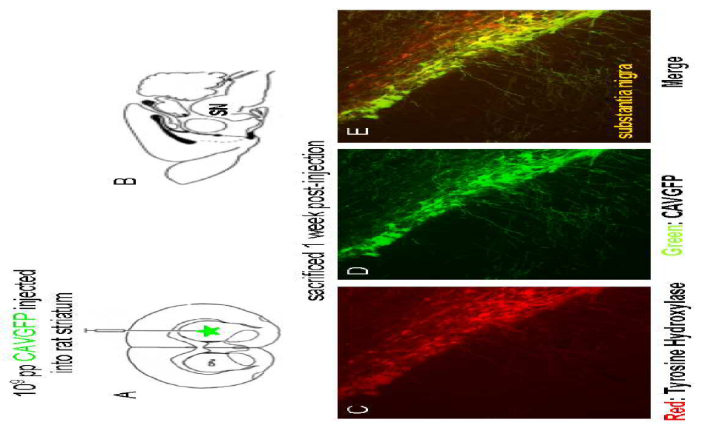
Experiments in Vivo
Bru T. et al. (2010). Viruses. 2, 2134-2153

Slide 33
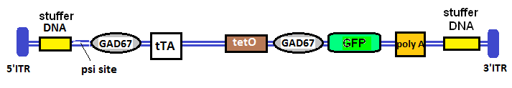
Demonstration of the efficiency of the regulation system tet off
DOCX
Without doxyciline
With doxyciline
GFP
GFP

Slide 34
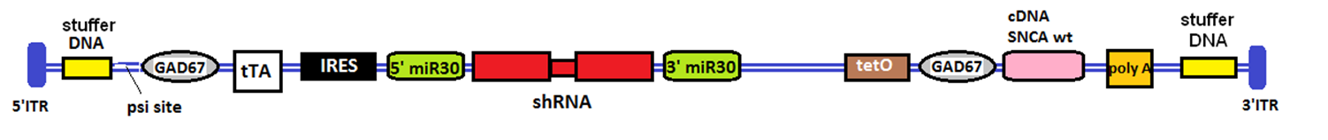

2. Demonstration of the efficiency of our vector
CAV
Reversion of behavioral
and pathological phenotype
Behavioral and
pathological phenotype

Slide 35
3. Behavioral tests
Cylinder test
4. Quantizzation of mutated mRNA and alphasynuclein
Western blot
Immunofluorescence
Oligoprobes
5. Monitoring of mice
Avoided the overexpression of snca wt
mice sacrificed at different week show different
grade of neuronal degeneration
6. Exstabilish range of efficiency
Threshold of neurons damaged beyond which our vector is ineffective

Slide 36
7. Experiments in vivo in non-human primates models of Parkinson's disease
8. Clinical trials with patients
LIMITS
NO recovery of neurons previously degenerate
Future clinical trials no recruitment of patients with advanced neurodegeneration

Slide 37




COSTS
SH-SY5Y cell line
Hek 293 cell line:
Single plasmid for: tet O
tTA
IRES
Plastics, chemicals, oligoprobes, siRNA, Antibodies (western and fluorescence), doxycicline, PCR kit
Transgenic mouse (n.1)
332,00 €
335,00 €
50,00 €
50,00 €
50,00 €
About 7000,00 €
232,00 €
Minimum equipment required in laboratory: centrifuges, optical microscopy, florescence microscopy, incubator, PCR machine, biological safety hood, cylinder test machinery…

Slide 38
REFERENCES
Andrei Surguchov. (2011) Synucleins: Are They Two-Edged Swords?
Ahmed F., Raghava G. P. S. (2011). Designing of Highly Effective Complementary and Mismatch siRNAs for Silencing a Gene. PLoS ONE 6(8): e23443.
Bru T., Salinas S., Kremer E.J. (2010). An update on Canine adenovirus type 2 and its vectors. Viruses. 2, 2134-2153.
Cristina Sundal, Shinsuke Fujiyoka, Ryan J.(2011) Autosomal Dominant Parkinson’s desease.
Coppedè F. (2012). Genetics and Epigenetics of Parkinson’s Disease. The ScientificWorld Journal Volume 2012, Article ID 489830,
Coune P. G., Schneider B. L., Aebischer. (2012). Parkinson’s Disease: Gene Therapies. Cold Spring Harb Perspect Med. 2(4): a009431.
Decressac M., Mattsson B., Lundblad M., Weikop P., Björklund A. (2012). Progressive neurodegenerative and behavioural changes induced by AAV-mediated overexpression of α-synuclein in midbrain dopamine neurons. Neurobiology of Disease 45. 939–953
Delzor A., Dufour N., Petit F. (2012). Restricted Transgene Expression in the Brain with Cell-Type Specific Neuronal Promoters. HUMAN GENE THERAPY METHODS 23:242–254.
Fabio Coppedè. (2010) Genetics and Epigenetics of Parkinson’s Disease
Han Y., Khodr E. C., Sapru K. M. et al. (2011). A microRNA embedded AAV alpha-synuclein gene silencing vector for dopaminergic neurons. Brain Res. 2011 April 22; 1386: 15–24.
Huang H., Qiao R., Zhao D. (2009). Profiling of mismatch discrimination in RNAi enabled rational design of allele-specific siRNAs. Nucleic acids research. Vol 37 n.22.
Jin. X., Sun T., Zhao T. et al. (2010). Strand antagonism in RNAi: an explanation of differences in potency between intracellularly expressed siRNA and shRNA. Nucleic Acids Research, 2012, Vol. 40, No. 4 1797–1806.

Slide 39
Kuhn K., Wellen J., Link N, Maskri L. et al. (2003). The mouse MPTP model: gene expression changes in dopaminergic neurons. Eur J Neurosci 3; 17:1–12.
Kurz A., Double K. L., Lastres-Becker I. et al. (2010). A53T-Alpha-Synuclein Overexpression Impairs Dopamine Signaling and Striatal Synaptic Plasticity in Old Mice. PLoS ONE 5(7): e11464.
McCormack A. L., Mak S. K., Henderson J. M., Bumcrot D., Farrer M. J., Di Monte D. A. (2010). a-Synuclein Suppression by Targeted Small Interfering RNA in the Primate Substantia Nigra. PLoS ONE Vol. 5 Issue 8
Nabel G. J. (1999). Development of optimized vectors for gene therapy. Proc. Natl. Acad. Sci. USA Vol. 96, pp. 324–326.
Naidoo J., Young D. (2012). Gene Regulation Systems for Gene Therapy Applications in the Central Nervous System. Hindawi Publishing Corporation Neurology Research International, Article ID 595410.
Richfield E. K., Thiruchelvam M. J., Cory-Slechta D. A., Wuertzer C., Gainetdinov R. R., Caron M. G., Di Monte D. A., Federoff H. J. (2002). Behavioral and Neurochemical Effects of Wild-Type and Mutated. Human -Synuclein in Transgenic Mice. Experimental Neurology 175, 35–48
Sapru M. K., Yates J. W., Hogan S., Jiang L., Halter J., Bohn M. C. (2006). Silencing of human α-synuclein in vitro and in rat brain using lentiviral-mediated RNAi. Experimental Neurology 198. 382–390.
Schneider B., Zufferey R., Aebischer P. (2008). Viral vectors, animal models and new therapies for Parkinson’s disease. Parkinsonism and Related Disorders 14 S169 - S171
Wan O. W., Chung K. K. (2012) The Role of Alpha-Synuclein Oligomerization and Aggregation in Cellular and Animal Models of Parkinson’s Disease. PLoS ONE 7(6): e38545.
Xiong W., Goverdhana S., Sciascia S. A. et al. (2006). Regulatable Gutless Adenovirus Vectors Sustain Inducible Transgene Expression in the Brain in the Presence of an Immune Response against Adenoviruses. JOURNAL OF VIROLOGY, p. 27-37.
Zhang H., Yang B., Ahmed S.S. et al. (2011). Several rAAV Vectors Efficiently Cross the Blood–brain Barrier and Transduce Neurons and Astrocytes in the Neonatal Mouse Central Nervous System. www.moleculartherapy.org vol. 19 no. 8, 1440–1448

Slide 40
“L’ingegno di un uomo si giudica meglio dalle sue domande che dalle sue risposte”
Duca di Lèvis

