Slide 1
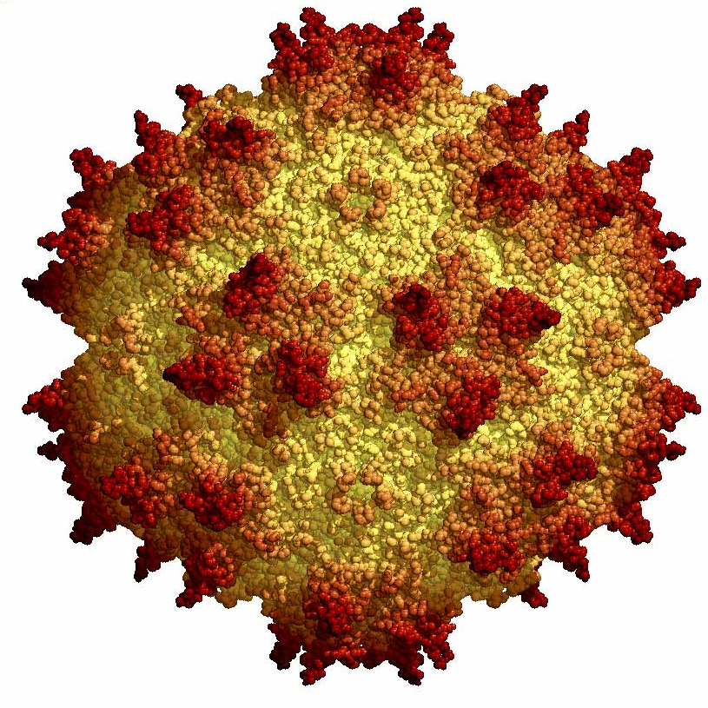
Corso di Terapia Genica anno 2012-2013
LAMINOPATHY-BASED PREMATURE AGING: GENE THERAPY IN RESTRICTIVE DERMOPATHY
Group members:
Daniela Celebrin
Anna Cerullo
Dario Cocciadiferro
Gemma Paciotti

Slide 2
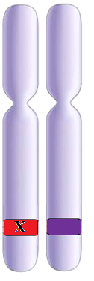
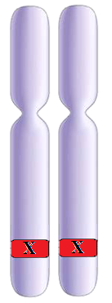
Restrictive Dermopathy
Autosomal recessive perinatal lethal dermatosis
Heterozygous
Homozygous
Heterozygous
Zmpste24
gene
x
Normal
Normal
Disease
Disease

Slide 3
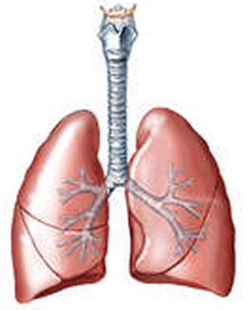
Restrictive Dermopathy
High death rate: respiratory failure is the main cause of death
Sistemic disease presenting premature aging features
Affected critical tissues :
Bone
Lung
Skin

Slide 4
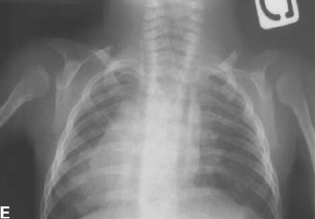
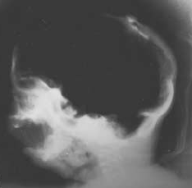
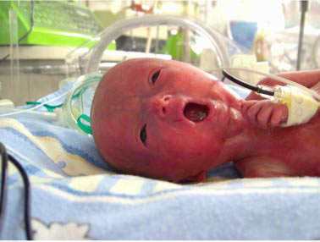
Restrictive Dermopathy : Macroscopic phenotype
Cranium ossification defects
Reduced bone density;
Generalized artrogryposis
Hypoplasic lungs
Facial dysmorphy:
Tightly adherent translucent skin

Slide 5
Restrictive Dermopathy : Histological and cellular phenotype
Histologically skin shows hyperkeratosis, thin dermis, abnormally dense collagen bundles with absence of elastic fibers
Cellular phenotype: variation of nuclear morphology structure with loss of heterochromatization

Slide 6
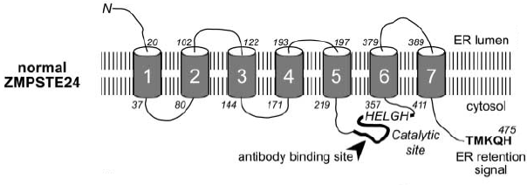
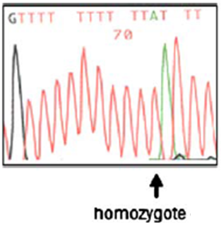
Restrictive Dermopathy : Genetic etiology
Mutations of Zmpste24 gene, encoding a lamin-binding protein endoprotease ZMPSTE24, involved in lamin A precursor processing
The mutation in the Zmpste24 gene is a “null” type, caused by the chromosome 1(c.1085_1086InsT) tymine insertion.
Results: complete absence of the ZMPSTE24 enzyme and prelamin A accumulation in cells

Slide 7
Restrictive Dermopathy : Lamin A post-translational processing

Slide 8
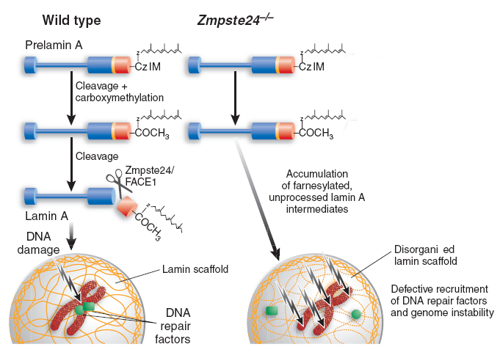
Restrictive Dermopathy : Progerin accumulation effects
Zmpste24 absence causes high levels of farnesylated-carboxymethylated prelamin A
Nuclear enlargement and mis-shapening, nuclear lamina thickening, loss of peripheral heterochromatin and clustering of nuclear pores

Slide 9
1.Objective: Modeling and correcting restrictive dermopathy
ITR
EF1α
ZMPSTE24
eGFP
ITR
AAV vector with ZMPSTE24 to restore the prelamin A processing Pathway

Slide 10
2. Background/Rationale : Why modeling and correcting restrictive dermopathy?
NO CURE FOR RD
CURRENT TREATMENTS USE OF FARNESYLTRANSFERASE INHIBITORS (FTI)
preventing high levels of toxic lamin A/C, without changing the normal protein expression
leading to chromatin damage and cellular senescence and skin and endothelial defects, bone resorption, lipodystrophy and accelerated aging
MORE EFFECTIVE TREATMENT FOR RD IS NEEDED
DISEASE MODEL to study RD and develop a cure

Slide 11
2. Background/Rationale : Why modeling and correcting restrictive dermopathy? Disease model
PRECLINICAL PHASE (IN VITRO)
SELECTION OF CELLULAR MODEL SYSTEM FOR DISEASE
DETECTION OF STANDARD FOR MOLECULAR PHENOTYPE
SELECTION OF THERAPEUTIC CARRIER FOR ZMPSTE24

Slide 12
3. Preliminary results: Lab results and literature
In vitro/ vivo RD model – preliminary data
SELECTION OF CELLULAR MODEL SYSTEM FOR DISEASE
Genotype of the target gene therapy
(ZMPSTE24-/-)
Mice will be provided by labs that are already testing mice knockout ZMPSTE24
Mouse embryonic fibroblasts (MEFs) derived from knockout mice
(Lamin A alteration)
Gene therapy cellular choice
Availability and culture advantages
Sampling of mouse embryos

Slide 13
3. Preliminary results: Lab results and literature
Correction of the target Model: MEFs
DETECTION OF STANDARD FOR MOLECULAR PHENOTYPE
ZMPSTE24 mRNA expression
ZMPSTE24 (protein) expression
Dysmorphic nucleus
High levels of farnesylated prelamin A
Loss of heterochromatin

Slide 14
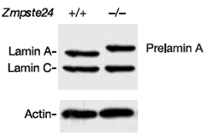
3. Preliminary results: Lab results and literature
Correction of the target Model: MEFs
DETECTION OF STANDARD FOR MOLECULAR PHENOTYPE

Slide 15
3. Preliminary results: Lab results and literature
In vitro/in vivo RD model – preliminary data
SELECTION OF THERAPEUTIC CARRIER FOR ZMPSTE24
long-term transgene expression
low immunogenicity and toxicity
non-pathogenic
broad tropism - serotype dependent
Why should you choose AAV vector ?
efficient transduction in a broad range of tissues , with high tropism for lung, bone, skin
does not affect the normal function of treated tissues
absence of inflammatory infiltrates in treated tissue
Choice of serotype?

Slide 16
3. Preliminary results: Lab results and literature
In vitro/in vivo RD model – preliminary data
Preliminary data showed :
overexpression of the protein does not cause adverse effects in mice wt
heterozygote proves to be healthy (50% of the protein)
Expression of the enzime under the 50% causes a disease decline. Critical condition becomes even worst when the expression is lower.

Slide 17
4. Description of the project: Experimental plan
Construction of the adeno-associated virus (AAV) vector
ITR
EF1α
ZMPSTE24
eGFP
ITR
Transduction control
Notes:
Thus, we have selected AAV6 vectors to express ZMPSTE24 widely in adult mice/ mefs and study its ability to process the prelamin A.
Here, we generated an adeno-associated virus (AAV) carrying the mouse ZMPSTE24 cDNA under the control of the EF1α promoter and containing the capsid proteins of the AAV serotype 6, known to confer tropism for a wide variety of mouse tissues (AAV9-mZMPSTE24).
As a negative control and reporter of AAV6 expression, we generated an analogous construct containing the enhanced green fluorescent protein (eGFP) instead of ZMPSTE24 (AAV6-eGFP).

Slide 18
4. Description of the project: Experimental plan
Cellular model : MEFs from knockout mice
ZMPSTE24 ^{-/-}
eGFP
Transduced cells separated
ITR
EF1α
ZMPSTE24
eGFP
ITR

Slide 19
4. Description of the project: Experimental plan
Preliminary data expected
Zmpste24 -/ -
eGFP
FLUORESCENT MICROSCOPY
FACS-SORT
Transduced cells

Slide 20
4. Description of the project: Experimental plan
Preliminary data expected
MOLECULAR AND CYTOLOGICAL ANALYSIS
Detection of ZMPSTE24 protein
Detection of Lamina A
Nuclear shape irregularities

Slide 21
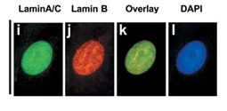
4. Description of the project: Experimental plan
Preliminary data expected
Which is the expected phenotype?
Transduced MEFs Zmpste24^{-/-}

Slide 22
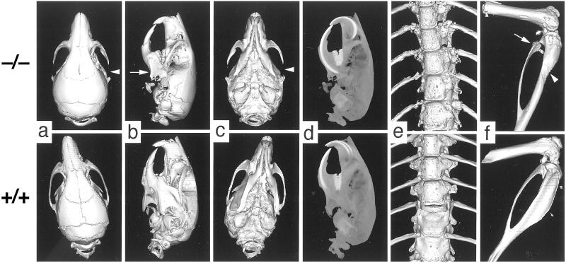
5. Description of the project: In vivo
ZMPSTE24 -/- vs WT

Slide 23
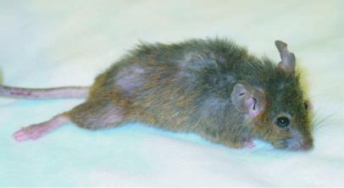
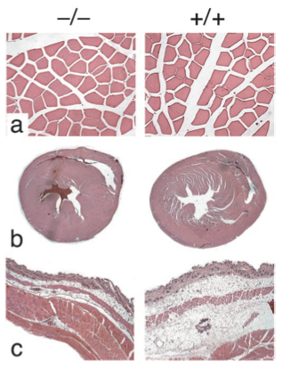
5. Description of the project: In vivo ZMPSTE24 -/- vs WT
Knockout
Wild type

Slide 24
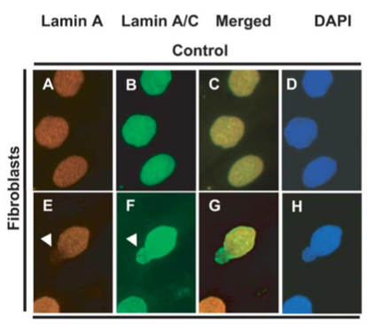
5. Description of the project: In vivo
ZMPSTE24 -/- Cellular Phenotype
In mice ZMPSTE24 -/- nuclear shape irregularities are shown cause of Lamin A aberrant expression.

Slide 25
5. Description of the project: In vivo
Gene therapy treatment
1. Intravenous tail vein injection of the sample after 21 days of age - Gene therapy: First injection - Control: (AAV6+GFP) injection in mice ZMPSTE24-/-
2. External phenotypical analysis -Behaviour -Weight -Death rate -Skin characteristic
3. Specific Analysis - X-ray Faxitron specimen radiography system (6 to 30 weeks of age) -Sampling of skin tissue (4-30 weeks of age)

Slide 26
5. Description of the project: In vivo
Gene therapy treatment
4. Full necropsies were performed on: 4-6-8...? weeks of age
GFP analysis in different tissues/organs
^{Biodiversity/Tropism}
^{Histological examination}
^{Protein tissue expression}
^{Immunocytochemistry}
^{Nuclear shape irregularities}
^{Immune response}
^{Anti AAV antibody detection}

Slide 27
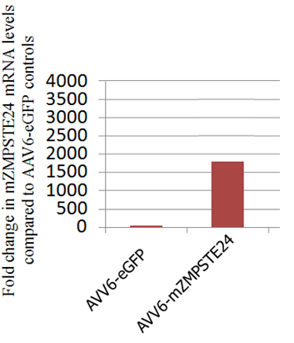
5. Description of the project: In vivo
Predictive results

Slide 28
5. Description of the project: In vivo
Immune response

Slide 29
5. Description of the project: Experimental plan
Costs
293T cells: 80€ www.abgent.com/products/CL1032_293T_Cell_Line
Adeno-associated virus (AAV) production: Price on request
Immuno-cytochemical analysis: 200 €
Transgenic mouse:200€
Lamin A/C (LMNA) antibody: 302.31 €
Purified whole goat antibody recognizing mouse IgG and IgM 250 µl List Price: $113.57
Molecular analysis ̴ 3000€
Growth medium , growing factor…
Laboratory: flasks, vials, tubes…

Slide 30
5. Description of the project: Experimental plan
References
Kleopatra Rapti1, Vedell Louis-Jeune1, Erik Kohlbrenner1, Kiyotake Ishikawa1 (2012). Neutralizing Antibodies Against AAV Serotypes 1, 2, 6, and 9 in Sera of Commonly Used Animal Models. 1073-1080
Müller, OJ, Leuchs, B, Pleger, ST, Grimm, D, Franz, WM, Katus, HA et al. (2006). Improved cardiac gene transfer by transcriptional and transductional targeting of adeno-associated viral vectors. Cardiovasc Res 70: 70–78.
Claire L. Navarro1 and Nicolas Le ́vy1,2,* (2004). Lamin A and ZMPSTE24 (FACE-1) defects cause nuclear disorganization and identify restrictive dermopathy as a lethal neonatal laminopathy: 2493-2593
Csoka, A.B., Cao, H., Sammak, P.J., Constantinescu, D., Schatten, G.P. and Hegele, R.A. (2004) Novel lamin A/C gene (LMNA) mutations in atypical progeroid syndromes. J. Med. Genet., 41, 304 – 308.
Martin O. Bergo*†‡, Bryant Gavino*, Jed Ross§, Walter K. Schmidt¶, Christine Hong*, Lonnie V. Kendall, Andreas Mohr**, Margarita Meta**, Harry Genant**, Yebin Jiang**, Erik R. Wisner (2002) Zmpste24 deficiency in mice causes spontaneous bone fractures, muscle weakness, and a prelamin A processing defect: 13049-13056
Kleopatra Rapti1, Vedell Louis-Jeune1, Erik Kohlbrenner1, Kiyotake Ishikawa1, Dennis Ladage1, Sergei Zolotukhin2, Roger J Hajjar1 and Thomas Weber1 (2012) Neutralizing Antibodies Against AAV Serotypes 1, 2, 6, and 9 in Sera of Commonly Used Animal Models 73-83
Hadri, L, Bobe, R, Kawase, Y, Ladage, D, Ishikawa, K, Atassi, F et al. (2010). SERCA2a gene transfer enhances eNOS expression and activity in endothelial cells. Mol Ther 18: 1284–1292.
Ishikawa, K, Ladage, D, Tilemann, L, Fish, K, Kawase, Y and Hajjar, RJ (2011). Gene transfer for ischemic heart failure in a preclinical model. J Vis Exp.

Slide 31
5. Description of the project: Experimental plan
References
Nichols, TC, Dillow, AM, Franck, HW, Merricks, EP, Raymer, RA, Bellinger, DA et al. (2009). Protein replacement therapy and gene transfer in canine models of hemophilia A, hemophilia B, von willebrand disease, and factor VII deficiency. ILAR J 50: 144–167.
Palomeque, J, Chemaly, ER, Colosi, P, Wellman, JA, Zhou, S, Del Monte, F et al. (2007). Efficiency of eight different AAV serotypes in transducing rat myocardium in vivo. Gene Ther 14: 989–997
CHRISTINE L. HALBERT,1 A. DUSTY MILLER,1 SHARON MCNAMARA,2 JULIA EMERSON,2 RONALD L. GIBSON,2 BONNIE RAMSEY,2 and MOIRA L. AITKEN3(2006). Prevalence of Neutralizing Antibodies Against Adeno-Associated Virus (AAV) Types 2, 5, and 6 in Cystic Fibrosis and Normal Populations: Implications for Gene Therapy Using AAV Vectors: 440-447
Carmela Zincarelli1, Stephen Soltys1,2, Giuseppe Rengo1,2 and Joseph E Rabinowitz1(2008). Analysis of AAV Serotypes 1–9 Mediated Gene Expression and Tropism in Mice After Systemic Injection:1073-1080

Slide 32
Fatti una domanda e
datti una risposta!

