Slide 1
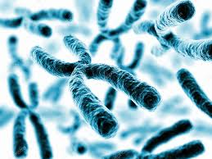

Cell and gene therapy for Dyskeratosis congenita
Marco Rulli
Daria Scintu
A.A.2017/2018

Slide 2
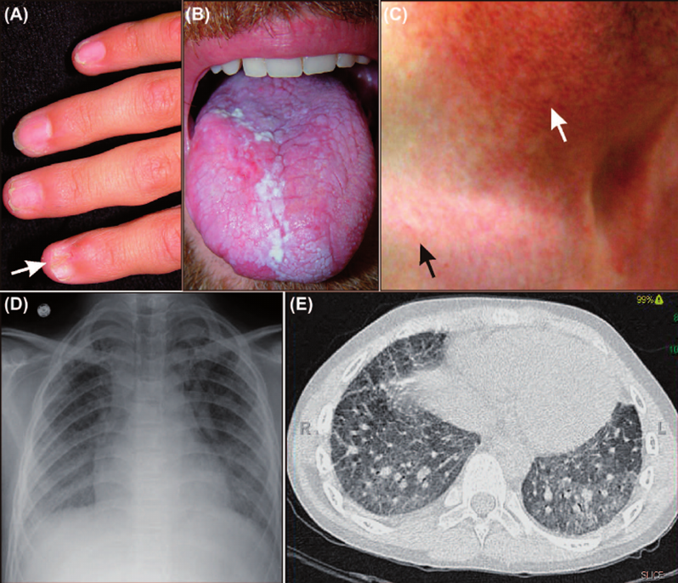
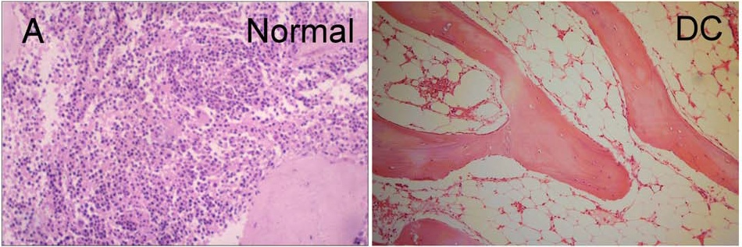
Clinical features
Phenotypic features of dyskeratosis congenita (DC).
(A) Nail dystrophy (arrow) in an adolescent. (B) Oral leukoplakia in an adult. (C) Skin changes in an adult. Hypopigmented lesions and the typical reticular rash of DC are evident on the upper chest (black arrow). Hypopigmentation is more pronounced in the sun-damaged skin of the neck (white arrow). (D) and (E) Pulmonary fi brosis on chest radiograph and CT scan of an adult.
Bone marrow failure that is the most significant cause of mortality in DC patients, up to 60-70%
Annals of Medicine, 2014; 46: 353–363
Histopathological features of dyskeratosis congenita (DC): (A) bone marrow slides show the loss of cells in an aplastic marrow, typical of dyskeratosis congenita.
Michael Kirwan and Inderjeet Dokal (2009)
Notes:
DC is a multisystem disorder caused by abnormal telomere biology.
The most characteristic clinical feature is a triad of mucocutaneous features: leukoplakia, reticulated skin pigmentation and nail dystrophy.
Patients with DC and the related telomere biology disorders (TBD) may present with one or a combination of BMF, pulmonary fibrosis, or liver disease. One of the most common haematological manifestations is bone marrow failure that is the most significant cause of mortality in DC patients, up to 60-70%. Patients present hypocellular bone marrow and severe cytopenias.
In the absence of telomerase activity and/or protection telomeres are shortened after each round of DNA replication.
When a critical size is reached, telomeres are recognized as damaged DNA by the cell p53-dependent DNA-repair system. Persistent activation of this pathway finally results in cell apoptosis or senescence.
Telomere shortening is associated to DNA replication, which is specially relevant in cells that have impaired systems of telomere elongation and protection, as is the case of DC patients cells. Therefore, highly proliferative cells are expected to be the firstly affected by telomere shortening. Some of these highly proliferative cells are the stem cells of tissues with high capacity of renewal such epithelia, bone marrow cells and lymphocytes.

Slide 3
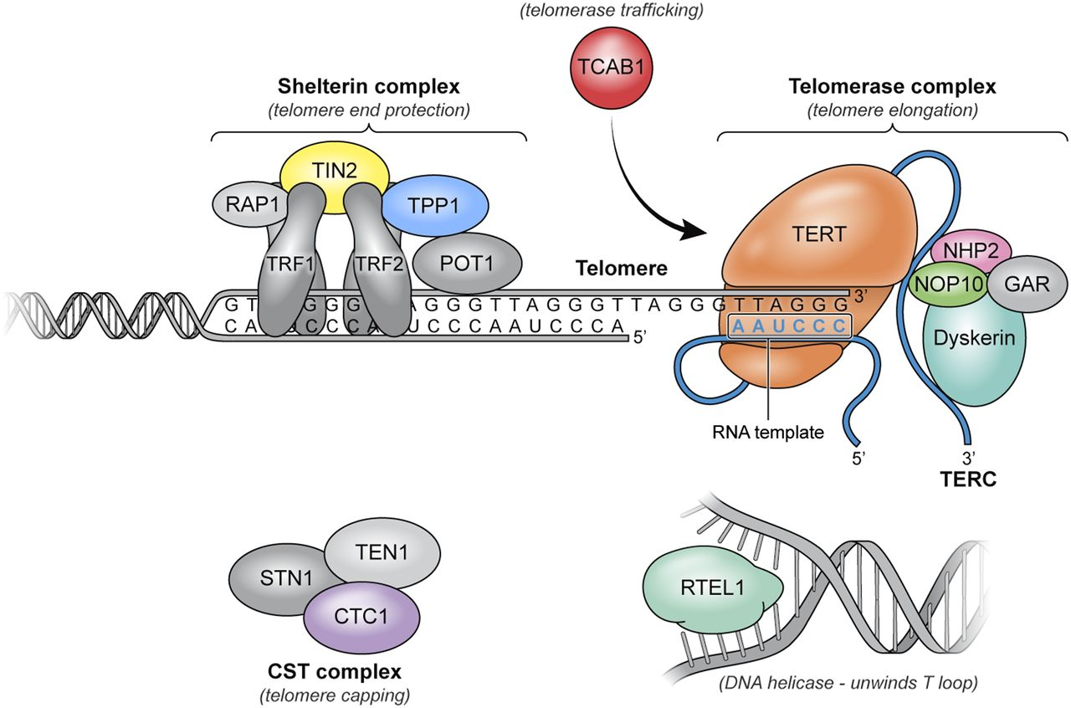
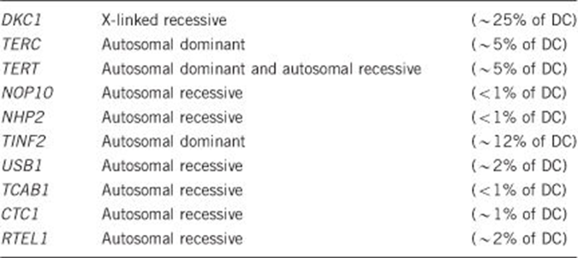
Genetics of Dyskeratosis Congenita
DC is heterogeneous at the genetic level
patients have mutations in genes that encode components of the telomerase complex and telomere shelterin complex
Adapted from Townsley et al., 2014
Telomerase ribonucleoprotein enzyme complex:
reverse transcriptase (encoded by the gene TERT),
RNA template (encoded by TERC),
associated proteins such as dyskerin
Notes:
Autosomal dominant, autosomal recessive, and X-linked recessive inheritance patterns have been identified as the causes of DC/TBD and resultant very short telomeres for age. The known genes include CTC1, DKC1, NHP2, NOP10,PARN, POT1, RTEL1, STN1, TERC, TERT and TINF2.
In particular, we have focused on the mutation of the TERT gene that encodes the reverse transcriptase.

Slide 4
Background
Hematopoietic stem cells transplantation (HSCT) is the only treatment than can cure bone marrow failure in DC patients
Inducible reactivation of telomerase activity could reverse defective hematopoiesis caused by telomere shortening in TERT-deleted mice opening new perspectives to gene therapy approaches.
Recent reports indicate that TERT plays roles beyond telomeres and contributes to stem cells maintenance and cell reprogramming which might offer new therapeutics targets for telomere biology disorders
Molecular diagnosis and precision therapeutic approaches for telomere biology disorders. Perona et al, 2016
The ability of HSCs to maintain a normal balance between quiescence and proliferation, self-renewal and differentiation, is based not solely on their intrinsic properties, but also on the microenvironment in which they reside, the HSC niche
Adherent, nonhematopoietic cells of BM stroma, BM stromal cells (BMSCs, also known as Bmderived “mesenchymal stem cells”) are able to re-create the hematopoietic microenvironment (HME) upon in vivo transplantation into mice
Bone marrow skeletal stem/progenitor cell defects in dyskeratosis congenita and telomere biology disorders.
Balakumaran et al., 2015

Slide 5
Background
DC-BMSCs exhibited reduced clonogenicity, spontaneous differentiation into adipocytes and fibrotic cells, and increased senescence in vitro
Upon in vivo transplantation into mice, DC-BMSCs failed to form bone or support hematopoiesis, unlike normal BMSCs
Bone marrow skeletal stem/progenitor cell defects in dyskeratosis congenita and telomere biology disorders.
Balakumaran et al., 2015.
Telomerase gene therapy in a mouse model of aplastic anemia targets the bone marrow and provides increased and stable telomerase expression
Telomerase expression leads to telomere elongation and subsequently to the reversal of aplastic anemia phenotypes
Despite the fact that AAV9 vectors carrying the Tert gene are nonintegrative and therefore unlikely to aid in the division of cancer cells, the association of many cancers with telomerase expression imposes specific safety concerns. In this regard, in a previous study, a longer than 1-year follow-up of wild-type mice treated with AAV9-Tert did not show increased cancer
Telomerase gene therapy rescues telomere length, bone marrow aplasia, and survival in mice with aplastic anemia.
Bär et al.,2016

Slide 6
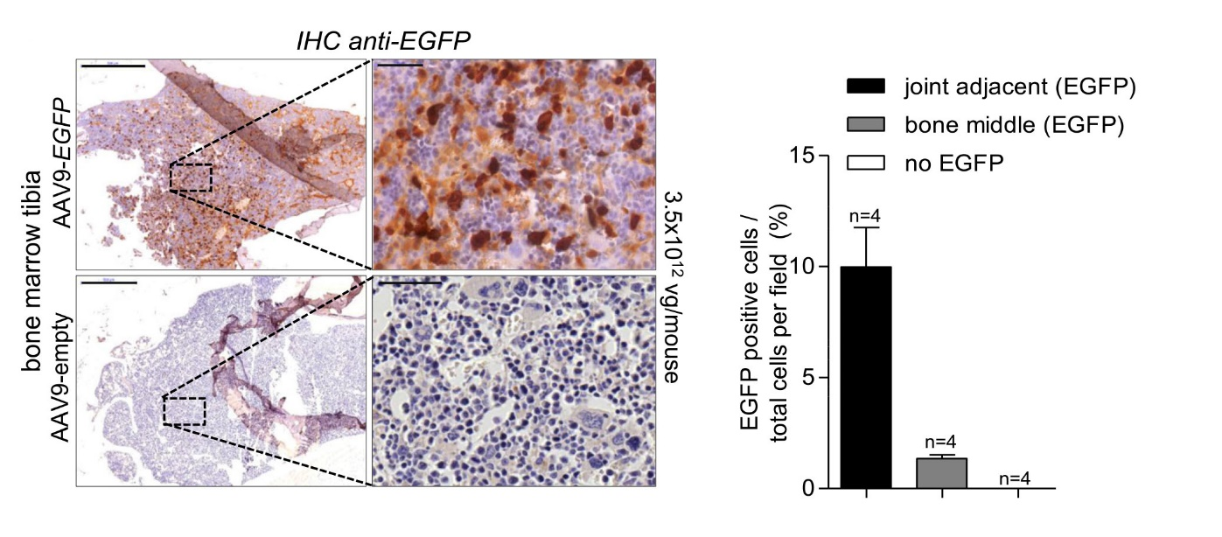

Preliminary data in literature
AAV9-Tert targets bone marrow and hematopoietic stem cells (A)
Tert mRNA expression is determined by quantitative real-time PCR in whole bone marrow isolates
at 2 weeks and 8 months after virus injection (B)
Higher Tert mRNA expression in whole bone marrow compared with isolated hematopoietic cells (HPSCs and lin1 cells) could suggest that additional bone marrow cells corresponding to the stroma may also be infected (C)
(A)
(B)
Telomerase gene therapy rescues telomere length, bone marrow aplasia, and survival in mice with aplastic anemia. Bär et al.,2016
Notes:
Bar and colleagues in this work have tested the therapeutic efficacy of telomerase activation by using adeno-associated virus (AAV)9 gene therapy vectors carrying the telomerase Tert gene in a mouse models of aplastic anemia due to short telomeres (Tert-deficient mice).
(A) First they tested the ability of AAV9 vectors to transduce bone marrow cells upon mouse IV injection. To determine the location and percentage of transduced cells, they first treated wild-type mice with an AAV9-EGFP reporter virus (3.5x10¹² viral genomes per mouse) via tail vein injections. They found that 2% of the BM cells were positive for EGFP upon immunohistochemistry with anti-EGFP antibodies in middle bone sections, and this increased to 10% in bone regions adjacent to the joints, which showed the highest AAV9 transduction.
(B) They then determined Tert mRNA expression by quantitative real-time PCR in whole bone marrow isolates at 2 weeks and 8 months after virus injection. At 2 weeks post treatment with the AAV9 vectors, Tert mRNA expression was significantly increased in the AAV9-Tert-treated mice compared with those treated with the AAV9-empty vector, and this increased expression was maintained up to 8 months after the initial treatment.
(C) They also noted higher Tert mRNA expression in whole bone marrow compared with isolated hematopoietic cells (HPSCs and lin1 cells). This result could suggest that additional bone marrow cells corresponding to the stroma (ie, adipocytes) may also be infected. Therefore we expect good results on MSCs.

Slide 7
Experimental plan
Objective
We want to work on the possible correction of niche problems to improve autologous bone marrow transplantation
Strategy
Test the therapeutic efficacy of telomerase activation by using adeno-associated virus (AAV)9 gene therapy vectors carrying the telomerase Tert gene in mouse models of aplastic anemia due to short telomeres (Tert-deficient mice)
HSCs and MSCs isolation and transduction with rAAV9-Tert
Co-infusion of MSCs with HSCs to improve hematopoietic reconstitution of recipients mice and to test MSCs effect in hematopoietic niche maintenance
Notes:
Based on preliminary data in the literature we focused on the ability of mesenchymal stem cells (MSCs) to recreate and maintain the hematopoietic microenvironment in order to improve autologous bone marrow transplantation.
Our strategy involves the use of gene therapy with AAV9 Tert vector on HSC and MSC cells isolated from the marrow of Tert-deficient mice.
We expect from the coinfusion of these cells:
telomere elongation and subsequently the reversal of aplastic anemia phenotypes, due to Tert expression
improvement in haematopoietic reconstitution and in haematopoietic niche maintenance

Slide 8
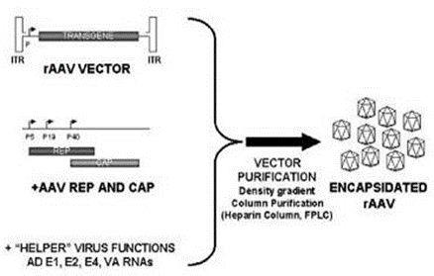
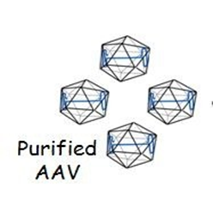
RECOMBINANT AAV VECTOR (rAAV)
rAAV9 vector production
Why rAAV?
No immunogenicity
High titers (10e¹⁰)
The Ad-­‐helper plasmid assembling E2A, E4 and VA regions (Ad-­‐helper plasmid) is cotrasfected into the 293 cells, along with plasmids encoding the AAV vector genome (vector plasmid) as well as rep and cap genes (AAV-­‐helper plasmid)
TERT 3,369 kbp
eGFP 717 bp
pCMV 669 bp
Our rAAV vector for HSCs and MSCs
AAV genome ̴ 4,7Kb
̴ 4,7Kb
Notes:
Given the good results obtained in targeting the bone marrow cells with serotype 9 in previous studies we have chosen to use this adeno-associated recombinant vector containing the Tert gene with the e-GFP marker.

Slide 9
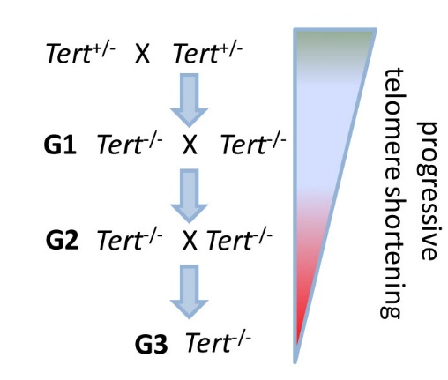
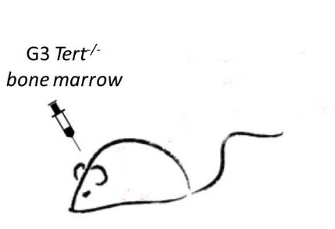
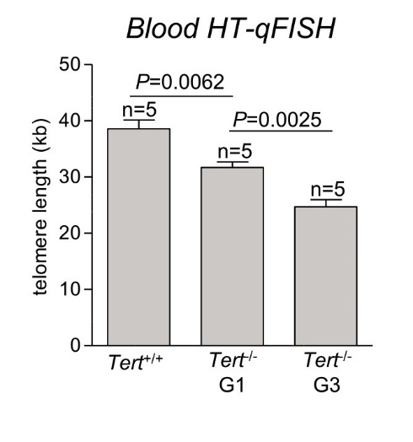
Mouse model «Mus musculus » C57 / BL6
Mouse A
Mouse B
Wild Type mouse
lethally irradiated (12 Gy)
mouse model of aplastic anemia due to short telomeres
The progressive shortening of telomeres decreases survival for each generation in these mice.
(Margaret A. Strong et al.,2011)
mice having an average telomere length of 25 kb
compared with 40 kb in the wild-type controls.
(Bär et al.,2016)
Notes:
In our project we used the mouse model C57/BL6; mice of this strain (inbred) are 99% isogenic and have a high genetic stability.
We can divide the experimental process in different steps:
Intercrossing mice Tert +/-
Extraction of the bone morrow from the mouse G3 Tert-/- (mouse A)
HSC and MSC cells isolation and transduction with the AAV9-TERT-GFP vector
Transplantation bone morrow into 8-week-old wild type mouse (mouse B) lethally irradiated (12 Gy)
Selected HSC and MSC are trasplanted into the mouse B bone morrow
The first step is the creation of the mouse A - G3 TERT knockout by crossing heterozygous mice for the TERT gene. This mouse has short telomeres and manifests aplastic anemia typical of human DC, that causes poor survival. To avoid the potentially deleterious and complex effects of Tert deletion in other tissues, we used bone marrow transplantation, allowing us to selectively analyze the consequences of Tert deletion in the bone marrow. To this end, the bone marrow from
G3 Tert-/- mice was transplanted into wild-type recipient littermates (Mouse B).

Slide 10



Experimental plan
In Vitro:
Extraction of the bone marrow from mice G3
Isolation of cells MSC and HSC from the bone marrow of mouse
Stem cells purification
HSCs and MSCs are transduced separately with rAAV9-TERT vectors
After transduction, selection of positive-GFP cells with FACS technology
Colony-forming assay of positive gfp cells (MSC,HSC)
MSC CD146
Mouse A
HSC CD34
rAVV9-TERT treatment
Adherent Cell Culture (MSCs)
Suspension Cell Culture (HSCs)
MSC CD146⁺
HSC CD34⁺
Notes:
Second step: extraction of the bone marrow from the mouse G3.
Third step: one part of the marrow is used for the isolation of HSC and MSC cells that will be trasduced with the AAV9-TERT-GFP vector. Using FACS technology we will select the cells transduced with the e-GFP marker.
Subsequently a short-term colony-forming assay was performed by plating 1x10⁴ and 2x10⁴ freshly isolated mononucleated bone marrow cells in 35mm dishes containing MethoCult media (both STEMCELL Technologies) following the manufacturer’s protocol. All experiments were performed in duplicate, and the number of colonies was counted after 12 days of incubation at 37°C.

Slide 11
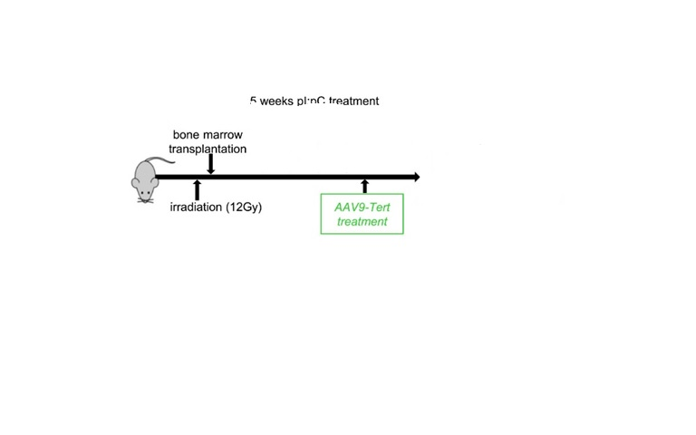
Experimental plan
Autologous BM transplantation improvement
Mouse B
monitored
Ex vivo:
Irradiated (12 Gy) wild-type mice
Transplantation of irradiated wild-type mice with G3 TERT Knockout bone morrow
One month after trasplation the mice are treated with intrabone injecton
After treatment ,we monitored mice during a follow-up period of 5 months
MSC (1X10⁶ cell )
HPS (1X10² cell )
Notes:
Fourth step: one part of the marrow will be used for transplantation in the mouse B, this mouse is immunocompromised with a damaged bone marrow using the irradiation (12 Gy).
Fifht step: one month after transplantation, the HSC and MSC cells selected in the third step will be transplanted into the bone marrow of mouse B.

Slide 12
Control EXPERIMENTS
Q-FISH
Mice : with HSCs-MSCs with HSCs Untreated WT
Blood HT-qFISH
∆ telomere length (kb)
telomere length (kb)
Notes:
During 5 months after the transplantation, several control analysis will be perform;
(Q-FISH) is a cytogenetic technique based on the traditional FISH methodology. In Q-FISH, the technique uses labelled (Cy3 or FITC) synthetic DNA mimics called peptide nucleic acid (PNA) oligonucleotides to quantify sequences in chromosomal DNA using fluorescent microscopy and analysis software. By using conditions that only allow labeled (CCCTAA)₃ PNA to hybridize to (TTAGGG)_{n} target sequences, Q-FISH is able to quantify the hybridization of PNAs to telomeric sequences. Similarly to metaphase Q-FISH, HT Q-FISH is performed with very high stringency hybridization conditions, which only allow detection of perfect TTAGGG repeats, therefore reflecting on the length of distal telomeric repeats and not of subtelomeric repeats. Furthermore, HT Q-FISH allows the determination of the frequency of cells with very short telomeres within a given population, which in turn are indicative of telomere dysfunction. HT Q-FISH generates large data sets for each sample, conferring high accuracy and statistical power to this method. HT Q-FISH, thus, represents a crucial improvement to the application of telomere FISH analysis to large-scale studies. (Canela A. et al.,2007)
We next compared the dynamics of telomere length in mice treated with:
AAV9-Tert HSCs+MSCs
AAV9-Tert HSCs
Untreated
Wilde-type
To this end, we performed a longitudinal study to follow telomere length in peripheral blood (PBMCs) over time using telomere HT-Q-FISH technology.3
We expect a significant increase in telomere length in mice treated with both HSCs and MSCs transduced with AAV-9 TERT, compared to differently treated mice.

Slide 13
Control EXPERIMENTS
Blood counts
hemoglobin g dL⁻¹
erythrocyte 10¹² l⁻¹
leukocyte 10⁹ l⁻¹
platelet 10⁹ l⁻¹
Notes:
A further check after treatment will be the blood count.
Also in this case we expect a significant increase in the levels of hemoglobin, erythrocytes, platelets and leukocytes in mice treated with HSCs and MSCs transduced with AAV-9Tert. This would confirm the hypothesis of the importance of the reconstitution of the hematopoietic stem microenvironment for the acquisition of a correct haematological phenotype.

Slide 14
CONCLUSIONS
Bone marrow autologous transplantation is improved injecting at the same time TERT-transduced hematopoietic and mesenchymal stem cells
MSC can restore BM stromal function
PITFALLS AND SOLUTION - FUTURE POSSIBILITIES
High execution times for the numerous steps required by the procedure
Critical feasibility for excessive stress to which mice are subjected for the expression of the disease-like Phenotype (human DC)
Effective efficiency of the vector on the MSCs
Inability of the mouse model to completely reproduce disease phenotypes
To improve the experimental plan it would be useful to further test the effectiveness of transduction of our vector on MSCs
In the future it would be interesting to use induced pluripotent stem cells (IPSs) as platforms for identifying signaling pathways and functional mapping of haplo-insufficient genes involved in large-scale chromosomal deletions–associated disorders.
Notes:
In conclusion, the ability of mesenchymal stem cells to recreate a functional stem cell niche led us to improve autologous bone marrow transplantation by opting for coinfusion of MSCs with HSCs.
Several steps are required for the realization of this project; this in terms of timing and feasibility can be a critical point. In particular, to obtain a mouse model with typical characteristics of aplastic anemia similar to DC patients, we hypothesized a rather invasive procedure for the mouse (myeloablative conditioning, bone marrow transplantation); this with the subsequent treatment with the transduced stem cells could be excessively drastic and compromise the success of the experiment.
Studies in mice have largely been unable to mimic disease phenotype in humans due to difficulties in fully replicating the human mutations and the differences between mouse and human cells with regard to telomere length regulation, processing of reactive oxygen species and lifespan. In the future it would be interesting to use induced pluripotent stem cells (IPSs) as platforms for identifying signaling pathways and functional mapping of haplo-insufficient genes involved in large-scale chromosomal deletions–associated disorders.
Furthermore, to improve the experimental plan it would be useful to further test the effectiveness of transduction of our vector on MSCs

Slide 15
MATERIALS and COSTS
Materials and assays | Product | Cost | Web page
r-AAV production | HEK293 cells Vector kit | 557.00 EUR 500.00 EUR | sigmaaldrich.com cellbiolabsinc.com
Animal model | M.musculus C57 / BL6 | 115.00 EUR/mouse (x12) | Thejacksonlaboratory.org
HT Q-FISH | PBS Acido acetico Metanolo Alumaseal 96 96-well plates DAPI Telomere PNA FISH Kits, PNA FISH Kit/Cy3, 20 tests | 82.00 EUR 66.50 EUR 42.25 EUR 516.00 EUR 895.20 EUR 46.25 EUR 1256.00 EUR | sigmaaldrich.com sigmaaldrich.com sigmaaldrich.com sigmaaldrich.com sigmaaldrich.com sigmaaldrich.com agilent.com
FACS | GFP quantitation kit | 365.00 EUR | Cellbiolabsinc.com
Blood counts | analysis laboratory | 300.00 EUR
Colony forming assay | 35mm dishes MethoCult™ M3134 | 474.00 EUR Contact vendor | sigmaaldrich.com stemcell.com
Stabulation |  | 300 EUR/month
 |  | Tot.≈ 20.000 EUR

Slide 16
Bibliography
Inherited bone marrow failure syndromes in adolescents and young adults.David B. Wilson , Daniel C. Link , Philip J. Mason & Monica Bessler.(2014). Annals of Medicine. 46: 353–363.
Exogenous TERC alone can enhance proliferative potential, telomerase activity and telomere length in lymphocytes from dyskeratosis congenita patients. Michael Kirwan, Richard Beswick,Tom Vulliamy,Amit C. Nathwani, Amanda J. Walne,Colin Casimir and Inderjeet Dokal. (2008). British Journal of Haematology, 144, 771–781
A Quiescent, Regeneration-Responsive Tissue Engineered Mesenchymal Stem Cell Bone Marrow Niche Model via Magnetic Levitation. Emily Elizabeth Louise Lewis, Helen Wheadon, Natasha Lewis, Jingli Yang,† Margaret Mullin, Andrew Hursthouse, David Stirling, Matthew John Dalby and Catherine Cecilia Berry.(2016) ACS Nano, 10, 8346−8354.
Bone marrow failure and the telomeropathies. Danielle M. Townsley, Bogdan Dumitriu, and Neal S. Young. (2014) BLOOD, volume 124, number 18.
Bone marrow skeletal stem/progenitor cell defects in dyskeratosis congenita and telomere biology disorders.Arun Balakumaran, Prasun J. Mishra, Edyta Pawelczyk,3 Sayuri Yoshizawa,1 Brian J. Sworder,1 Natasha Cherman,Sergei A. Kuznetsov, Paolo Bianco, Neelam Giri, Sharon A. Savage, Glenn Merlino, Bogdan Dumitriu, Cynthia E. Dunbar,6 Neal S. Young,6 Blanche P. Alter,5 and Pamela G. Robey.(2015) BLOOD,volume 125, number 5.
Current Knowledge and Priorities for Future Research in Late Effects after Hematopoietic Cell Transplantation for Inherited Bone Marrow Failure Syndromes: Consensus Statement from the Second Pediatric Blood and Marrow Transplant Consortium International Conference on Late Effects after Pediatric Hematopoietic Cell Transplantation.Andrew C. Dietz , Parinda A. Mehta , Adrianna Vlachos , Sharon A. Savage , Dorine Bresters , Jakub Tolar , Farid Boulad , Jean Hugues Dalle , Carmem Bonfim , Josu de la Fuente , Christine N. Duncan , K. Scott Baker , Michael A. Pulsipher , Jeffrey M. Lipton , John E.Wagner , Blanche P. Alter . (2017) A.C. Dietz et al. / Biol Blood Marrow Transplant 23.726–735

Slide 17
Bibliography
Mesenchymal stem cells (MSCs) as skeletal therapeutics–an update.
Hamid Saeed, Muhammad Ahsan, Zikria Saleem, Mehwish Iqtedar, Muhammad Islam, Zeeshan Danish and Asif
Manzoor Khan.(2016) Saeed et al. Journal of Biomedical Science 23:41
Mesenchymal and haematopoietic stem cells form a unique bone marrow niche
Simo´n Me´ndez-Ferrer, Tatyana V. Michurina, Francesca Ferraro, Amin R. Mazloom, Ben D. MacArthur, Sergio
A.Lira, David T. Scadden, Avi Ma’ayan, Grigori N. Enikolopov & Paul S. Frenette. (2010) NATURE Vol 466:12.
Survival after Hematopoietic Stem Cell Transplant in Patients with Dyskeratosis Congenita: Systematic Review
of the Literature.Pasquale Barbaro , Aditi Vedi.(2016).Biol Blood Marrow Transplant 22 ,1152:1158
The bone marrow niche: habitat to hematopoietic and mesenchymal stem cells, and unwitting host to molecular parasites. Y Shiozawa, AM Havens, KJ Pienta and RS Taichman. (2008). Leukemia 22, 941–950.
The diagnosis and treatment of dyskeratosis congenita: a review.M Soledad Fernández García, Julie Teruya-Feldstein. (2014) Journal of Blood Medicine 5.
Telomeres in health and disease. Shailja Chatterjee.(2017) J Oral Maxillofac Pathol 21(1): 87–91.
Telomere-driven diseases and telomere-targeting therapies. Paula Martínez, Maria A. Blasco.(2017) Journal of Cell Biology.
Telomerase gene therapy rescues telomere length, bone marrow aplasia, and survival in mice with aplastic anemia.Christian B., Juan Manuel Povedano, Rosa Serrano, Carlos Benitez-Buelga, Miriam Popkes, Ivan Formentini, Maria Bobadilla, Fatima Bosch, and Maria A. Blasco.(2016) BLOOD,volume 127, number 14.
Molecular Diagnosis and Precision Therapeutic Approaches for Telomere Biology Disorders Rosario Perona, Laura Iarriccio, Laura Pintado-Berninches, Javier Rodriguez-Centeno, Cristina Manguan-Garcia, Elena Garcia, Blanca Lopez-Ayllón and Leandro Sastre. (2016) Molecular Diagnosis and Precision Therapeutic Approaches for Telomere Biology Disorders.
Concise Review: Getting to the Core of Inherited Bone Marrow Failures.SOHEIR adam,DARIO MELGUIZO sanchis, GHADA el-kamah, SUJITH samarasinghe,SAMEER alharthi,f LYLE armstrong, MAJLINDA LAKO. (2016) STEM CELLS ;35:284–298.

Slide 18
Bibliography
High-throughput telomere length quantification by FISH and its application to human population studies.
Andres Canela,Elsa Vera, Peter Klatt and Maria A.Blasco;(2007) Editorial Board January, 5300 –5305,vol.104.
Bone marrow skeletal stem/progenitor cell defects in dyskeratosis congenita and telomere biology disorders. Arun Balakumaran, Prasun J. Mishra, Edyta Pawelczyk, Sayuri Yoshizawa, Brian J. Sworder, Natasha Cherman, Sergei A. Kuznetsov, Paolo Bianco, Neelam Giri, Sharon A. Savage, Glenn Merlino, Bogdan Dumitriu, Cynthia E. Dunbar, Neal S. Young, Blanche P. Alter and Pamela G. Robey; (2015) BLOOD, vol. 125 number 5.

