Slide 1
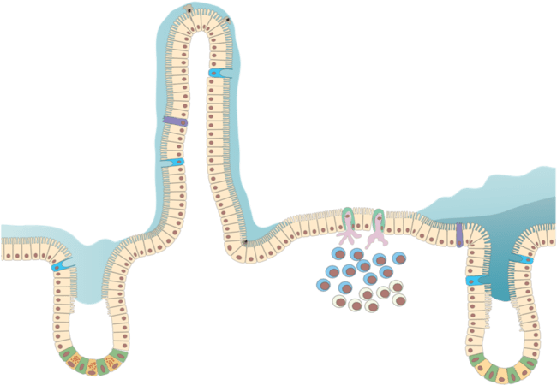
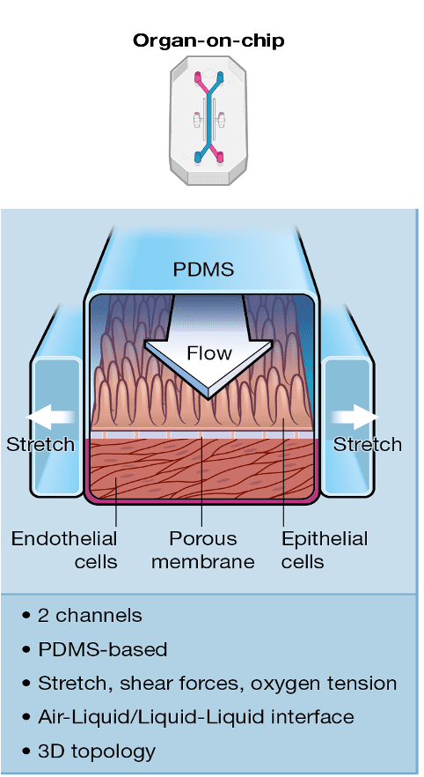
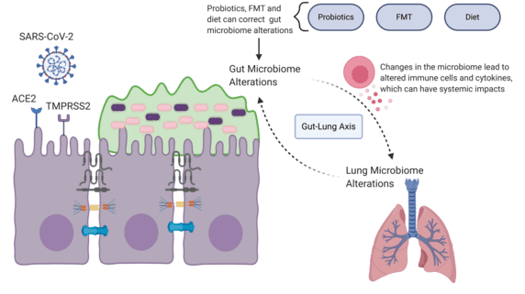
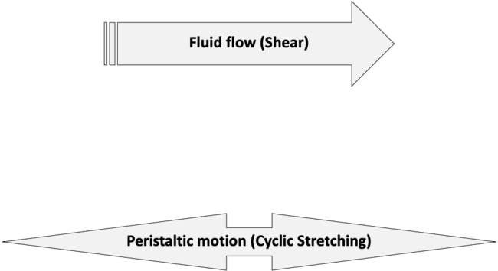
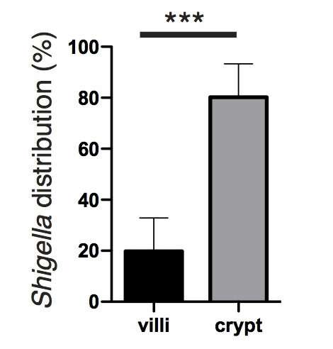
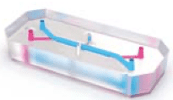
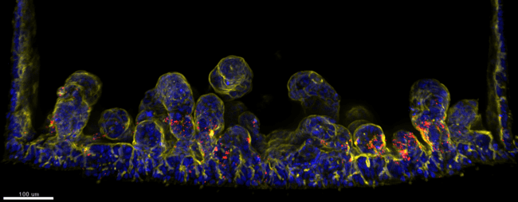
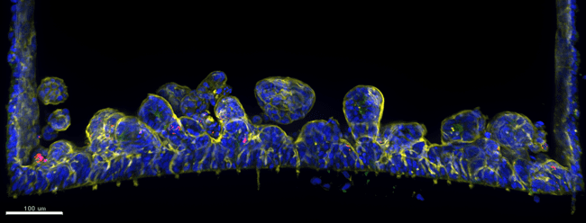
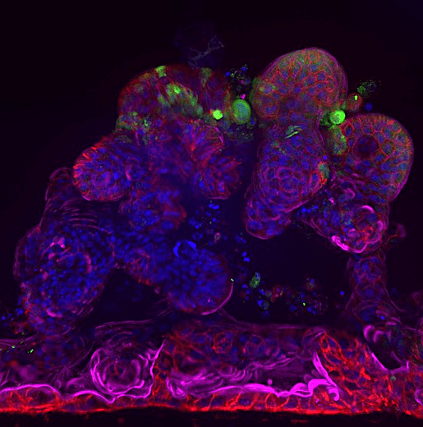
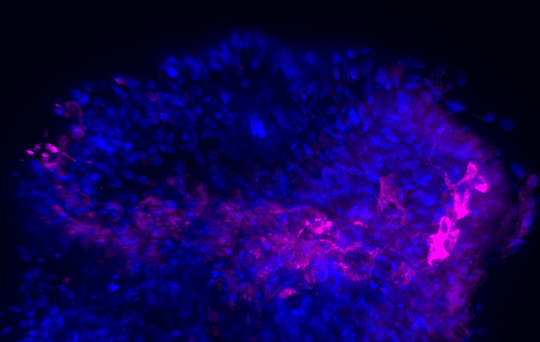
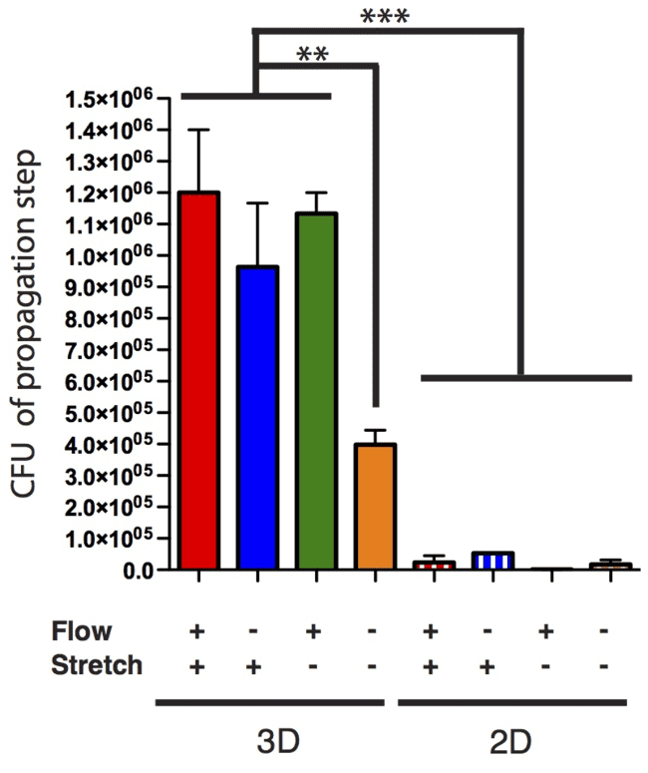
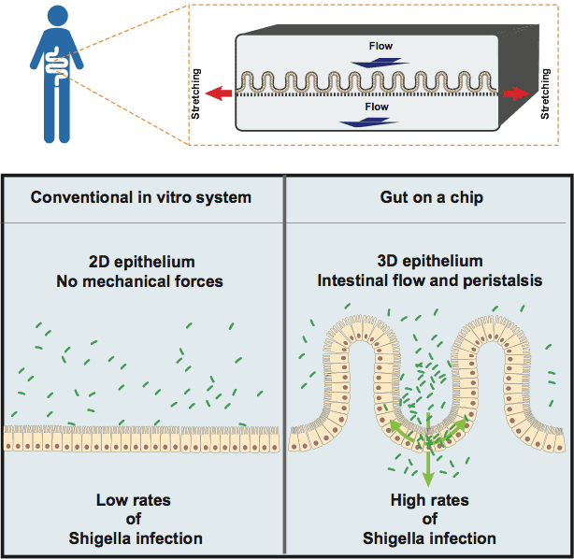
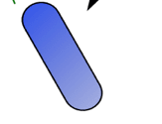
Impact of intestinal physical forces on the tissue organization and consequence on SARS-CoV-2 invasion and replication
Group: Intracellular trafficking and tissue homeostasis, department Biologie Cellulaire et Infection
Institut Pasteur, 28 rue du Dr Roux 75015 Paris
Remigiusz Walocha, Dr. Nathalie Sauvonnet, directrice de recherche, HDR
Abstract
SARS-CoV-2
Cells contain mechanosensitive molecules that can sense external forces and translate them to signaling cascades modifying gene expression and tissue organization. Organ-on-chip technology allows at recapitulating the full hallmark of the gut interface organized in 3 dimension (3D) and mechanically stimulated. Our lab saw that SARS-CoV-2 enters preferentially in differentiated cells of colon/ileum and better in 3D-organised barrier mechanically stimulated.
The SARS-CoV-2 is a pathogen that can enter in the cells using the receptor ACE2, present not only in the lung but also in the gut. This allows it to infect also the enterocytes, leading to some intestinal symptoms. Sometimes it is also correlated to a severe outcomes of the disease COVID-19. The Gut-Lung axis in the infection is still unclear and more studies are crucial to understand it. For these reasons it is important to evaluate if intestinal topology and mechanical forces could impact the infection of SARS-CoV-2.
SARS-CoV-2 infection in gut-on-chip maturated Caco-2
Using the Caco-2 colonic cell line, my host lab observe an increase of SARS-infected cells using the GoC, which is 3.5 more compared to petri dish. Moreover, they observed by SEM, that SARS-CoV-2 reorganized the colonic barrier, especially the microvilli.
Shigella
NI I
Shigella was the first pathogen investigated to understand how the 3D microarchitecture and mechanical forces impact on its infection of the epithelial barrier. Shigella is an enteroinvasive bacteria which reservoir is restricted to human colon. Moreover, it is immobile and not adherent because of the absence of flagellum and adhesin. First of all it has been shown that Shigella is 10000-fold more infectious in gut-on-chip (GoC) than in Transwell. It could be due to the 3D epithelium organization and to mechanical forces present in the GoC and not in the transwell. Successive observations made with the Scanning Electron Microscopy (SEM) detected an enrichment of Shigella in intestinal crypts. Moreover, the stretching of the epithelium enhances the Shigella colonization speed, with an increase by 2.5-fold upon stretch.
% of infected cells
3.5-increased infection in chip
compared to petri dish
Transwell
Intestine-Chip
1 u
3D epithelium organization
2. SARS-CoV-2 infection on colon and ileum-on-chip
With portion of healthy tissue removed during surgical resection, it was possible to grow some human organoids in a 3D-culture matrigel and load them into chips, in order to have human colonic organoids-on-chip. The analysis demonstrate that SARS-CoV-2 infects and replicates in both ileum and colon, and the 3D-architecture and mechanical forces of the gut seem to enhance the viral infection, proved by a higher amount of viral RNA copy in cells under the fluid-flow compared to cells under no force.
Mechanical forces:
Flow and stretching
Shigella (TSAR)
Bacterial virulence?
Shigella (TSAR)
Virulence ON
Virulence OFF
Maturation for 1 week with mechanical stimulation
The topology and the mechanical forces seem to have an impact on Shigella invasion too. Tissue rheology analysis demonstrated an enrichment of the pathogen in higher tension area and analyzing the epithelium under cyclic stretching induction, it was possible to evaluate not only a local tension of the tissue, but a higher rate of virulent bacteria, a higher rate of bacterial colocalization with actin and a higher bacterial uptake.
Also propagation is affected by topology and mechanical forces, increasing the Shigella infection efficiency.
Stretching
No Stretching
Viral spreading through the colon barrier
10 X
Viral RNA copy /ul cell extract
Shigella
Actin
Nucleus
Shigella
Actin
Nucleus
SARS-CoV-2
Dapi
2D
No force
Chip 3D
+ Fluid-Flow
Stretch
SARS-CoV-2
ACE2
b-Catenin
DAPI
3D-architecture and mechanical forces of the gut enhance SARS-CoV-2 infection
No Stretch
SARS-CoV-2
Virulence activated bacteria (TSAR)
Flow
Stretch
Shigella
Next Steps
Characterize the effect of mechanical forces on transcription and organization of the gut using primary colon/ileum-on-chips and modulating the mechanical forces, we will analyze gene expression (RT-PCR) and cell polarization (immunofluorescence (IF)).
Impact of identified forces-regulated factors on SARS-CoV-2 infection
Analyze SARS-CoV-2 invasion (IF, RT-PCR) upon forces modulation in colon/ileum-on-chips. This will determine if differences are linked to expression level and/or cellular distribution of known players of SARS invasion (ACE2, TMPRSS2, cholesterol).
Uncover how the mechanical stimulation governs SARS-CoV-2’s cell tropism.
Flow
Stretch

