Slide 1
TAMs targeting in vivo gene therapy in PDAC
Di Roma Claudia
Gambelli Jasmine
Karayagmurlu Deniz
Gene Therapy 2021-2022
Prof. Saggio Isabella
Tutor: Burla Romina

Slide 2
BACKGROUND
TUMOR-ASSOCIATED MAGROPHAGES
Promote tumor progression by:
Promoting genetic instability
Nurturing cancer stem cells
Supporting metastasis
Taming protective adaptive immunity
Inducing therapeutic chemoresistance
PANCREATIC DUCTAL ADENOCARCINOMA
Only cured by surgical resection in its early stage
85% of pancreatic cancer cases
5-year overall survival of less than 10%
TAMs are the most abundant ICs population in pancreatic tumor stroma
TAMs targeting approaches in PDAC
already investigated in pre-clinical models :
Depletion
Inhibition of recruitment
Reprogramming
Notes:
Tumor microenvironment (TME) is fundamental in cancer development. It shapes the intracellular program of cells regulating their functionality through cytokines, growth, transcriptional factors, oxygen levels and nutrients. Immune cells in the TME reprogram their phenotype to a tumor- associated one. In this context tumor-associate macrophages (TAMs) are one of the main cellular components, indeed in solid tumors consist up to the 50% of the mass. TAMs contribute to tumor progression at different levels: by promoting genetic instability nurturing cancer stem cells, supporting metastasis and taming protective adaptive immunity. Furthermore they can induce therapeutic chemoresistance. Massive infiltration of TAMs or enrichment of TAM-related markers, at least the ones characterizing the M2 phenotype, usually indicate cancer progression and a poor prognosis.
Pancreatic ductal adenocarcinoma (PDAC) is a highly lethal malignancy. PDAC is only cured by surgical resection in its early stage, but there remains a relatively high possibility of recurrence. Pancreatic ductal adenocarcinoma takes a proportion of 85% in pancreatic cancer cases and is still one of the most malignant tumors with 5-year overall survival of less than 10%. The development of PDAC is closely associated with the tumor microenvironment. Tumor-associated macrophages (TAMs) are one of the most abundant immune cell populations in the pancreatic tumor stroma. The role of TAMs in PDAC, is to promote PDAC development and progression by contributing to chronic inflammation, promoting cancer stemness, desmoplasia, immunosuppression, angiogenesis, inducing EMT, tumor invasion and metastasis, and mediating drug resistance. For these reasons this kind of cancer it is an optimal choice for the treatment targeting TAMs. Indeed TAMs is an emerging field of interest, there are many researches on TAM-focused therapeutic strategies that have the potential to complement and synergize with both chemotherapy and immunotherapy. The principle strategies developed in pre-clinical models of PDAC aim to deplete TAMs, inhibit their recruitment or reprogramming TAMs towards the M1 phenotype, as M1 macrophages have been shown playing a tumor-suppressive role, whereas the phenotype M2 has been shown pro-tumoral.

Slide 3
AIM of the PROJECT
01.
02.
03.
Induce Tumour-associated Macrophages suppression
In order to:
How
Decrease tumour progression
Prevent metastasis development
Synergize with Chemotherapy
Adeno-associated Vector in vivo Gene Therapy on PDAC mouse model
Expressing a suicide gene in TAMs
Notes:
The aim of the project is to test if tumour-associated macrophages suppression can slow down tumour progression and increase chemotherapy efficacy avoiding the chemoresistance insurrection. We decided to make an in vivo gene therapy in a mouse model of pancreatic ductal adenocarcinoma by using an Adeno-Associated Vector that specifically targets pancreatic TAMs and expresses a suicide gene.

Slide 4
TOOLS
Induce Tumour-associated Macrophages suppression
SUICIDE GENE
VECTOR
PROMOTER
ANIMAL MODEL
HSV-TK
AAV6
KPC (LSL-Kras^{G12D/+};LSL-Trp53^{R172H/+};Pdx-1-Cre)
CD163
AAV Genome
ITR
CD163 Promoter
Suicide gene
CD163
Promoter
GFP
ITR
CMV Promoter
E4
E2a
VA
+
CMV Promoter
REP
CAP
Helper Plasmid
HEK-293E1a+/
E1b55K+
HEK-293
E1⁺
Recombinant AAV6 with HSV-TK and GFp
Notes:
The recombinant AAV vector is produced using as package cell line the HEK-293, cotransfected with the expression cassette containing the transgene we aim to express (HSV-TK) and a reporter gene (GFP) enclosed between 2 ITRs, a plasmid containing Rep and Cap genes, that allow the formation of the capsid and the replication, and an Helper plasmid containing the adenoviral E4, E2A and VA RNA genes necessary for the replication of the recombinant AAV (The E1a and the E1B55K genes are expressed from the HEK-293 cell line itself).
The transgene HSV-TK (Herpes simplex virus thymidine kinase) is a suicide gene that works converting Ganciclovir (GCV) into the monophosphorylated metabolite, further phosphorylated by the host cell kinase. This triphosphate form of GCV (deoxythymidine triphosphate) inhibits DNA polymerase, blocking the both nuclear and mitochondrial DNA synthesis and inducing the apoptosis cascade. Achieving HSV-TK expression in TAMs and administrating GCV we induce TAMs apoptosis.
Both the suicide gene and the reporter gene (GFP) are expressed under CD163 promoter, in order to induce the expression of the cassette only in TAMs. Indeed CD163 is a marker of M2 macrophages, expressed on TAMs surface.
The serotype we have chosen is the AAV6, that shows tropism for pancreatic cells (and that have been used in previous studies on PDAC).
The murine model of PDAC used for in vivo experiments is the KPC Model (LSL-Kras^{G12D/+};LSL-Trp53^{R172H/+};Pdx-1-Cre).

Slide 5
EXPERIMENTAL PLAN :
IN VITRO
1. Cells extraction from KPC⁺
4. INCUBATION WITH CHEMOTHERAPEUTIC AGENT
2. TRANSFECTION
3. IN VITRO ASSAYS
Transfection efficacy
TAMs count
TAMs apoptosis
HSV-TK and control treated with GEM
HSV-TK
control
5. INJECTION of 40 x KCP mices
IN VIVO
10. TUMOR WEIGHT AND METHASTASIS
7. PET
9.IMMUNOHISTOCHEMISTRY
6. CHEMOTHERAPY
10 HSV-TK
10 control
TAMs count
TAMs apoptosis
8. SACRIFICE
20 injected with HSV-TK
20 injected with control
Notes:
With the method already seen are producend 2 vectors : in one is cloned the HSV-TK and the GFP gene as reporter, and the other is a control expressing only the GFP gene.
The experimental plan is divided in 2 parts : in vitro and in vivo. The assays both in vitro and in vivo aim to compare the amount of TAMs and their apoptosis rate and the efficacy of chemotherapy with and without the expression of HSV-TK.
In vitro : Cells are extracted from the murine model KPC. The cells are cultured in two different plates (both with GCV in the soil). One cell culture is transfected with HSV-TK (and GFP as reporter gene), the other cell culture with the control (GFP only). First is assessed the efficacy of transfection in both the cell cultures. Further assays aim to assess the TAMs amount and the rate of TAMs apoptosis in both the cells transfected with the HSV-TK and in the control.
Then both the HSV-TK and control are treated with the chemotherapeutic agent Gemcitabine, in order to analyze the drug metabolism .
In vivo : the in vivo assays are performed on a cohort of 40 mices . They are divided in 2 groups : one is injected with HSV-TK vector (20 mices), the other one with the control (20 mices). After the vector injection each group of 20 mices- the HSV-TK injected, and the control- is divided into 2 groups : 10 mices are treated with chemotherapy (Gemcitabine, GEM), the other 10 mices are used as control. Such that the initial cohort of 40 mices is divided in 4 groups, each composed by 10 mices : (1) HSV-TK; (2) control; (3) HSV-TK +GEM; (4) control + GEM. First is assessed tumor progression and metastatization in living mices by performing PET. Then mices are sacrificed. Once is assessed the efficacy of transfection, in all the groups, are performed histochemical assays on HSV-TK and control group that aim to assess the amount of TAMs. Further histochemical assay to assess the TAMs apoptosis rate is performed on HSV-TK, HSV-TK+GEM and control +GEM groups. Finally ulterior assays are performed to evaluate the tumor growth and the methastasis formation among all the 4 groups.

Slide 6
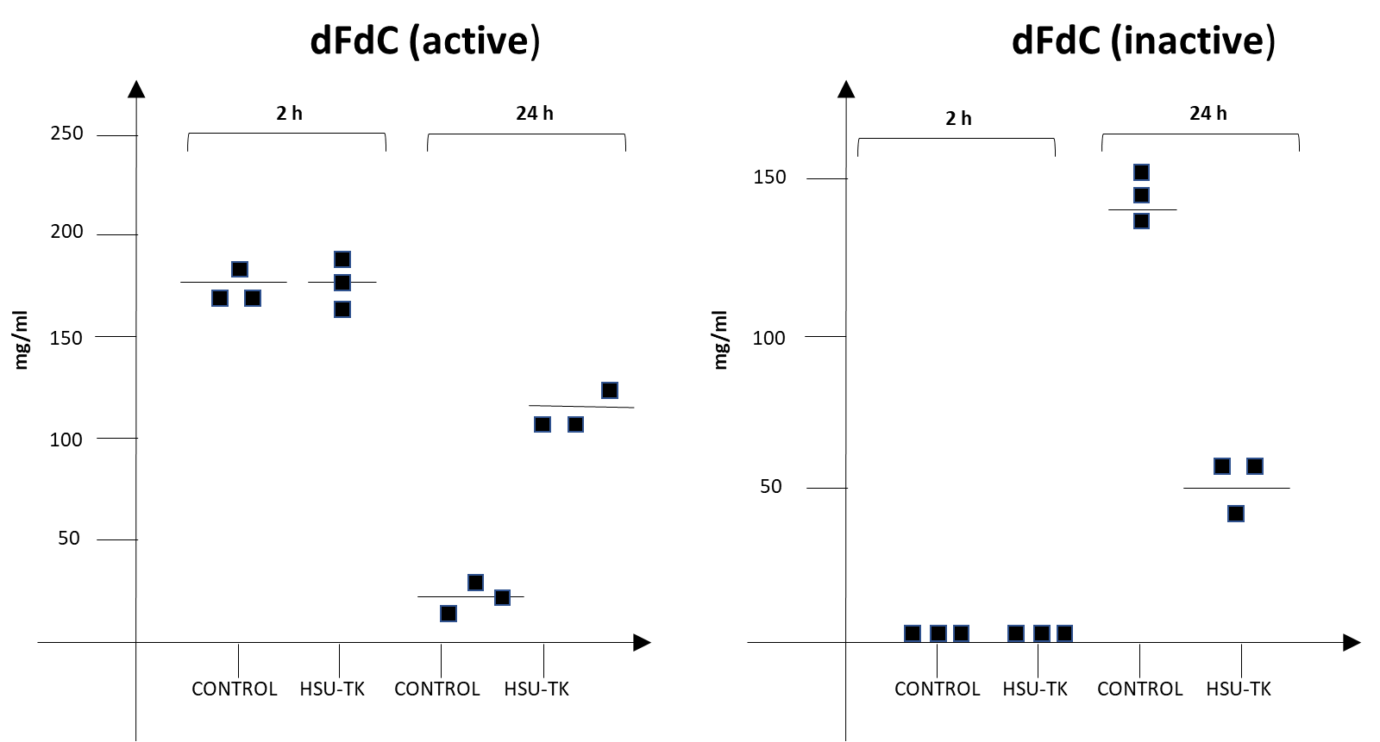
IN VITRO
Adapted from Kaila Q. et al. Mol Ther Methods & Clin Dev, 2017 [1]
Cioffi M. et al, Clinical Cancer Research, 2015 [2]
experiments and espected results
control
Immunofluorescence assay – assess the efficacy of transfection
FACS for CD163 –amount of TAMs with vs without HSV-TK
FACS for Annexin V – amount of apoptotic TAMs with vs without HSV-TK
Incubation with Gemcitabine and LC-MS/MS to assess the drug metabolism
HSV-TK
CD163
control
HSV-TK
dFdU (inactive)
control
Adapted from Bucholz S.M et al. Cancers, 2020 [3;4]
HSV-TK
Notes:
The cells were extracted from the murine model KPC, a group was transfected with the recombinant vector with HSV-TK + GFP as reporter gene, the other with the control only containing the GFP. At first it is verified that the vector has been transfected in the cells checking for the GFP fluorescence emission and we were able to see that in both cases it happened.
In order to quantify the amount of TAMs it was performed a flow cytometry for CD163 – an antigen specific for the monocyte – macrophages lineage. It was performed both on the transfected cells and on the control, showing that the expression of the suicide gene induces the decrease of the TAMs population.
It was made a flow cytometry for Annexin V to assess that the apoptosis has occurred aafter the transfection. We could observe that in the cells transfected with the suicide gene the apoptosis was significantly higher than apoptosis in the control.
TAMs are responsible for chemoresistance to Gemcitabine, as they can transform it from the active metabolite (dFdC) to the inactive one (dFdU).
Both the cell cultures (the one transfected with the suicide gene HSV-TK and the negative control) were incubated with 1 microM of Gemcitabine.
The drug metabolism of Gemcitabine was analyzed by liquid chromathography-tandem mass spectrometry (LC-MS/MS) of the supernatant respectively 2 and 24 h treatment with gemcitabine. The active metabolite of the drug (dFdC) after 24 h results increased in the HSV-TK transfected cells with respect of control. Viceversa the inactive metabolite (dFdU) results decreased after 24 h in the transfectd HSV-TK cells with respect to the control. Thus the suppression of TAMs leads to an higher concentration of active Gemcitabine in vitro, may reducing chemoresistance in vivo.

Slide 7
IN VIVO
Adapted from Cheng X. et al., Aging, 2021
experiments and espected results
control
Positron emission tomography/computed tomography (PET/CT)
Immunofluorescence
Immunohistochemistry
Tumour progression analysis
Metastasis analysis
CC3 assay
control
HSV-TK
Adapted from "Florian R. et al., Gastroenterology 2002
Notes:
Once completed the in vitro experiments and verified that everything is on point we passed to the in vivo testing. So we transfected the mices, one group of 20 with the empty vector (control), one (group of 20) expressing the suicide gene (HSV-TK) by retrograde ductal delivery via cannulation of the common bile duct.
We have done a biopsy of the mice pancreas and performed an immunofluorescence assay to check the GFP expression in order to know that the transfection has occurred. And we could observed that indeed in both cases, the vector with the suicide gene and the control, the transfection was successful. (2)
After 21 days we made a Positron emission tomography/computed tomography (PET/CT) on both mice and we could observe primary pancreatic tumor and liver metastatic lesions in both but there was a significantly higher liver metastasis in the control group compared to the TAM-depletion group, and also the dimensions of the primary tumour were bigger (1).

Slide 8
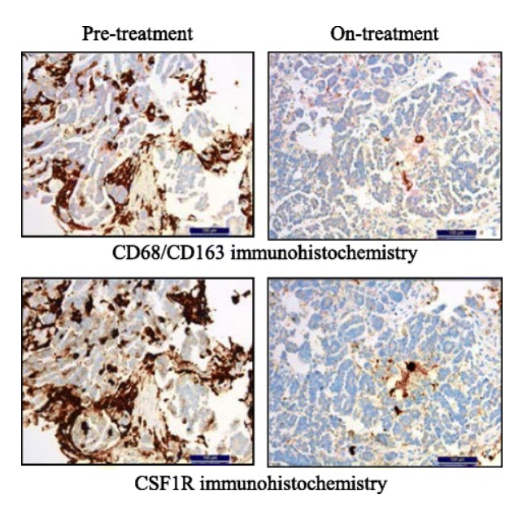
HE
control
HSV-TK
Adapted from Jonathan B. et al., Cancer research, 2013
CD68
THEORY 1
THEORY 2
control
HSV-TK
HSV-TK
HSV-TK
Venus has a beautiful name and is the second planet from the Sun. It’s terribly hot, even hotter than Mercury
HSV-TK
Adapted from Bucholz S.M et al. Cancers, 2020; Cheng X. et al., Aging,2021
Notes:
Then we performed some immunohistochemistry assays; in one case using hematoxylin-eosin dyes for looking at the tissue morphology and CDC8 staining to visualize the macrophages expression in both samples, the one treated with the suicide gene and the control. We observed that the cells expressing the suicide gene had a tissue morphology similar to healthy pancreas and that the expression of macrophages marker CD68 was lower than its expression in the control that showed instead a tumoral phenotype. Furthermore we made an assay using antibodies against TAMs surface marker CD163 and also against CSF1R Macrophage colony-stimulating factor 1 receptor, the receptor of myeloid growth factor whose expression is important for the tumour progression. So the expression of CD163 and CSF1R were tested in the group expressing the suicide gene and in the control and it was possible to see that the expression of both was significantly reduced in the HSV-TK group suggesting that the suicide gene worked (3).
We made some analysis in order to understand if TAMs suppression effectively inhibit tumour growth and can increase chemotherapy with Gemcitabine efficacy by looking at the wet tumour weight and volume of mice sacrificed at different times. We observed that TAMs suppression as single agent modestly slows PDAC tumor growth, similar to Gemcitabine therapy. To determine whether TAMs suppression could improve responses to chemotherapy, we treated mice with Gemcitabine alone (in the control) or in combination with the TAMs suppression. We found that the combination dramatically slowed tumor progression. We observed that Gemcitabine reduced tumor growth (compared with parallel mice sacrificed at the start of treatment, Rx Start) by 32% as compared with vehicle-treated tumors, whereas HSV-TK treatment plus Gemcitabine reduced tumor growth by 81% (4).

Slide 9
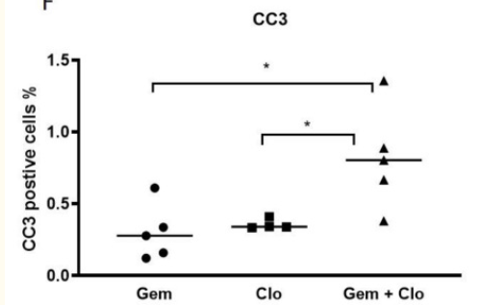
Adapted from Jonathan B. et al., Cancer research, 2013
positive cells %
HSV-TK
HSV-TK
Gem
HSV-TK
Gem + HSV-TK
Adapted from Bucholz S.M et al. Cancers, 2020
Notes:
We observed the frequency and/or severity of disseminated tumors in the perennial cavity or liver is depicted as the proportion of mice with gross tumors at necropsy. Similar to human PDAC, the mice develop hepatic and peritoneal metastatic disease. In mice bearing tumors, gemcitabine or TAMs suppression alone reduced peritoneal metastases, and combined treatment regimens had an additive effect. Gemcitabine or TAMs suppression alone also decreased the frequency of hepatic metastases; Consistent with these results, HSV-TK expression plus gemcitabine also increased the survival of tumor-bearing mice (5).
Then we made the Cleaved Caspase 3 assay, CC3 is a hallmark of the apoptosis and it is produced by both intrinsic and extrinsic pathway; immunohistochemistry revealed that the number of cleaved caspase-3 increased significantly with the combination of the Gemcitabine chemotherapy and the gene therapy compared to the two therapies alone giving an ulterior corfirmation of what observed in the other experiments (6).

Slide 10
costs
General Lab Equipments:
Cost for experiments:
Positron emission tomography/computed tomography (PET/CT) $ 750
Immunofluorescence $ 570
Immunohistochemistry $ 250
Tumour progression analysis $ 200
Metastasis analysis $ 300
CC3 assay $ 250
2000$/ year
pAAV6 Vector
150 $ / year
LSL-KrasG12D/+ Mice Model
255 $ / 2F, 1M
TOTAL
1 Post-Doc 20.400 € / year
2 PhD 26.400 € / year
$ 149.325.000/3 years
Notes:
Depending on our research, total and sub-divided costs are expected to be as presented above.
General lab equipments cost approximately 2000 €/year. It includes from used pipette tips to gloves etc. during the whole experiments.
pAAV6 Vector costs 75 $, (we might need a pair per year/ in anycase.)
We will order 1 mice model and it already includes 2 female and 1 male and we will produce the rest of the mice we will need.
Cost for experiments show variety as; PET/CT $ 750 , Immunofluorescence $ 570 , Immunohistochemistry $ 250, tumor progression for $200, metastasis analysis for $ 300 and CC3 assay $ 250,
Moreover, during the entire project, 1 post-Doc and 2 PhD are required to perform the studies. As an average salary per year it costs 20.400 and 26.400 Euros, respectivelty.
At total, the entire project with the full expenses will cost approximately,149.320.000 dollars, assuming that we will need three years to complete it.

Slide 11
PITFULLS and SOLUTIONS
Translatability between Pre-Clinical models and human patients
Limited markers to discriminate between TAMs and normal Macrophages
Minimizing off-target side effects
Models that mimic the stage of cancer in which the therapy is meant to be tested in clinical trials.
Increased accessibility to novel technologies of single cell-sequencing and transcriptomics
Intraductal delivery
Notes:
1: Many studies have shown that the tumor microenvironment at the primary site can differ from that of metastasis. Thus, while a TAMs depleting approach works in decreasing the primary tumor growth in mice, the same approach does not give the same outcome in PDAC patients with advanced disease. To maximize the translatabilitybetween preclinical models and humans can be used models that mimic the stage of cancer in which the therapy is meant to be tested in clinical trials. An example of model realized to recapitulate advanced disease in mice is the intrasplenic pancreatic tumor model.
2 : There are currently limited markers to distinguish TAMs from normal macrophages in non-tumor tissues.
The increased accessibility to novel technologies such as including mIHC, CyTOF, high-throughput scRNA-seq, and spatial transcriptomics can help to identify novel TAMs targets improoving the outcome of TAMs based approaches. Moreovere these technologies can also help to get a more complete landscape of the of the inter-tumoral and intra-tumoral heterogeneity in terms of macrophages density shown in previous studies that have identified different subtypes of PDAC.
3: Because systemic macrophage depletion in an immunocompromised patient treated with chemotherapy may increase vulnerability to infections, and because systemic delivery of anti-TAMs agents (in particulary macrophage depletion inhibiting CSF1R) has been shown in previous studies to promote inflammation. Thus, we purpose instead of systemic administration the intraductal delivery, which have been demonstrated safe and effective.

Slide 12
CONCLUSIONS
TAMs represent an attractive therapeutic target to impair tumour
TAMs suppression effectively induces:
Tumour progression inhibitions
Reduction of metastasis
Complementary effects when combined with chemotherapy
Further research is required to comprehensively characterize TAMs subsets
Notes:
Given the multiples roles of TAMs in promoting PDAC and their correlation with a poor prognosis, they represent an attractive therapeutic target to impair tumor development and progression. There are many different strategies aiming at targeting TAMs in pre-clinical models, these therapeutic agents also demonstrate complementary effects when combined with chemotherapy and immune check-point blockade, suggesting the additive benefit of targeting TAMs. However, despite showing great potential there are some difficulties in part due to the complexity associated with the nature and origin of TAMs, and the diverse heterogeneity of PDAC tumors in humans compared to mice. Further research is therefore required to comprehensively characterize TAM subsets within the tumor microenvironment.

Slide 13
THANKS!

Slide 14
REFERENCES
Poh, Ashleigh R, and Matthias Ernst. “Tumor-Associated Macrophages in Pancreatic Ductal Adenocarcinoma: Therapeutic Opportunities and Clinical Challenges.” Cancers vol. 13,12 2860. 8 Jun. 2021, doi:10.3390/cancers13122860
Buchholz, S.M.; Goetze, R.G.; Singh, S.K.; Ammer-Herrmenau, C.; Richards, F.M.; Jodrell, D.I.; Buchholz, M.; Michl, P.; Ellenrieder, V.; Hessmann, E.; Neesse, A. Depletion of Macrophages Improves Therapeutic Response to Gemcitabine in Murine Pancreas Cancer. Cancers 2020, 12, 1978. https://doi.org/10.3390/cancers12071978
Karjoo Z, Chen X, Hatefi A. Progress and problems with the use of suicide genes for targeted cancer therapy. Adv Drug Deliv Rev. 2016 Apr 1;99(Pt A):113-128. doi: 10.1016/j.addr.2015.05.009. Epub 2015 May 22. PMID: 26004498; PMCID: PMC4758904.
Cioffi M, Trabulo S, Hidalgo M, Costello E, Greenhalf W, Erkan M, Kleeff J, Sainz B Jr, Heeschen C. Inhibition of CD47 Effectively Targets Pancreatic Cancer Stem Cells via Dual Mechanisms. Clin Cancer Res. 2015 May 15;21(10):2325-37. doi: 10.1158/1078-0432.CCR-14-1399. Epub 2015 Feb 23. PMID: 25717063.
Xiong C, Zhu Y, Xue M, Jiang Y, Zhong Y, Jiang L, Shi M, Chen H. Tumor-associated macrophages promote pancreatic ductal adenocarcinoma progression by inducing epithelial-to-mesenchymal transition. Aging (Albany NY). 2021 Jan 10;13(3):3386-3404. doi: 10.18632/aging.202264. Epub 2021 Jan 10. PMID: 33428605; PMCID: PMC7906203.
Mitchem JB, Brennan DJ, Knolhoff BL, Belt BA, Zhu Y, Sanford DE, Belaygorod L, Carpenter D, Collins L, Piwnica-Worms D, Hewitt S, Udupi GM, Gallagher WM, Wegner C, West BL, Wang-Gillam A, Goedegebuure P, Linehan DC, DeNardo DG. Targeting tumor-infiltrating macrophages decreases tumor-initiating cells, relieves immunosuppression, and improves chemotherapeutic responses. Cancer Res. 2013 Feb 1;73(3):1128-41. doi: 10.1158/0008-5472.CAN-12-2731. Epub 2012 Dec 5. PMID: 23221383; PMCID: PMC3563931.
Quirin KA, Kwon JJ, Alioufi A, Factora T, Temm CJ, Jacobsen M, Sandusky GE, Shontz K, Chicoine LG, Clark KR, Mendell JT, Korc M, Kota J. Safety and Efficacy of AAV Retrograde Pancreatic Ductal Gene Delivery in Normal and Pancreatic Cancer Mice. Mol Ther Methods Clin Dev. 2017 Sep 30;8:8-20. doi: 10.1016/j.omtm.2017.09.006. PMID: 29349096; PMCID: PMC5675991.
Lee JW, Komar CA, Bengsch F, Graham K, Beatty GL. Genetically Engineered Mouse Models of Pancreatic Cancer: The KPC Model (LSL-Kras(G12D/+) ;LSL-Trp53(R172H/+) ;Pdx-1-Cre), Its Variants, and Their Application in Immuno-oncology Drug Discovery. Curr Protoc Pharmacol. 2016;73:14.39.1-14.39.20. Published 2016 Jun 1. doi:10.1002/cpph.2
Wu, Kaiyue et al. “Redefining Tumor-Associated Macrophage Subpopulations and Functions in the Tumor Microenvironment.” Frontiers in immunology vol. 11 1731. 4 Aug. 2020, doi:10.3389/fimmu.2020.01731

