Slide 1
Preventing metastasis in SCLC cells by targeting NF1B transcription factor.
A. Hadziemric | C. Oubad | E. Selita
Tutors:
Prof. Isabella Saggio
Prof. Romina Burla
Notes:
Preventing metastasis in Small Cell Lung Cancer (SCLC) cells by targeting NFIB transcription factor. (Chiraze Oubad, Amina Hadziemric, Erisa Selita)

Slide 2
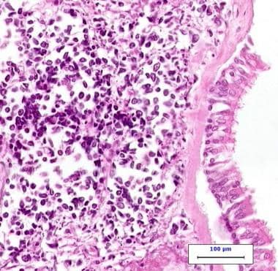
Background:
About the disease:
Highly malignant cancer in lung tissues.
Smoking is the major risk factor for SCLC.
Signs and symptoms: coughing and shortness of breath, hence the difficulty in diagnosis.
Survival rates:
The general 5-year survival rate for people with SCLC is 7%. Depends mostly on the stage of disease.
Highly metastatic; metastasis especially promoted by a transcriptional factor (NF1B).
About NFIB:
NFIB is a DNA binding motif.
Its overexpression leads to progression of tumoral cells.
It has been described as an oncogene.
Notes:
Before we begin to analyze the therapy, it is necessary to have some background on the disease that we are working on. Small cell lung cancer is a highly malignant cancer observed in lung tissues. Most of the time it is triggered by a lifetime of smoking, which is its major risk factor. For small cell lung cancer, a 2-stage system is most often used. Small cell lung cancers are staged as limited stage and extensive stage. Limited stage means that the cancer is only in one lung and maybe in lymph nodes on the same side of the chest. It is called extensive stage if the cancer has spread to the other lung, to lymph nodes on the other side of the chest, or to distant organs. The general 5-year survival rate for people with SCLC is 7%. It mostly depends on the stage of the disease, hence if it is extensive the survival rates are expected to drop. This is a highly metastatic cancer, which means that it can spread fast and promote the progression from limited to extensive. Metastasis is especially promoted by a transcriptional factor (DNA binding motif) called NFIB. The overexpression of NFIB leads to progression of tumoral cells, not only in SCLC but also in other types of cancer. According to several studies, NFIB has been described as an oncogene.

Slide 3
Aim of the project: gene therapy downregulating NFIB
Why SCLC?
Difficult to treat, current therapies are surgeries, chemotherapy and radiation therapy.
Highly prolific and aggressive.
New therapy could substitute the need of invasive therapies or reduce the intensity.
Why NFIB?
Recent studies have shown that this factor, if overexpressed, induces tumor growth and metastasis.
Its role is close to unknown, but its downregulation provides a plausible solution for new therapies.
Delivery methods?
Inhalation, easy way to reach the lungs.
Cell line and animal model for our study:
Cell Line: Human SCLC cells Luc-GFPH69 (with 50% Matrigel)
Animal Model: SCID mice (immunodeficient Rag2-/-cc-/- mice)
Notes:
SCLC is difficult to treat, and current therapies do not provide optimal solutions. They involve surgeries, chemotherapy, and radiation therapy, all of which could be invasive and painful, especially considering that this type of cancer is highly prolific and aggressive. A new combined therapy could substitute the need of invasive therapies or at least reduce their intensity. Several studies cited in this presentation have shown that the overexpression of NFIB induces tumor growth and promotes metastasis. However, its role is still not fully known. It has been shown, nevertheless, that its downregulation provides a good solution for new therapies. We aim to knock down its expression by using siRNA encapsulated in a liposomal vector and deliver the whole complex by inhalation, which is a less traumatic way of delivery, and it could reach the target cells easily.

Slide 4
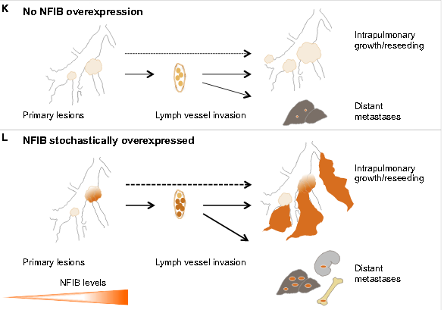
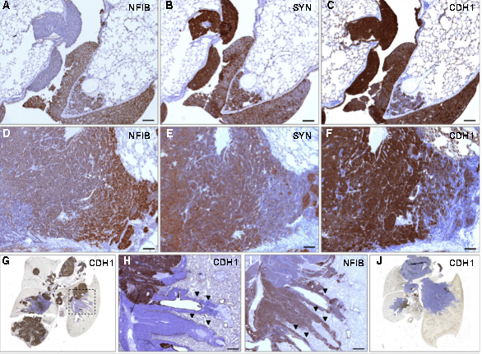
How does the NFIB level expression affect the tissue?
Notes:
(A–C) Early lesions NFIB (A), SYN (B), and CDH1 (C) staining, respectively (Nfib cohort). (D–F) Advanced lesion NFIB (D), SYN (E), and CDH1 (F) staining, respectively (Mycl cohort).(G) Whole lung, CDH1 staining (Mycl cohort).(H and I) Part of the lung indicated with dotted area in (G), CDH1 (H) and NFIB (I), respectively. Invasive sheaths indicated with arrowheads. (J) Whole lung, CDH1 staining (Nfib cohort).(K and L) Diagrams of tumor growth and local and distant metastatic dissemination. NE tumor cells are abundantly found in lymph vessels. Without NFIB overexpression, intrapulmonary dissemination and metastatic load in liver is very limited (K). With NFIB overexpression, there is massive intrapulmonary dissemination, large metastatic load in the liver, and metastasis to kidney and bone (L). Scale bars in (A)–(F) represent 100mm. Scale bars in (H) and (I) represent 500mm.

Slide 5
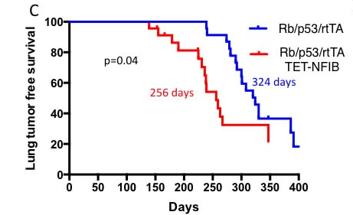
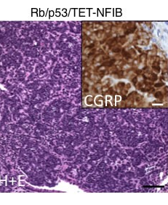
Tumor acceleration promoted by NF1B: graphical and histological representations.
Notes:
Two images that can be interpreted in this way: Kaplan-Meier curve showing acceleration of SCLC in Rb/p53/TET-NFIB compared to the Rb/p53 model. Median survival for each model is indicated and p-value from log-rank test is shown. In cells where NFIB is lacking tumoral progression is slower than in cells where NFIB is overexpressed. Hematoxylin and eosin stain of representative SCLC arising in the Rb/p53/TET-NFIB model, black scale bar, 50mm. Inset: CGRP immunostaining of Rb/p53/TET-NFIB tumor, white scale bar, 10mm.

Slide 6
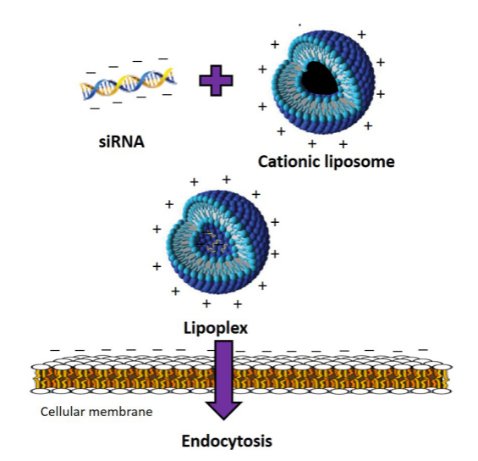
Gene knockdown by transfecting siRNA through a lipid-based delivery vector.
Why a liposome vector?
The cationic lipoplex interacts with the negatively charged cellular membrane leading to enhanced delivery within the cells via endocytosis.
Notes:
After analyzing the role of NFIB in this type of cancer, it was important to us to find a way of downregulating the gene expression. After consulting several studies, we saw best that a siRNA is used. The best way to deliver our siRNA in the target cells is by using a liposome. Liposomes are versatile and well-proven as a means to deliver nucleic acids into cells. So how does it exactly work and why did we choose a liposome vector? The cationic lipoplex, as shown in the picture will interact with the negatively charged cellular membrane which will lead to an enhanced delivery within the cells via endocytosis. The siRNA is encapsulated into the cationic liposome (positively charged) leading to the formation of a lipoplex. The lipoplex then will enter the target cells by interacting with their membrane (negatively charged).

Slide 7
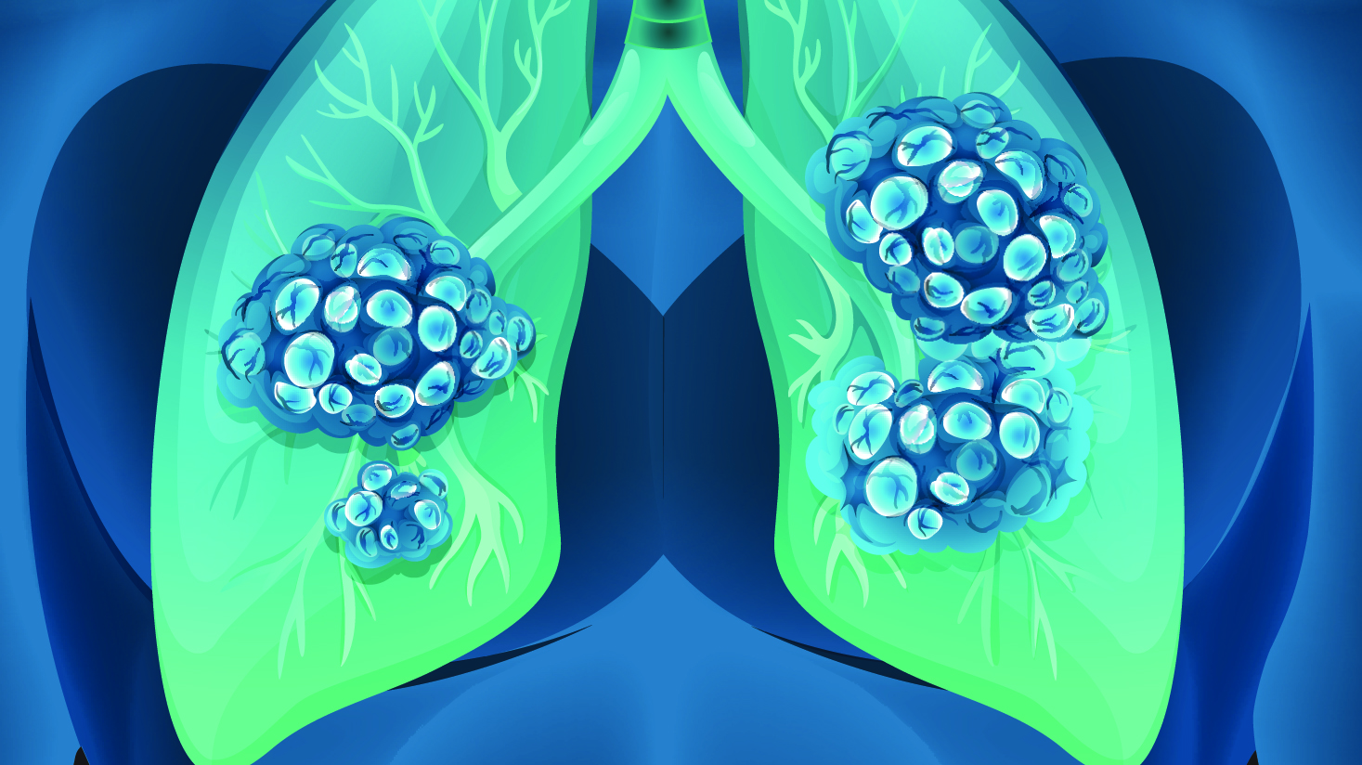
Inhalation therapy:
efficiency and clinical trials.
Notes:
Studies have shown that inhalation therapy (as a delivery method) is promising. There have been some studies and very few clinical trials. There is great potential, however, for this delivery method. The major side effect profile and toxicity of cytotoxic agents were reduced by delivering therapeutic concentrations locally to the lung. Although further studies are required to improve the efficacy of liposomal aerosol chemotherapeutics, the unique targeting options to the lungs clearly shows potential for the combination of active ingredients over the single drug treatment approach.

Slide 8
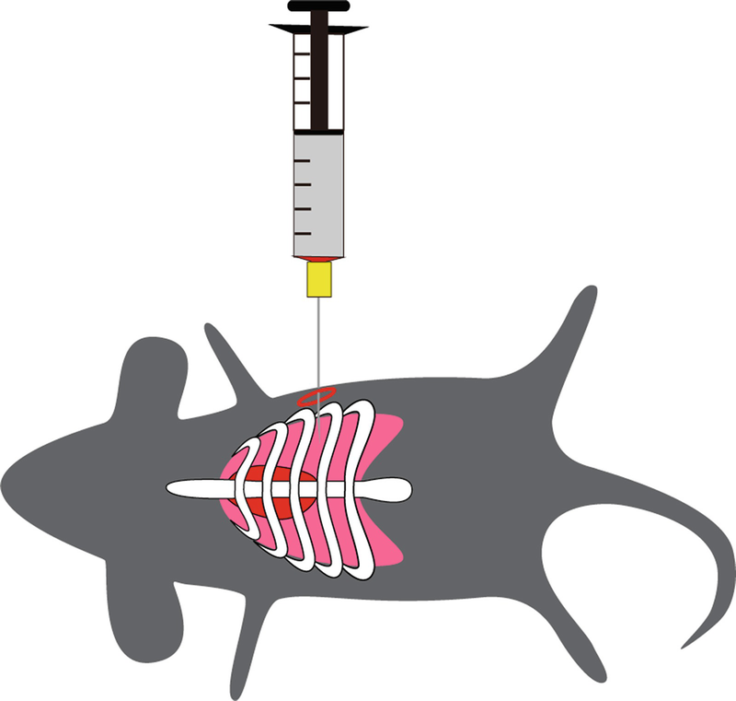
TOOLS
- CATIONIC LIPOSOME VECTOR*modified
- CELL LINE: Human SCLC cells Luc-GFPH69 (with 50% Matrigel)
- ANIMAL MODEL: SCID mice (immunodeficient Rag2-/-cc-/- mice)
- DELIVERY: vibrating mesh nebulizers
Injection of the mouse model whose immune system lacks B-cells,
T-cells and NK-cells with cells Luc GFP H69 in order to create an
orthotopic mouse model.
Notes:
What we need for this study is the cationic liposome vector, a cell line (Human SCLC cells Luc-GFPH69 with 50% Matrigel), an animal model (SCID mice, immunodeficient Rag2-/-cc-/-mice) and an aerosol delivery method (vibrating mesh nebulizers). Our aim is to create an orthotopic mouse model by injecting the mouse whose immune system lacks B-cells, T-cells and NK-cells with the pre-described human cell line.

Slide 9
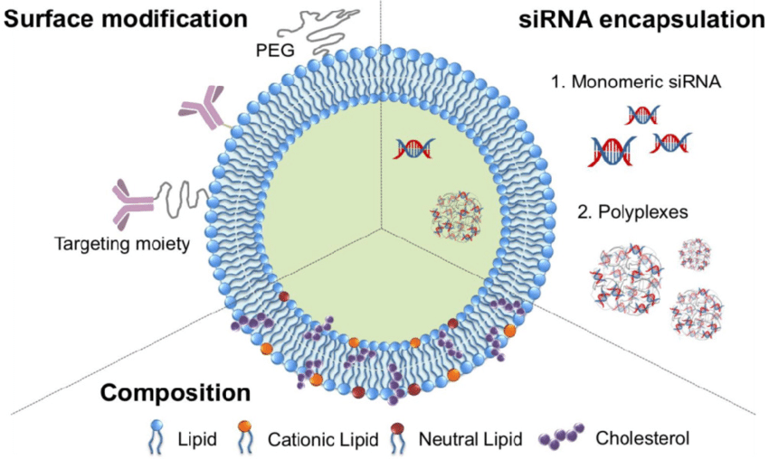
EXPERIMENTAL PLAN - Designing the siRNA liposome vector
https://pubmed.ncbi.nlm.nih.gov/22701467
Notes:
The simplest method to encapsulate siRNA into the core of liposomes is to mix a dry, thin lipid film with an aqueous siRNA solution. For example, a dry lipid film composed of phosphatidylcholine, cholesterols, cationic lipids, and PEG-lipids was hydrated with a siRNA solution to form siRNA-encapsulated cationic liposomes. The cationic lipids (e.g., 1,2-dioleoyl-3-trimethylammonium-propane (DOTAP)) were electrostatically complexed with siRNA, allowing the efficient encapsulation of siRNA into liposomes. The outer surfaces of the cationic liposomes were conjugated with arginine octamers (R8) as cell-penetrating peptides for enhanced cellular uptake and gene silencing. The resultant R8-liposomes encapsulating siRNA effectively inhibited the targeted gene and significantly reduced the proliferation of cancer cells. The siRNA can be designed manually by using this free website or it can be already bought (together with the control siRNA) from a supplier of scientific instrumentation. This website can be accessed by anyone.
The inclusion of cholesterol or high-phase transition phospholipids in liposome formulations has improved the stability of vesicles during nebulization.

Slide 10
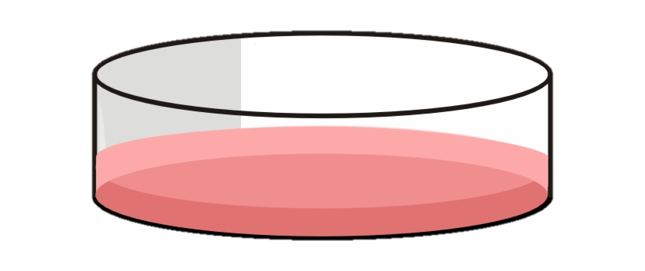
In-vitro experimental plan and expected results.
Addition of cells that are not going to be treated with our GT
Expectations: Cell proliferation.
Addition of cells that are going to be treated with our GT
Expectation: Slower cell proliferation, not cancer-like metabolism.
Notes:
We will use Human SCLC cells Luc-GFPH69 and measure the tumor progression on 2 samples: the control sample in which no siRNA will be transfected and the one where the siRNA is transfected. Cells will grow for 1 to 3 days, according to protocol provided by the manufacturer. The transfection efficiency can be measured by fluorescence microscopy. To assess the gene knockdown, we use Real Time – PCR (as a quantitative method). Western blotting is also a good way to observe protein production.
We use a positive control siRNA to optimize siRNA delivery conditions and to reconfirm high levels of delivery in each RNAi experiment. If a positive control fails to produce the anticipated phenotype, we need to evaluate the experimental conditions and decide if some factors need to be adjusted.
What we would expect, substantially is that the transfected siRNA should stop the proliferation of the cells at a high percentage, which would lead us to proceed in the in vivo experiment.

Slide 11
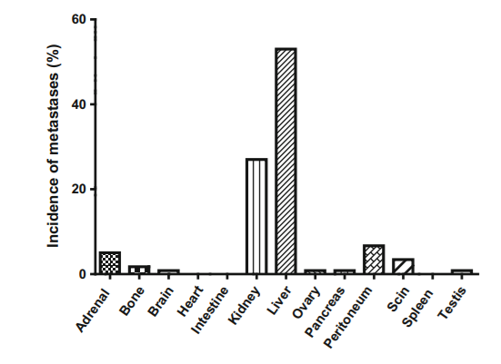
Orthotopic mouse model – in-vivo experimental plan (Taromi, S., Kayser, G., von Elverfeldt, D. et al. An orthotopic mouse model of small cell lung cancer reflects the clinical course in patients. Clin Exp Metastasis 33, 651–660 (2016). https://doi.org/10.1007/s10585-016-9808-8
Notes:
What we would expect, after the gene therapy on the orthotopic mice is that in the mice that were not treated, the tumor will progress at a higher rate (accelerated also due to the fact that the mice are immunodeficient) and in the mice that were treated with the inhalation therapy the metastasis will not occur due to the gene knockdown. At this point, it is important to combine therapies (chemotherapy or surgery) to remove the tumoral cells.
To assess the tumor progression, we use optical imaging.
Metastasis in this type of cancer is observed mostly in kidneys and in the liver (sometimes in the bones). This gene therapy is supposed to lower the incidence of metastasis.

Slide 12
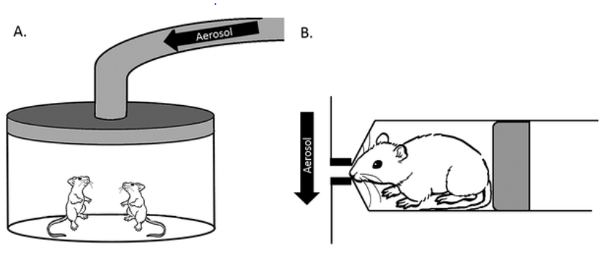
Inhalation of the siRNA liposome therapy with the use of vibrating mesh nebulisers
Price, Dominique & Kunda, Nitesh & Muttil, Pavan. (2018). Challenges Associated with the Pulmonary Delivery of Therapeutic Dry Powders for Preclinical Testing. KONA Powder and Particle Journal. 36. 10.14356/kona.2019008.
Notes:
It was shown that vibrating mesh nebulizers customized with large mesh apertures are less disruptive to liposomes than jet nebulizers, especially when the vesicle size was optimized to be small (e.g. around 1 μm) prior to nebulization.
Mice will inhale for 30 minutes.

Slide 13
Check points before treatment
Western blotting
Proceeding to treat a portion of the mice and leaving some untreated to follow the tumor progression real time without treatment.
Tumor progression
after injection.
(Optical imaging)
Notes:
Before treating the mice with our gene therapy, it is important to assess tumoral progression alongside NFIB expression. This can be done by performing Western Blot to identify the NFIB expression and we can see the tumor progression on the mice using optical imaging. Some mice will be left untreated, and those will be our control mice. What’s expected to happen is that in these mice there will be metastasis, primarily in the liver and kidneys, which will help us understand and determine an approximate number of days needed for the tumor to progress from a tissue to another. After this we will proceed in the same manner with the remaining mice, but prior to metastasis they will be treated with our gene therapy to further investigate whether there will be metastasis or not and observe cell proliferation.

Slide 14
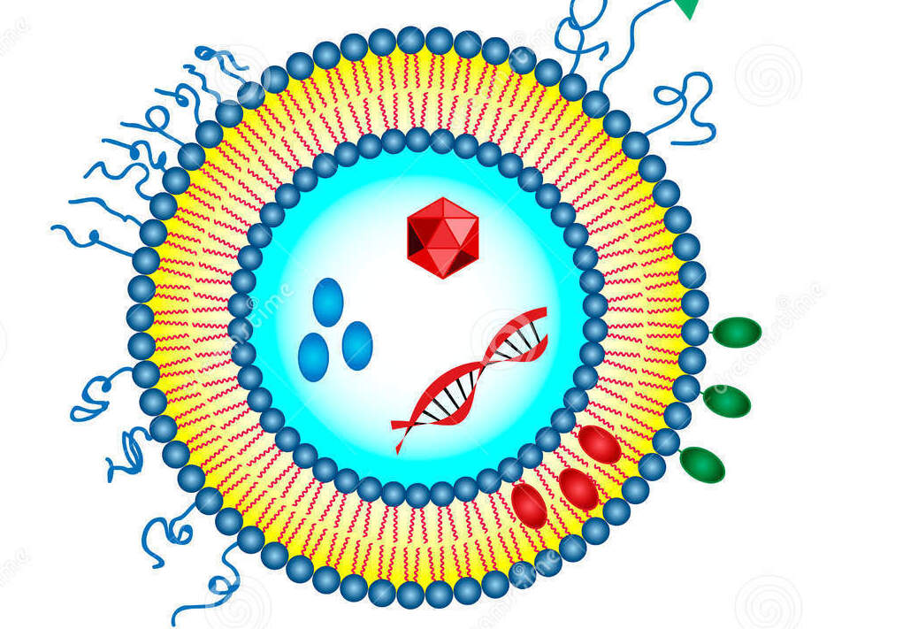
MATERIALS AND METHODS
Liposome vectors: containing the modified siRNA in order to downregulate the NFIB transcription factor.
Orthotopic mice model: severely imunocompromised mice injected with Human SCLC cells Luc-GFPH69.
Control siRNA injection in vitro and vivo
Mesh nebulizers.
Use of already lucifersed cells in order to monitor progression of the cancer in mice.
Western blot: Because siRNA oligonucleotides target mRNA for degradation.
RT- PCR to assess NFIB levels.
Real Time – PCR to assess gene knockdown.
Optical imaging.

Slide 15
Potential limits and their resolutions
Liposome vectors
Fragility of liposomes during
nebulisation.
Cationic liposomes form a corona layer while trying to reach the target site.
(delivery by injection)
The inclusion of cholesterol or high-phase transition phospholipids in liposome formulations has improved the stability of vesicles during nebulisation.
Usage of inhalation delivery
Notes:
L. Digiacomo, F. Giulimondi, M. Mahmoudi, G. Caracciolo Effect of molecular crowding on the biological identity of liposomes: an overlooked factor at the bio-nano interface
Nanoscale Adv., 1 (2019), pp. 2518-2522 (we bypass: CLs pick up plasma protein such as serum albumin, complements, immunoglobulins (Igs), and apolipoproteins to form a corona layer on their surface, providing them with a totally new biological identity that will dramatically alter their fates in vivo.)

Slide 16
Conclusions Future prospects
The gene knockdown in the tumoral cells is efficient: no off-target effects due to the delivery efficiency (inhalation therapy is better than injections).
The mice models and human cell lines are an effective way of conducting the experimental trials. The orthotopic mice mimic human responses.
The downregulation of NFIB slows down the tumoral progression thus stopping metastasis in the kidneys and liver.
The treated mice show a higher survival rate than the untreated mice, leaving space for a combined therapy for the treated mice.
Optimized therapies and increased survival rate for patients affected by SCLC.
Less traumatic and invasive combined therapies to avoid off-target effects, maintaining the healthy adult cells and avoiding tissue lesions post therapy.
Further studies to better analyze the role of NFIB in cells post differentiation.
Potential substitution of current therapies.

Slide 17
BUDGET
Salaries (2 post docs, 2 PhDs) approximately € 130.000
Expected: €144,000

Slide 18
REFERENCES
1. L. Digiacomo, F. Giulimondi, M. Mahmoudi, G. Caracciolo (2019), Effect of molecular crowding on the biological identity of liposomes: an overlooked factor at the bio-nano interface; Nanoscale Adv., 1, pp. 2518-2522
2. Cheol Am Hong and Yoon Sung Nam.(2014) Functional Nanostructures for Effective Delivery of Small Interfering RNA Therapeutics. Article in Theranostics · DOI: 10.7150/thno.8491 · Source: PubMed
3. Ozpolat, B., Sood, A. K., & Lopez-Berestein, G. (2014). Liposomal siRNA nanocarriers for cancer therapy. Advanced Drug Delivery Reviews, 66, 110–116. doi:10.1016/j.addr.2013.12.008
4. Price, Dominique & Kunda, Nitesh & Muttil, Pavan. (2018). Challenges Associated with the Pulmonary Delivery of Therapeutic Dry Powders for Preclinical Testing. KONA Powder and Particle Journal. 36. 10.14356/kona.2019008.
5. Johanna Pruller, Isabella Hofer, Massimo Ganassi, Philipp Heher, Michelle T. Ma, Peter S. Zammit (2021), A modified human Myogenin promoter that is highly active in alveolar rhabdomyosarcoma. Cancer Gene Therapy doi: 10.1038/s41417-020-00225-0
6. Rudokas, M., Najlah, M., Alhnan, M. A., & Elhissi, A. (2016). Liposome Delivery Systems for Inhalation: A Critical Review Highlighting Formulation Issues and Anticancer Applications. Medical principles and practice : international journal of the Kuwait University, Health Science Centre, 25 Suppl 2(Suppl 2), 60–72. https://doi.org/10.1159/000445116
7. Sanaz Taromi, Gian Kayser, Dominik von Elverfeldt, Wilfried Reichardt, Friederike Braun, Wolfgang A. Weber, Robert Zeiser, Meike Burger (2016), An orthotopic mouse model of small cell lung cancer reflects the clinical course in patients. Clin Exp Metastasis, 33:651–660 DOI 10.1007/s10585-016-9808-8
8. Semenova et al., (2016) Transcription Factor NFIB Is a Driver of Small Cell Lung Cancer Progression in Mice and Marks Metastatic Disease in Patients., Cell Reports16, 631–643; The Author(s).http://dx.doi.org/10.1016/j.celrep.2016.06.020
9. Susanne R. Youngren-Ortiz, Nishant S. Gandhi, [...], and Mahavir B. Chougule. Kona. (2017) Aerosol Delivery of siRNA to the Lungs. Part 2: Nanocarrier-based Delivery Systems.; 34: 44–69. Published online 2016 Apr 30. doi: 10.14356/kona.2017005
10. Nan Wu, Deshui Jia, [...], and David MacPherson; Oncotarget. (2016), NFIB overexpression cooperates with Rb/p53 deletion to promote small cell lung cancer. Sep 6; 7(36): 57514–57524. Published online 2016 Aug 24. doi: 10.18632/oncotarget.11583
11. siRNA Design Software for a Target Gene-Specific RNA Interference Yuki Naito, Kumiko Ui-Tei PMID: 22701467 PMCID: PMC3371628 DOI: 10.3389/fgene.2012.00102

