Slide 1


FUS1 gene targeting in order to improve moto-neuronal function in ALS mice model
A Gene Therapy approach
Castrucci C.
Nutarelli S.
Piscopo F.
Romano V.
Rubiu R.R.

Slide 2
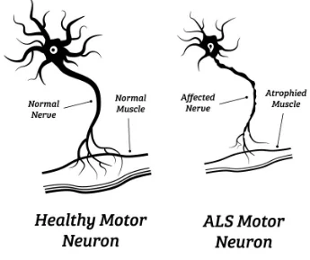
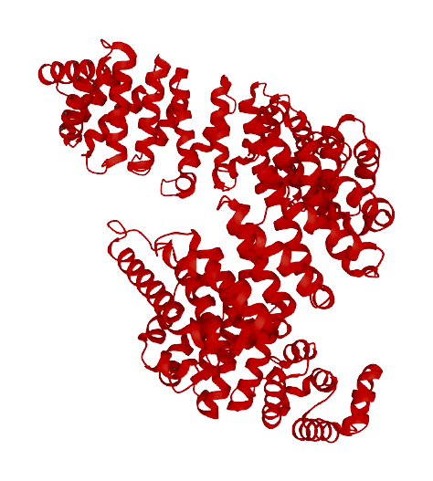
What is ALS?
Amyotrophic Lateral Sclerosis is a neurodegenerative disease causing a progressive loss of motor neurons that control voluntary muscles.
Early symptoms:
Muscle weakness
Difficulty speaking or swallowing
Difficulties with thinking and behavior
The most frequently involved genes are:
SOD1
TARDP
FUS
And why FUS?
The mutated FUS gene causes the most severe outcomes of ALS disease.
Pathological mechanism
  Skipping of exon 14 due to a single nucleotide deletion
  Formation of cytoplasmic granules and inclusions leading to neural dysfunction and degeneration
  Upregulation of HuD protein
Notes:
ALS
Amyotrophic lateral sclerosis (ALS) is a neurodegenerative disorder affecting primarily the motor system. The loss of upper and lower motor neurons (UMN &LMN) in the motor cortex, the brain stem nuclei and the anterior horn of the spinal cord gives rise to progressive muscle weakness and wasting. ALS often has a focal onset but subsequently spreads to different body regions, where failure of respiratory muscles typically limits survival to 2–5 years after disease onset.
ALS is the most common adult motor neuron disease with an incidence of 2 per 100,000 and prevalence of 5.4 per 100,000 individuals. Onset typically occurs in late middle life but there is a form of ALS (juvenile) with onset prior to age 25 years. In 10% of ALS patients, the family history suggests an autosomal dominant inheritance pattern. The remaining 90% have no affected family members and are classified as sporadic ALS (sALS). Currently, there is no cure for ALS and no effective treatment to halt, or reverse, the progression of the disease.
Clinical presentation
The hallmark of ALS is progressive muscle weakness, accompanied by muscle atrophy, fasciculations, muscle cramps and slowness of movements with muscle stiffness. But half of the people with ALS develop at least mild difficulties with thinking and behavior, and about 15% develop frontotemporal dementia.
Pathogenesis
The neuropathological signature of ALS is characterized by loss of the neuromuscular connection, axonal retraction and subsequent cell death of UMNs and LMNs, surrounded by astrogliosis and microgliosis, with ubiquitin‐positive inclusions being observed in surviving neurons.
Multiple molecular pathways have been implicated in the pathogenesis of ALS, such as failure of proteostasis, excitotoxicity, neuroinflammation, mitochondrial dysfunction and oxidative stress, oligodendrocyte dysfunction, cytoskeletal disturbances and axonal transport defects, disturbed RNA metabolism, nucleocytoplasmic transport deficits and impaired DNA repair
Causes
ALS is thought to be caused by a combination of genetic factors and environmental factors. At the genetic level, more than 20 genes have been linked with the disease to date. The most frequently genes involved are SOD1, TARDP, and FUS.
FUS
RNA-binding protein FUS(Fused in Sarcoma) is a member of the FET protein family. FUS has been identified as the hnRNP P2 protein, a subunit of a complex involved in maturation of pre-mRNA.
FUS mutations represent the second most common gene abnormality to be described in familial ALS. Mutations in the gene FUS (fused-in-sarcoma) account for ∼5% of familial and ∼1% sporadic ALS. In particular, mutations in the FUS gene cause an aggressive, some- times juvenile-onset disease.
The FUS gene is located on chromosome 16p11.2 and consists of 15 exons, the mutation affects the splice-acceptor site of FUS intron 13 and was shown to induce skipping of FUS exon 14 leading to the C-terminal truncation of FUS. This results in the impairment of the interaction with the nuclear import receptor Transportin-1 (TNPO1), and reducing nuclear localization.
Mutant FUS cause accumulation of NEAT1 isoforms and paraspeckles. / mutant FUS leads to loss (dysfunctional paraspeckles) and gain (excess of free NEAT1) of function in the nucleus.
A mutation that impairs the nuclear localization of FUS may trigger a domino effect onto other RBPs. One of the consequences is the escape of HuD from negative regulation by FMRP on its 3′UTR So we have increased levels of HuD targets (NRN1 and GAP43.) in FUS mutant MNs as a consequence of the disruption of the FMRP-mediated negative regulation of HuD. In particular, NRN1 is strongly upregulated, while GAP43 is affected in the same direction, although to a minor extent. The overexpression of NRN increases axonal branching/outgrowth and neurite branching. Axonal degeneration is a key feature in the ALS pathophysiology.

Slide 3
Genome editing on mutated FUS to rescue motor neurons function in murine model of ALS
Aim of the project
Notes:
The aim of our project is to study the role of the FUS gene in the physiopathology of ALS and to understand the consequences of its mutation and recovery both in vitro and in vivo.
The main goal of our project is to restore the correct open reading frame in the FUS gene with CRISPR/Cas9 by exploiting the endogenous Homologues Recombination system.

Slide 4
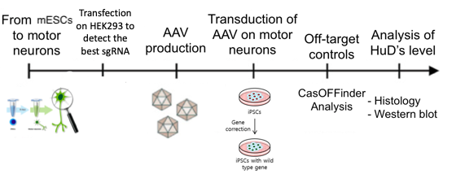
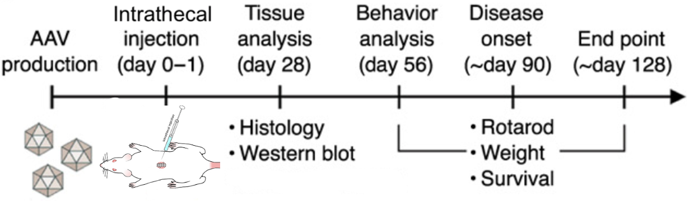
Experimental plan:
IN VITRO
Transfection on mESCs to detect the best sgRNA
AAV production in HEK293
Bacteria transformation with plasmids
Recovery of the amplified plasmids
Transfection in HEK293 cells
Recovery of the viral particles
Transduction of target cells or in vivo injection in mice
mESC
mESC with wt gene
AAV production in HEK293
IN VIVO
Notes:
Our project is led following 3 main steps:
Production of the viral vector
In vitro experiment
In vivo experiment
We chose to use Adeno-associated viral vector (specifically serotype 9 that was shown to be very effective in motoneuronal targeting) because they were proved to be safer and non pathogenic when injected in humans and animal cells.
Once we have produced our viral vector, which we are going to use both for the in vitro and the in vivo experiment, we can start.
In the in vitro experiment we develop motor neurons starting from MESCs collected from our murine model knock-out for FUS gene, we test different sgRNAs and we detect the one which is more suitable for our model. Once we obtained our motor neurons and our vector we transduct the AVV vector in the plate with the cells.
To prove that our experiment worked out properly we undergo two different kind of analysis:
Off-target controls (with the CasOFFinder program)
Analysis of the level of expression of the protein HuD (with Western Blot and histological test using FISH)
If the in vitro part gives us promising results, we can move forward to the in vivo experiment.
We use the same AVV vector that we used for the in vitro experiment and we execute an intrathecal injection on a new born murine model FUS∆14 and we lead different analysis to prove that our experiment worked.
Tissue analysis (histology tests and Western Blot) 28 days after the injection;
Physical tests (rotarod, weight and survival) repeated every 35 days after the injection;
Off-target controls (with the CasOFFinder program);
Deep sequencing analysis of the FUS locus after CRISPR/Cas technology usage.

Slide 5
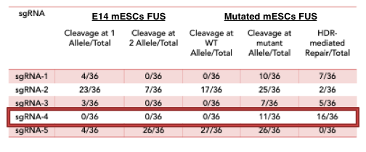
In vitro analysis with expected results:
2. sgRNA detection
Transfection on mESCs to detect the best sgRNA
AAV production in HEK293
mESC
mESC with wt gene
3a Co-transfection to obtain rAAV CRISPR/cas9 system
3b Co-transfection to obtain rAAV donor sequence
Notes:
ADENO-ASSOCIATED VIRAL VECTOR:
Why do we use AAV vector?
The advantage to using adeno-associated virus vector over other vectors is its ability to infect both dividing and quiescent cells, allowing genetic material to be delivered to a highly diverse range of cell types.
Also AAVs lack of pathogenicity.
Wild Type AAV can integrate into host cells site specifically, which makes it highly predictable as they feature a reliable insertion pattern.
Although modern day recombinant AAV has been modified to not insert into the host genome, it can persist in cells in an extra-chromosomal form for a long period of time.
AAV brings long term expression in non-dividing cells, causes almost negligible pathogenicity and exerts a very mild immune response, all of which are favorable for use in gene therapy.
We found in literature some experiments in which AAV vetors serotype 6/9 were proven efficient when working with motor neurons (our target cells).
Benefits:
High selectivity and capacity for the purification of viral vectors and mRNA
An efficient and robust purification process, from crude material in one step, offering scalability and process consistency
Significant improvement to the downstream process of viral vectors, by reducing the purification steps and maximizing productivity
An efficient and scalable solution for the purification of in vitro transcribed mRNA
Integration can be important for certain applications, but can also have unwanted consequences. Recent human clinical trials using AAV for gene therapy in the retina have shown promise.
Disadvantages:
The cloning capacity of the vector is relatively limited and most therapeutic genes require the complete replacement of the virus's 4.8kb genome.
We want to induce a replacement of the exon 14 of FUS-1 gene, to recover the normal transcription of the protein, without having the accumulation of the FUS mutated protein into cytoplasm of cell causing ALS.
To recover gene’s function we designed this triple transfection method to have an HR for the sequence inside exon 14 and avoid the deletion that cause the disease for FUS gene. The mutation is on the splice sites on the precedent intron, which is between exon 13 and 14.
Co-Transfection of the Crispr/Cas9 system:
1st Plasmid:
We designed several sgRNAs that do not overlap with the mutation, and we chose the best with a minor off target value. We have found the guides thanks to zhang lab program.
Then we have done preliminary experiments, we investigated the specificity of sgRNAs by separately transfecting plasmids expressing both the Cas9 and each of the five sgRNAs into WT mESCs;
For each sgRNA, PCR products corresponding to the putative target region were amplified from the resulting mESCs clones. The results showed that sgRNA-2 and sgRNA-5 efficiently targeted the WT alleles and led to nonhomologous end joining (NHEJ)-mediated mutations of the FUS gene, while sgRNA-1 and sgRNA-3 did so much less frequently. By contrast, no mutation was detected in mESCs clones transfected with sgRNA-4.
We performed similar experiments in heterozygous mutant mESCs (termed mFUS-1 mESCs) and found that all of the sgRNAs could induce cleavage at the mutant FUS-1 allele. Consistent with the results from the mESCs, we found that sgRNA-2 and sgRNA-5 targeted both the WT and mutant alleles in mFUS-1 mESCs, while the other three sgRNAs only targeted the mutant allele.
Importantly, while all of the sgRNAs could induce NHEJ-based deletions and insertions as expected, sgRNA-4 could also efficiently promote HDR-based precise gene editing (16 of 36 mESCs clones sequenced), indicating that Cas9-induced DNA breaks in the mutant FUS-1 allele could be repaired through HDR using the normal allele on the homologous chromosome as a template. Taken together, these data suggest that sgRNA-4 specifically targets the mutant allele; this effect is likely due to the neo-PAM contained in the mutant allele. We thus selected sgRNA-4 (CCTAAGCCAGATGGCCCAGG) for our subsequent targeting experiments. (Adapted from: “ Wu Y, Liang D, Wang Y, Bai M, Tang W, Bao S, Yan Z, Li D, Li J. Correction of a genetic disease in mouse via use of CRISPR-Cas9. Cell Stem Cell. 2013 Dec 5;13(6):659-62. doi: 10.1016/j.stem.2013.10.016. PMID: 24315440.”)
We put the sgRNA sequence under the promoter U6 because we saw that is the suitable one used in other experiments found in literature.
ITR sequences are needed to induce the correct transcription of the genes, and we use the one for the serotype 9, because it has shown the best for motoneuron cells.
CAS9 is the nuclease that will generate a cleavage in a specific DNA site to undergo the substitution of the sequence with the mutation, this protein is guided thanks to our sgRNA.
We will use in particular SaCas9 from staphylococcus aureus because is often used thanks to its smaller size, scientists showed that it performs better than SpCas9, this gene will act under the CMV promoter because it’s the better for the ITR serotype that we have.
A selective element (PROMO) is added in the first plasmid to select only the vector who have inserted correctly.
HA encode for a short peptide, this element will have an important function to check in vivo if the rAAV has been incorporated.
2nd Plasmid:
An helper plasmid is needed because we need genes from the adenovirus, such as E4 and E2a and VA that mediate AAV replication, we use this helper because it has no viral component such as a normal adenovirus.
3rd Plasmid:
We also put another plasmid with the REP and CAP sequences encoding for important protein involved in the formation of the particle capsules, under the respectively promoters.
We will co-transfect all these plasmids inside a HEK293, to generate this quantity of rAAV by transfection, more than 10^11 cells may be needed. At the and we will harvest the rAAV thanks to the antibiotic resistance which has given selectivity to the vectors and then a purification is needed to get the encapsidated rAAV.
Co-Transfection of the DONOR seq:
We will have basically the same 2nd and 3rd plasmids, while we will use instead of the first one, another one:
It will contain the donor sequence of the exon 14 (200nt), which will be used by the Crispr/Cas9 system to get an Homologous Recombination, and also a selective element, in this case the Blasticidin.The same process will follow also for this co-transfection.

Slide 6
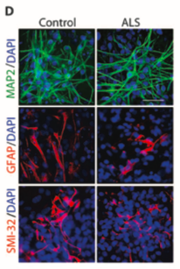
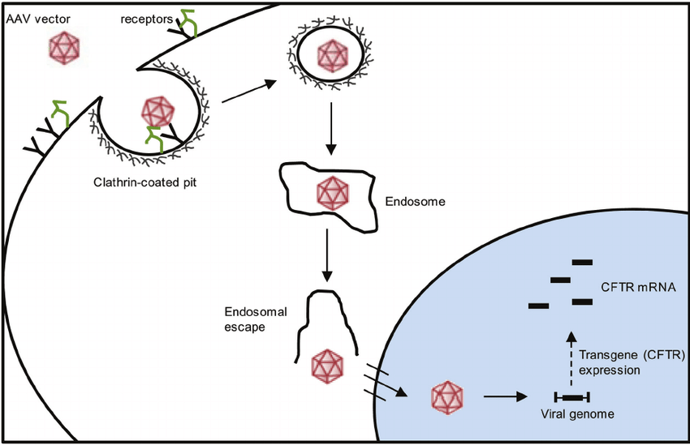
In vitro analysis with expected results:
Transfection on mESCs to detect the best sgRNA
AAV production in HEK293
mESC
mESC with wt gene
1. Motor neuron differentiation from ALS and control mESCs
4. Molecular mechanism of AVV transduction
.
mESCs-MNs
ALS
rAAV binds to cell surface
Cellular internalization
Endosome escape
Nucleus entrance
Uncoating
Deliver of genetic cargo
Replication
Adapted from “Drug Screening for ALS Using Patient-Specific Induced Pluripotent Stem Cells” Naohiro Egawa et al.
Notes:
Mouse embryonic stem cells (mESCs) could help to define disease mechanisms and therapeutic strategies for ALS as they could be differentiated into MNs, otherwise inaccessible from living beings. Hence we produce motor neurons from a blood sample of our murine model knock-out for FUS∆14, which presents the predisposition to develop the disease. We induce differentiation of mESCs lines, we can observe that the ALS motor neurons in culture recapitulated cellular and molecular abnormalities associated with ALS. To prove that we did immunocytochemical analysis with MAP2 (neuronal marker), SMI-32 (motor neuron-specific marker), and GFAP (for astrocytes) that did not reveal any differences in differentiation between ALS and mESCs derived motor neurons.
After the detection of our sgRNA, which we explained earlier, we can transduct our viral vector in the plate with the motor neurons so that we can prove the efficiency of our treatment.
Genetic transduction is the transfer of DNA from a virus to its bacterial or eukaryotic host cell. Transduction with viral vectors is a common method for gene delivery, and it takes place through the following workflow:
Binding to cell surface glycan receptors, triggering cellular internalization and trafficking leading to transduction. Internalization of rAAV in mammalian cells occur via clathrin-mediated endocytosis.
After its entrance in the cell, rAAV has to move towards the nucleus in order to deliver its genetic cargo.
rAAV has to be transported into the cytosol: it escapes the endosome thanks to phospholipase enzymes.
The viral vector has to enter the nucleus, where it will
Uncoating (unclear mechanism, but is known that genome composition may play an important role in this step);
Deliver of its genetic cargo
Once the transduction occurred we wait until the viral particles replicates and then we undergo different controls to check if our therapy worked.

Slide 7
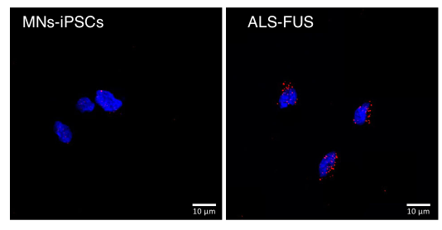
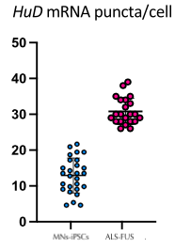
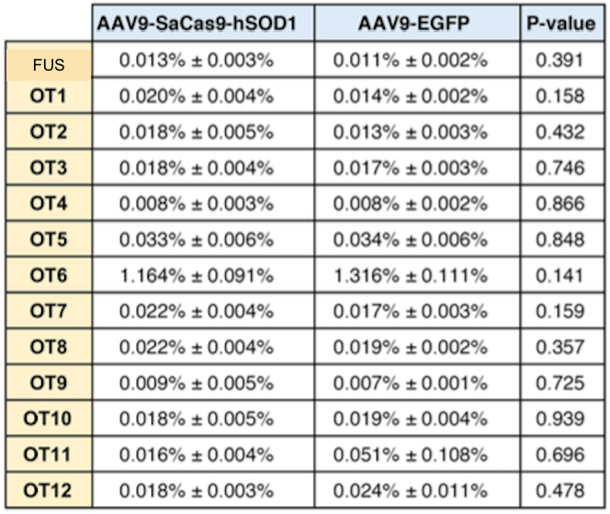
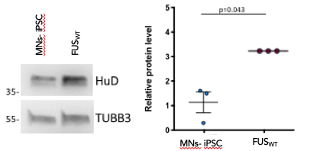
In vitro analysis with expected results:
7. Detection by FISH of protein HuD’s expression
mESCs-MNs
Transfection on mESCs to detect the best sgRNA
AAV production in HEK293
mESC
mESC with wt gene
5. Off-target modification analysis usisng Cas-OFFinder
6. HuD protein levels analysis by Western blot in FUS_{WT} and mESCs derived MNs trated with AAV vector
AAV9-SaCas9-FUS
mESCs-MNs
.........................
mESCs-MNs
ALS-FUS
mESCs-MNs
ALS-FUS
Adapted from “ALS-related FUS mutations alter axon growth in motoneurons and affect HuD/ELAVL4 and FMRP activity” A.Rosa et al.
Notes:
We performed two different kind of controls to prove that our treatment worked:
Off-target controls: we checked if SaCas9 induced off-target modifications in vitro. Thanks to the CasOFFinder analysis we were able to detect 12 possible off-target sites which presented differences in the on-target SaCas9 cleavage site by up to four mismatches.
We also checked the protein HuD’s level after the transduction of our AAV vector through two different analysis:
Histological analysis using FISH to detect HuD mRNA in MNs-FUS and ALS-FUS. The graph shows the average count of HuD mRNA puncta per cell from three independent differentiation experiments, error bars indicate the standard error of the mean (Student’s t-test; paired; two tails).
Western Blot analysis showed lower levels of the HuD protein in the motor neuron transducted with our AAV modified vector in comparison with the controls in ALS-FUS. The graph shows the average from three independent biological replicates, error bars indicate the standard deviation.

Slide 8
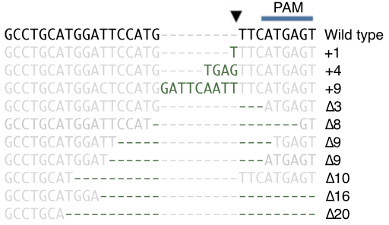
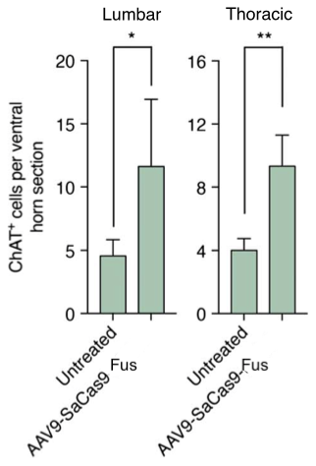
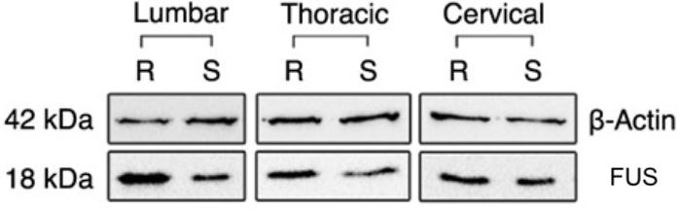
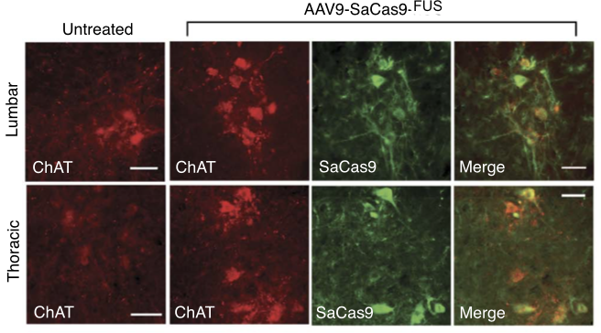
In vivo analysis with expected results:
5. Sequencing analysis of indels from whole spinal cord tissue
AAV production in HEK293
4. Number of ChAT+ neurons from spinal cord hemisection
3. Western blot of lumbar, thoracic, and cervical spinal cord lysate
2. Immunofluorescent staining of lumbar and thoracic spinal cord sections
1. Intrathecal injection in mice FUSΔ14
AAV injection (R group)
control mice (S group)
-Fus
-Fus
Adapted from "In vivo genome editing improves motor function and extends survival in a mouse model of ALS" Thomas Gaj et al.
Notes:
For the in vivo analysis we started by directly injecting the AAVs with an intrathecal injection in the first group of mice, while for a second group we injected as control AAV-EGFP and for the third group we injected as control AAV9-saCas9-mRosa26, which target the mouse Rosa26 locus which is a genomic “safe harbor site” often used for mouse transgenesis.
4 weeks after injection we did specific molecular analysis. In particular we conducted both histological and western blot analysis.
We started with Immunofluorescent staining of lumbar and thoracic spinal cord sections and we analysed sections obtained both from untreated mice and treated mice with AAV9-SaCas9-FUS. In this experiment we wanted to check the efficiency of the transduction in motoneurons. Spinal cord sections were analyzed by immunohistochemistry for expression of the motor neuron marker choline acetyltransferase (ChAT) and SaCas9 via a genetically fused HA epitope. From the graph we can state that we obtained a broad motor neuron transduction.
Later we did western blot analysis of lumbar, thoracic, and cervical spinal cord lysate and as we can see we obtained an higher expression of the FUS protein in treated mice respect to control mice. Actin has been used as an internal control.
At the end we checked the number of ChAT+ neurons from spinal cord hemisections both in treated and untreated mice, as shown in the histogram we obtained a significant higher number of neurons in treated mice.
We also performed sequencing analysis of indels from whole spinal cord tissue to be aware of the changes that our CRISPR/cas9 system had induced.

Slide 9
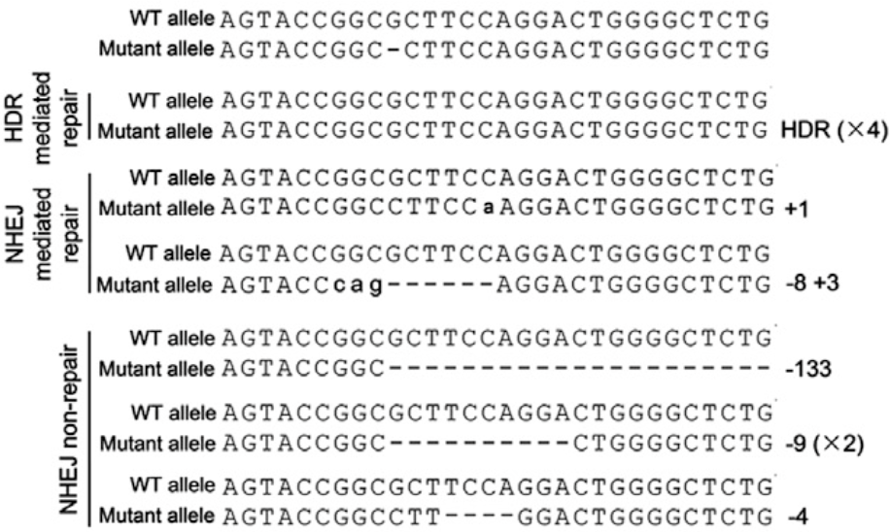
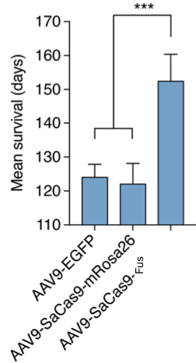
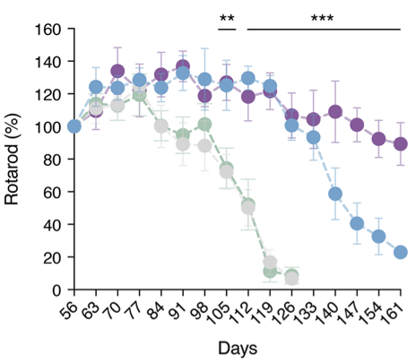
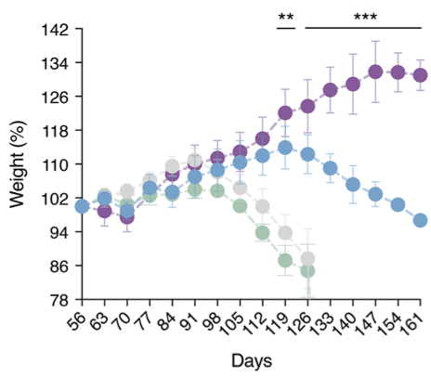
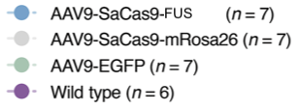
In vivo analysis with expected results:
8. Off-target modification analysis usisng Cas-OFFinder
AAV production in HEK293
9. Identification of 10 mice carrying genetic modifications of the mutant allele
5. Survival rate
6. Rotarod performance
7. Weight analysis
-Fus
Adapted from «In vivo genome editing improves motor function and extends survival in a mouse model of ALS» Thomas Gaj et al.
Notes:
We also performed specific behaviour analysis on the mice. We did:
Survival rate analysis on the treated mice and both the controls. In particular we can see that the survival rate in AAV9-Cas9-FUS treated mice significally increased respect to the two controls.
Rotarod analysis on AAV9-Cas9-FUS treated mice, on the two controls and on wild-type mice. From the graph we easely deduce that WT and AAV9-Cas9-FUS treated mice have much better performances respect to the two types of control mice.
Weight analysis on AAV9-Cas9-FUS treated mice, on the two controls and on wild-type mice. We obtain a similar graph respect to the previous one. Treated mice also exhibited reduced muscular atrophy, as evidenced by a slower rate of weight loss after disease onset.
We also investigated whether SaCas9 induced OT modifications in vivo. Using Cas-OFFinder, we identified 12 potential OT sites in the mouse genome that differed from the on-target SaCas9 cleavage site by up to four mismatches. Deep sequencing revealed no significant increase in indel formation at each candidate OT site in CRISPR-treated mice compared to control animals.
We also analysed the sequences of the Fus gene in mice carrying CRISPR-Cas9-induced gene modifications. Insertions are indicated with (+), deletions are indicated with (-). Small letters represent the inserted nucleotides.
Thanks to DNA sequencing analysis, we identified 10 mice carrying genetic modifications of the mutant allele and also, we weren’t able to detect any gene editing events in the WT allele of these gene-modified mice, confirming the specificity of sgRNA in targeting the mutant allele.
We found that gene-editing events induced by the CRISPR-Cas9 system included both NHEJ-mediated insertions and deletions and HDR-mediated repair.
After all these analysis we can state that CRISPR-Cas9–mediated reconstitution of FUS expression in FUSΔ14 mice enhances the survival of spinal cord motor neurons and improves motor function and life span.

Slide 10
Pitfalls & Solutions:
1. CRISPR off-target mutations
Second guide RNA
The cell’s natural repair process could create unwanted off-target mutations where the modified DNA is inserted at the cut site.
To prevent off-target binding, an additional second guide RNA can be implied that has a blocking guide sequence that is complementary to an off-target nucleic acid sequence.
2. Limits of AAV delivery via lumbar puncture
Delivery into the cisterna magna
Intrathecal lumbar puncture shows a limited distribution and low transduction in the spinal cord
Vector administered into the cisterna magna distributed reproducibly throughout the spinal cord and has a high transduction rate
3. Immune response
Plasmapheresis
The capsid protein of AAV can produce an immune response that could reduce the effectiveness of the therapy due to prior exposure to AAV by natural infection. (45% human sera contain antibodies against rAAV9)
Transiently remove all antibodies or capsid-specific IgG in subjects prior to vector administration
Developing a stealth vector
Development of stealth vectors with surface viral epitopes masked by non-antigenic features that do not interfere with target cell transduction
Notes:
During a CRISPR based edit, a strand of molecules called a guide RNA leads the DNA-slicing protein Cas9 to the section of DNA targeted for editing. Once the guide RNA binds to the DNA, Cas9 makes the cut so that new DNA can be inserted or deleted. But there can be problems because the cell’s natural repair process could create unwanted off-target mutations where the modified DNA is inserted at the cut site. To prevent off-target binding, an additional second guide RNA can be implied that has a blocking guide sequence that is complementary to an off-target nucleic acid sequence.
Preclinical studies have demonstrated that a single injection of an adeno-associated virus (AAV) vector into the cerebrospinal fluid (CSF) can achieve widespread gene transfer throughout the central nervous system.But by conducting studies in nonhuman primates to evaluate the impact of injection volume on spinal cord transduction after AAV delivery via lumbar puncture, we found that lumbar puncture failed to achieve widespread distribution and significant transduction of the spinal cord. In contrast, vector administered into the cisterna magna distributed reproducibly throughout the spinal cord.
Prior exposure to wild-type AAV by natural infection results in neutralizing antibodies in serum that efficiently block target cell transduction and thereby therapeutic efficacy of systemically administered rAAV. Natural infections are common, and 45% of human sera contain antibodies against rAAV9. To facilitate rAAV-mediated gene therapy in a broader patient population, several strategies are being developed to circumvent the barrier posed by capsid antibodies. An important strategy is the development of stealth vectors with surface viral epitopes masked by non-antigenic features that do not interfere with target cell transduction. Alternative approaches to transiently remove antibodies in subjects prior to vector administration include plasmapheresis to remove total or capsid-specific IgG. Manoeuvres to deplete antibodies present risks that need to be balanced with the potential benefits of gene transfer.

Slide 11
Budget & Materials:
B6 FUS-Δ14 + wild type murine model
About 10,000 € excluding maintenance
Cas9 protein (100 µg)
About 200 €
AAV9 vector
About 2,200 €
Immunofluorescence staining protocol
About 250 €
Western Blot analysis
About 2,000 €
Cell line HEK293 (10⁴)
About 3,500€
Microfluidic device and mESCs equipment
About 5,000 €
Researchers salary
About 60,000 € per year x 2 PhD students
and 1 Post-doc
FISH analysis
About 3,000 €
Average cost/year: 110,000 €
For a total of 2 years
Notes:
FUS Delta14 knock-in mice have a frameshift mutation introduced into exon 14 of the Fus gene, and replacement of exon 15 with the human homologue, resulting in expression of physiological levels of "humanized" mutant protein from the endogenous locus. Heterozygous FUS Delta14 mice exhibit progressive, adult-onset motor neuron degeneration and denervation of neuromuscular junctions.
Adeno-Associated Virus Large scale prep (1000 ul of ~1×1013 vg/ml virus), the preparation will take about 2 weeks. we chose serotype 9 because serotype 9 that was shown to be very effective in motoneuronal targeting.
Western Blot analysis kit: contains optimized reagents that shorten the time required to perform a typical chemiluminescent Western blot from 4 hours down to approximately 55 minutes. The kit provides all the reagents necessary to complete a Western blot being probed with a mouse or rabbit primary antibody. The included Pierce ECL Substrate produces a chemiluminescent signal, which is detected using photographic or other imaging methods. Blots can be repeatedly exposed to film to obtain optimal results or stripped of the primary antibody and immunodetection reagents and reprobed.
Microfluidic device and iPSCs equipment
FISH analysis: is a technique that uses fluorescent probes which bind to special sites of the chromosome with a high degree of sequence complementarity to the probes. The fluorescent probes are nucleic acid labeled with fluorescent groups and can bind to specific DNA/RNA sequences. We use FISH to detect HuD mRNA in MNs-FUS and ALS-FUS and prove the functionality of our gene therapy.
Cas9 protein: is a dual RNA-guided DNA endonuclease enzyme which plays a vital role in the immunological defence of certain bacteria against DNA viruses and plasmids. Its main function is to cut DNA and thereby alter a cell's genome.
Immunofluorescence staining protocol: is a technique that permits visualization of virtually many components in any given tissue or cell type that can be performed on cultured cells or cell suspensions, as well as on specific targets in tissues samples or entire organisms. We used immunostaining to check the efficiency of the transduction of our vector in motoneurons.
Cell line HEK293: we chose this cell line because they appeared to be the best to use for the production of AAV vectors based on literature.

Slide 12
Thanks for your attention!
Castrucci C.
Nutarelli S.
Piscopo F.
Romano V.
Rubiu R.R.

Slide 13
References:
Background:
https://www.frontiersin.org/articles/10.3389/fnins.2019.01310/full
https://www.ncbi.nlm.nih.gov/pmc/articles/PMC7540334/
https://actaneurocomms.biomedcentral.com/articles/10.1186/s40478-019-0658-x
https://jnnp.bmj.com/content/81/6/639
https://www.ncbi.nlm.nih.gov/pmc/articles/PMC2764725/
https://www.nature.com/articles/s42003-021-02538-8
https://www.ncbi.nlm.nih.gov/pmc/articles/PMC2922682/
In vitro experiments:
Grieger JC, Choi VW, Samulski RJ. Production and characterization of adeno-associated viral vectors. Nat Protoc. 2006;1(3):1412-28. doi: 10.1038/nprot.2006.207. PMID: 17406430.
Urabe M, Ding C, Kotin RM. Insect cells as a factory to produce adeno-associated virus type 2 vectors. Hum Gene Ther. 2002 Nov 1;13(16):1935-43. doi: 10.1089/10430340260355347. PMID: 12427305
Yun Y, Ha Y. CRISPR/Cas9-Mediated Gene Correction to Understand ALS. Int J Mol Sci. 2020 May 27;21(11):3801. doi: 10.3390/ijms21113801. PMID: 32471232; PMCID: PMC7312396
Snyder BR, Gray SJ, Quach ET, Huang JW, Leung CH, Samulski RJ, Boulis NM, Federici T. Comparison of adeno-associated viral vector serotypes for spinal cord and motor neuron gene delivery. Hum Gene Ther. 2011 Sep;22(9):1129-35. doi: 10.1089/hum.2011.008. Epub 2011 Jul 25. PMID: 21443428
Wu Y, Liang D, Wang Y, Bai M, Tang W, Bao S, Yan Z, Li D, Li J. Correction of a genetic disease in mouse via use of CRISPR-Cas9. Cell Stem Cell. 2013 Dec 5;13(6):659-62. doi: 10.1016/j.stem.2013.10.016. PMID: 24315440.
Garone MG, Birsa N, Rosito M, Salaris F, Mochi M, de Turris V, Nair RR, Cunningham TJ, Fisher EMC, Morlando M, Fratta P, Rosa A. ALS-related FUS mutations alter axon growth in motoneurons and affect HuD/ELAVL4 and FMRP activity. Commun Biol. 2021 Sep 1;4(1):1025. doi: 10.1038/s42003-021-02538-8. PMID: 34471224; PMCID: PMC8410767
Egawa N, Kitaoka S, Tsukita K, Naitoh M, Takahashi K, Yamamoto T, Adachi F, Kondo T, Okita K, Asaka I, Aoi T, Watanabe A, Yamada Y, Morizane A, Takahashi J, Ayaki T, Ito H, Yoshikawa K, Yamawaki S, Suzuki S, Watanabe D, Hioki H, Kaneko T, Makioka K, Okamoto K, Takuma H, Tamaoka A, Hasegawa K, Nonaka T, Hasegawa M, Kawata A, Yoshida M, Nakahata T, Takahashi R, Marchetto MC, Gage FH, Yamanaka S, Inoue H. Drug screening for ALS using patient-specific induced pluripotent stem cells. Sci Transl Med. 2012 Aug 1;4(145):145ra104. doi: 10.1126/scitranslmed.3004052. PMID: 22855461.
In vivo experiments:
Gaj T, Ojala DS, Ekman FK, Byrne LC, Limsirichai P, Schaffer DV. In vivo genome editing improves motor function and extends survival in a mouse model of ALS. Sci Adv. 2017 Dec 20;3(12):eaar3952. doi: 10.1126/sciadv.aar3952. PMID: 29279867; PMCID: PMC5738228
Wu Y, Liang D, Wang Y, Bai M, Tang W, Bao S, Yan Z, Li D, Li J. Correction of a genetic disease in mouse via use of CRISPR-Cas9. Cell Stem Cell. 2013 Dec 5;13(6):659-62. doi: 10.1016/j.stem.2013.10.016. PMID: 24315440
Pitfalls and solutions:
https://www.frontiersin.org/articles/10.3389/fimmu.2021.675897/full
https://www.sciencedirect.com/science/article/pii/S2329050120300723
https://www.greyb.com/problems-with-crispr/

